Slide 2
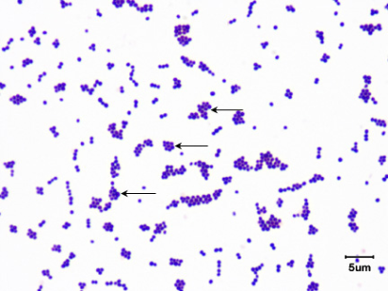
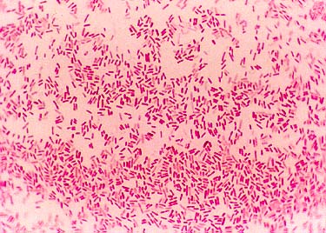
2. Gram-positive bacteria are coloured
purple because they take up the staincrystal violet
a. Their cell walls are made of: one
thick layer of carbohydrate and protein molecules
3. Gram-negative bacteria are coloured red because they take up the stain safranine
a. Their cell walls are made of: a second, outer layer of lipid and carbohydrate molecules

Slide 3
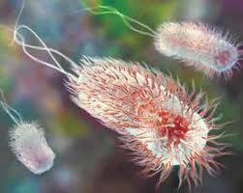
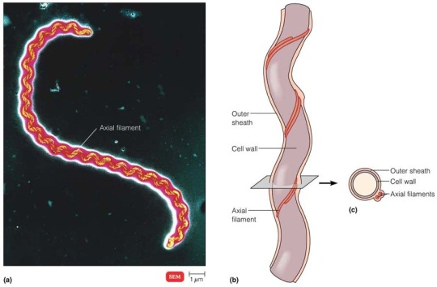
D. Types of bacterial movement:
propelled by one or more flagella
helical bacteria which have a specialized internal structure known as the axial filament
3. glide slowly along a layer of slime like
material that they secrete themselves
4. do not move
http://www.microbiologybytes.com/video/motility.html

Slide 4
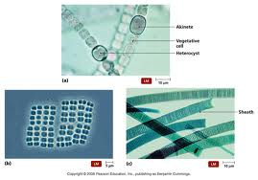
IV. How Monerans Obtain Energy
A. Autotrophs
1. Phototropic autotrophs: organisms that trap the energy of sunlight and convert it to organic nutrients
a. Example: cyanobacteria, eubacteria

Slide 5
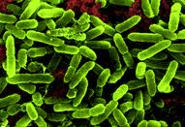
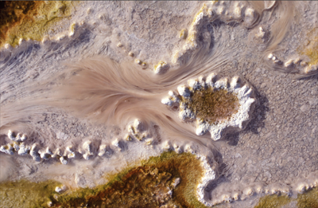
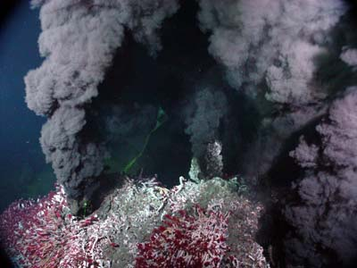
2. Chemotrophic autotrophs: organisms
that can obtain energy from inorganic molecules
a. Example inorganic molecules used:
hydrogen sulfide, nitrites, sulfur, and iron
Example: Nitrosomonas
(uses ammonia and oxygen)
The thin pink strands are bacteria
That use sulfides in hotsprings
Sulphur bacteria live in the hydrothermal vents off of H₂S

Slide 6
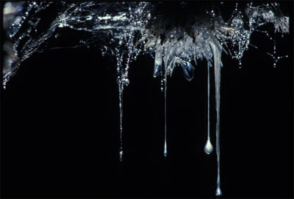
Snottites:
These colonies of single-celled bacteria hang from the walls and ceilings of caves. They are similar to small stalactites, but have the consistency of "snot," or mucous. They feed on the sulfur-rich water that seeps into caves, and they live ensconced in a biofilm that protects them from the sulfuric acid in their environment. This acid is as strong as the acid found in car batteries

Slide 7
B. Heterotrophs
1. Chemotrophic heterotrophs: organisms that can obtain energy from inorganic molecules
Example: bacteria
2. Humans are also chemotrophic heterotrophs
a. Many bacteria compete with us for:
food sources
b. Example: Salmonella grows in raw meat, poultry, & eggs
c. If not properly cooked (to kill the
bacteria) they will “eat” this food and release poisons into it
d. This causes the illness we call food poisoning

Slide 8
V. Bacterial Respiration
A. Aerobic Respiration: process that involves oxygen and breaks down food molecules to release energy
B. Fermentation: process that enables cells
to carry out energy production in the
absence of oxygen (Anaerobic respiration)

Slide 9
Bacteria can be classes as:
C. Obligate aerobes: organisms that require
a constant supply of oxygen in order to live.
eg: Bacillus subtilis
D. Obligate anaerobes: organism that lives only in the absence of oxygen
Eg: Clostridium botulinum
E. Facultative anaerobes: organisms that
can survive with or without oxygen
eg: Staphlococcus, E. coli, Listeria

Slide 10
The Case of Clostridium botulinum (An obligate anaerobe)
1. Example organism: Clostridium
Botulinum
Often found in: soil
3. Causes no problems because it is
unable to grow in the presence of
oxygen, it normally causes very few problems
4. If it finds its way into a place free of air and filled with food material, they grow very quickly
A perfect place for them: canned food
6. They produce toxins that cause
“botulism”
7. These are deadly; they interfere with nerve activity, causing paralysis andsometimes death
8. Commercially canned goods are safe because: the bacteria and their toxins have been destroyed by heating the foods for a long time before the cans are sealed

Slide 11
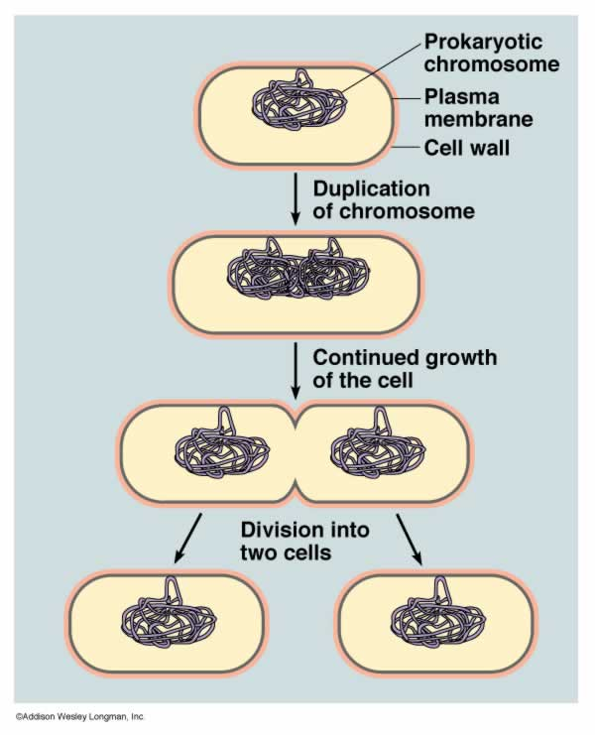
VI. Bacterial Growth and Reproduction
A. Bacterial growth is limited by:
1. space
2. food
B. Binary fission: type of asexual reproduction in which an organism
divides to produce two identical daughter cells

Slide 12
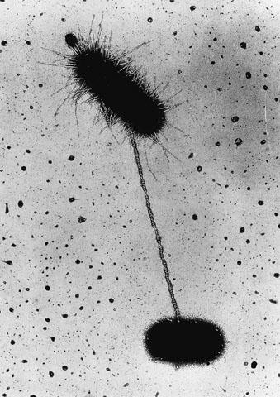
C. Conjugation
C. Conjugation: process in bacteria and
protists that involves an exchange of
genetic information
1. List the steps:
A long bridge of protein forms between and connects two bacteria
b. The genetic information from one cell (donor), is transferred to the other cell (recipient), through
this bridge
c. The recipient cell has a different set of genes
d. New combinations of genes
increase the genetic diversity in that
population of bacteria
2. Genetic diversity helps to ensure that even if the environment changes, a few bacteria may have the right
combinations of genes to survive

Slide 13
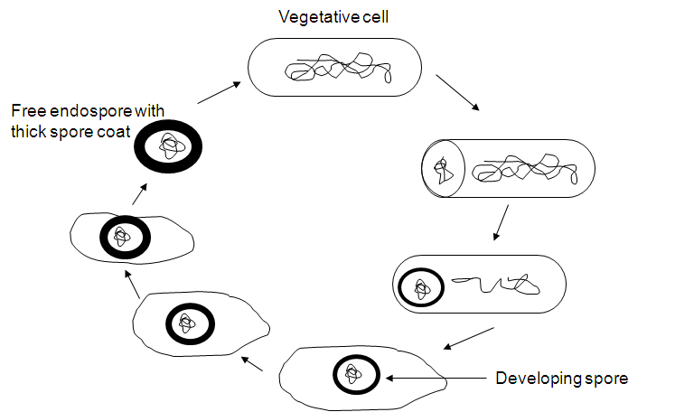
D. Spore formation:
1. An endospore is formed when conditions become unfavorable
2. Can remain dormant for months or even years
3. When conditions improve the endospore will open and the bacterium will begin to grow again

Slide 14
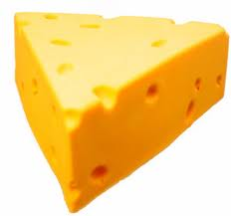
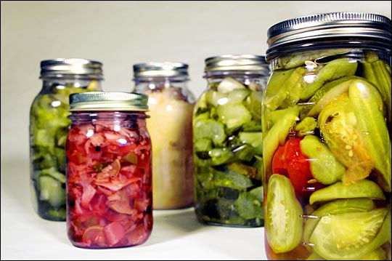
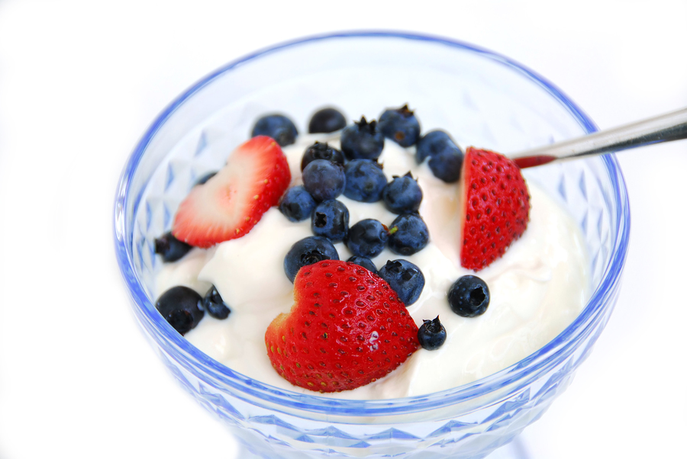
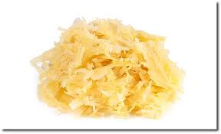
VI.Importance of Monerans
A. Bacteria are used to produce:
1. Cheese
2. Yogurt
3. Buttermilk
4. Sour cream
5. Pickles
Sauerkraut
Wine

Slide 15
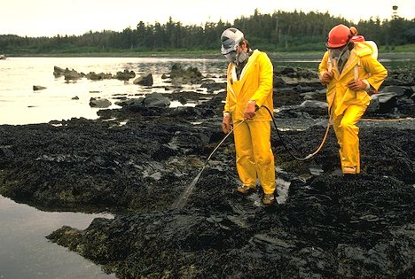
B. Industrial uses of bacteria:
1. Cleaning up oil spills
2. Remove waste products and poisons
from water
3. Mine minerals from the ground
4. Synthesize drugs and chemicals

Slide 16
C. Symbiosis: close relationship between two species in which at least one species benefits from the other
1. Example: humans and E. coli:
a. Bacteria benefit by being provided with:
i. Warm safe home
ii. Plenty of food
iii. Free transportation
b. Humans benefit by getting:
i. Help in digesting our food
ii. Vitamins that we cannot produce
c. Cattle benefit by: having the bacteria in their intestines to produce enzymes necessary to break down cellulose, the principal carbohydrate in grass and hay

Slide 17
VII.Bacteria in the Environment
A. Nutrient flow: Bacteria recycle and
decompose, or break down, dead material
1. Saprophytes: organism that uses the complex molecules of a once-living organism as its source of energy and nutrition
2. Other non-monerans that also help
the process: insects and fungi

Slide 18
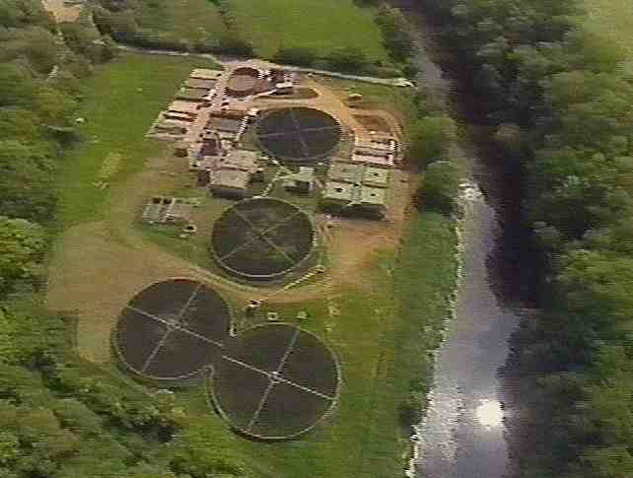
B. Sewage decomposition:
1. Waste water contains: human waste, discarded food, organic garbage, and even chemical waste
2. Bacteria grow rapidly here and as they grow, they break down the complex compounds in the sewage into simpler compounds
3. This process produces: purified water, nitrogen gas and carbon dioxide gas, and leftover products that can be used as crop fertilizers

Slide 19
C. Nitrogen fixation:
1. All organisms on Earth are totally dependent on monerans for nitrogen
a. Green plants use it to make amino acids (building blocks for proteins)
b. Since animals eat plants, plant proteins is, ultimately, the ONLY source
2. Our atmosphere is 80 % N₂ gas – but living things need it in ammonia form
3. Cyanobacteria are the only organisms
capable of performing nitrogen fixation

Slide 20
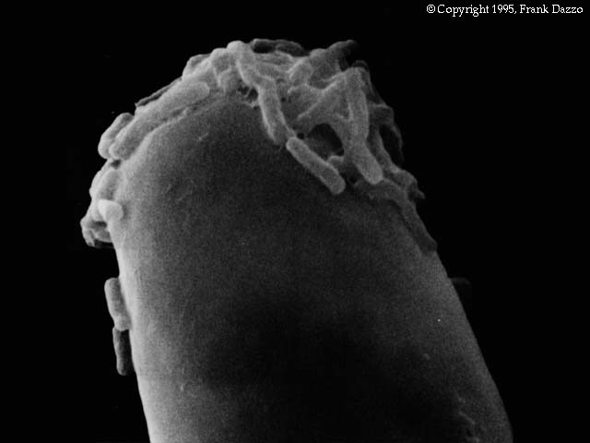
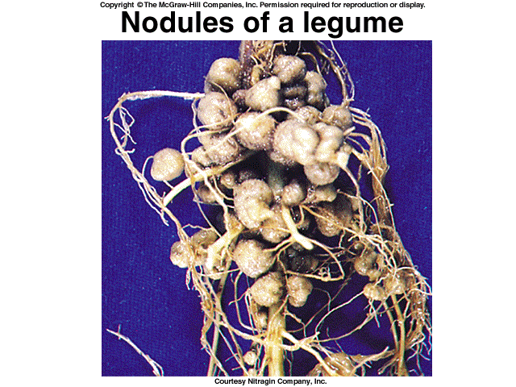
4. Many plants have symbiotic relationships with nitrogen-fixing bacteria:
a. Example: soybean and Rhizobium, which invades and grows in root nodules
i. Bacteria get: home and a source of nutrients
ii. Plant gets: ammonia
iii. Nodules are built-in fertilizer factories
5. More than 170 million tons of nitrogen fixed every year

Slide 21
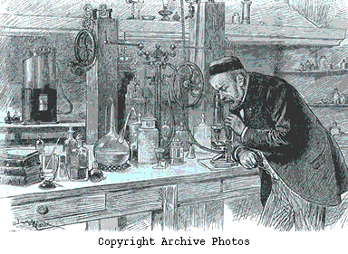
17-3: Diseases Caused by Monerans
II. Bacteria and Disease
A. Only a few types cause disease
B. Louis Pasteur was the 1st person to show
that bacteria cause disease

Slide 22
C. Some diseases caused by pathogenic
bacteria:
1. Diphtheria
2. Tuberculosis
3. Typhoid fever
4. Tetanus
5. Hansen disease
6. Syphilis
7. Cholera
8. Bubonic plague

Slide 23
D. Two ways in which bacteria cause
disease:
1. Damage cells/tissues of infected
organism by breaking down living cells for food
2. Release toxins that travel through body
& interfere with normal activity of host

Slide 24
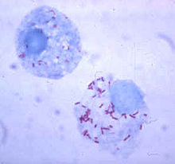
E. Class rickettsias
Can only grow inside a living cell
Cause disease by method #1
3. Some diseases they cause:
a. Rocky Mountain spotted fever
b. Typhus
c. Q fever

Slide 25
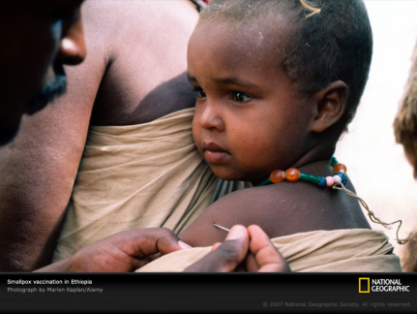
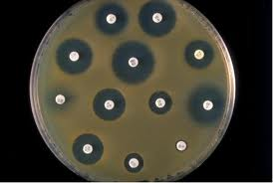
F. Methods for fighting bacterial disease
1. Stimulating immune system through
vaccines
2. Antibiotics (def’n): a natural
compound that can destroy bacteria

Slide 26
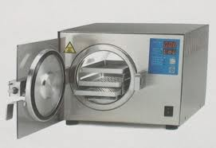
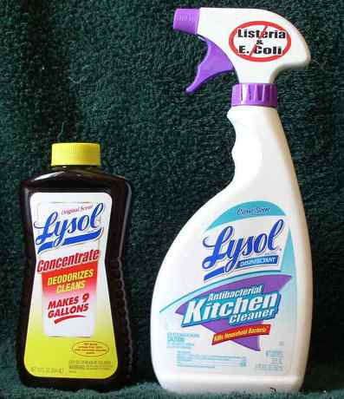
III.Controlling Bacteria
A. Sterilization: Destruction of living bacteria by exposure to great heat or chemical action
1. Heat: most can be killed in boiling water
Autoclaves are used to sterilize medical and laboratory equipment
2. Disinfectant (def’n): a chemical solution that kills bacteria

Slide 27
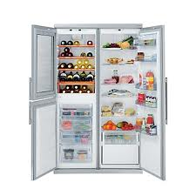
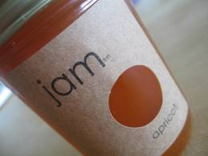
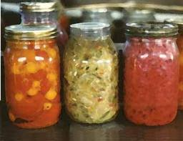
B. Food Processing
1. When bacteria “eat” our food, they cause it to spoil
2. Preventing spoilage:
a. Refrigeration: slows the growth of bacteria
b. Sterilization by cooking (e.g. boiling, frying, steaming)
c. Canning: sterilized food is sealed into glass or metal containers
d.Chemical treatments that inhibit bacterial growth in food:
i. salt (e.g. salted meat)
ii vinegar (e.g. pickled vegetables)
iii sugar (e.g. jam)

