Slide 2
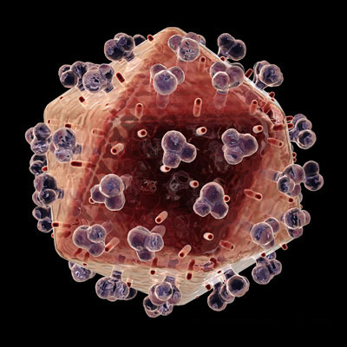
Ch. 17.1 Viruses
The name “virus” means poison in the Latin language

Slide 3
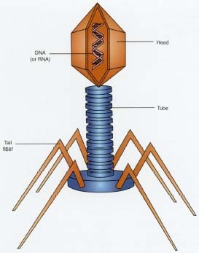
I. What is a Virus?
A.Virus: is a noncellular particle made up of genetic material and protein that can invade living cells

Slide 4
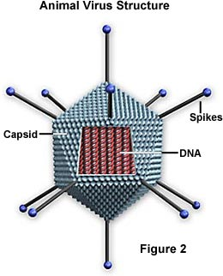
B. Structure of a Virus
1. CORE of nucleic acid
a. Made of DNA or RNA but never both
b. Contains up to several hundred
genes

Slide 5
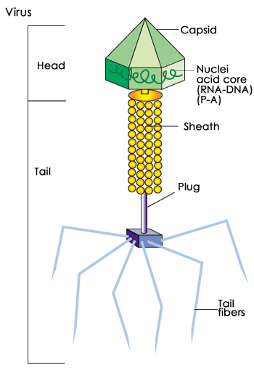
Because most viruses are extremely well adapted to their host organism, virus structure varies greatly.
All viruses have a capsid or head region that contains its genetic material
Some viruses, mostly those that infect bacteria, have a tail region. The tail is an often elaborate protein structure. It aids in binding to the surface of the host cell and in the introduction of virus genetic material to the host cell.

Slide 6
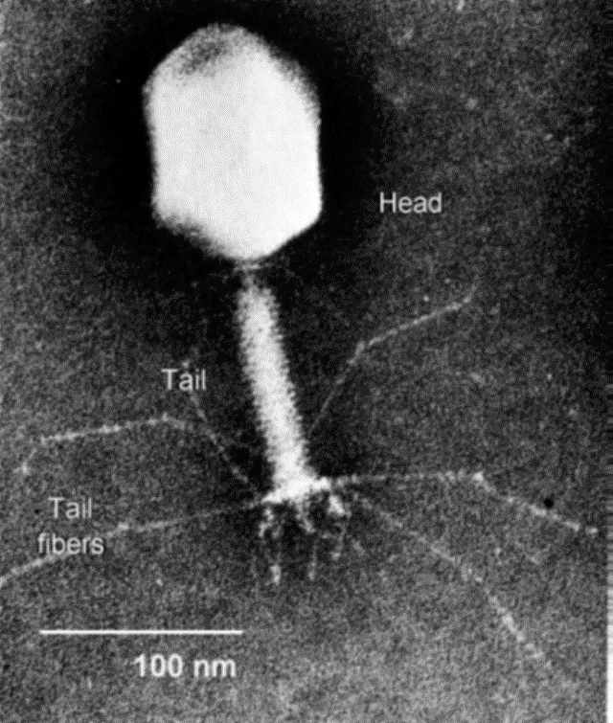
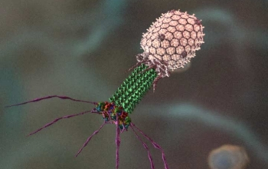
C. Bacteriophage:
are viruses that invade
bacteria

Slide 7
Some shapes of viruses:
Rod-shaped
Tadpole Shaped
Helical
Cube shaped
Viruses vary in size from approximately 20 to 400 nanometers.
1 metre(m)=1 000 000 000 nanometer(nm)

Slide 8
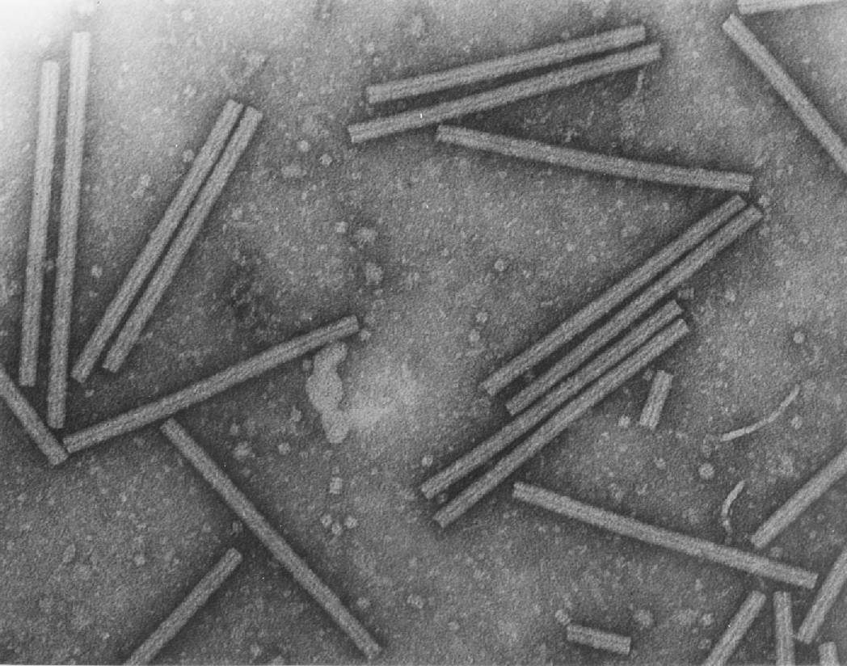
Specificity of a virus
1. What specificity means: specific viruses will infect specific organisms
a. Example: a plant virus cannot infect an animal
Tobacco Mosaic Virus

Slide 9

II. Life Cycle of a Lytic Virus
A. In order to reproduce, viruses must invade, or infect, a living host cell.
Click on image

Slide 10
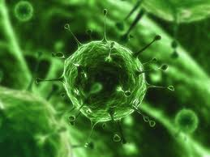
B. Infection:
1. Virus activated by chance contact with
right host cell
2. T4: tail attaches to the surface of a
bacterium
3. DNA is injected into the bacterium
VIRAL INFECTION

Slide 11
C. Growth:
1. Host cell cannot tell the difference
between its own DNA and the DNA of
the virus
2. Viral messenger RNA (mRNA) acts
like a molecular wrecking crew, taking over the infected host cell
3. Produces enzymes that destroy
host's own DNA but don’t harm the viral DNA!

Slide 12
D. Replication
Virus uses materials of the host cell to make thousands of copies of its own protein coat and DNA
Host cell becomes filled with hundreds of viral DNA molecules
3. This sequence (I,G,R) can take as little
as 25 minutes!
4. During final stages:
a. New virus particles are assembled
b. Infected cell lyses (bursts)
c. Hundreds of new virus particles are released and may now infect other cells
5. Called a lytic infection because the host cell is lysed and destroyed

Slide 13
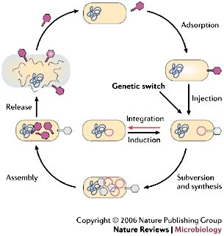
Lytic Cycle
Click on image

Slide 14
E. Make a labeled sketch of the Lytic cycle Figure 17-4

Slide 15

III. Lysogenic Infections
A. How it differs from a lytic infection:
1. Viral DNA enters cells and is inserted Into the DNA of the host cell
2. Once there, called a prophage
3. May remain in host DNA for many generations
Click above image

Slide 16
Prophage activity:
May actually benefit the host cell by:
1. Blocking the entrance of other viruses
2. Adding useful DNA sequences
3. Doesn’t stay in prophage form forever; eventually DNA becomes active, and
removes itself from host DNA
4. Then it directs the synthesis of new virus particles
5. Factors that can activate the virus:
a. Sudden changes in temperature
b. Availability of nutrients

Slide 17
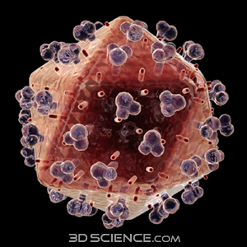
C. Retroviruses:
1. Contain RNA as their genetic material
2. When infecting a host, make a DNA copy of their RNA genes
3. This DNA acts like that of a lysogenic virus and is inserted into the host DNA
4. Name means “backward virus” and comes from their genes being copied
backward from RNA to DNA
5. AIDS is caused by a retrovirus called HIV

Slide 18
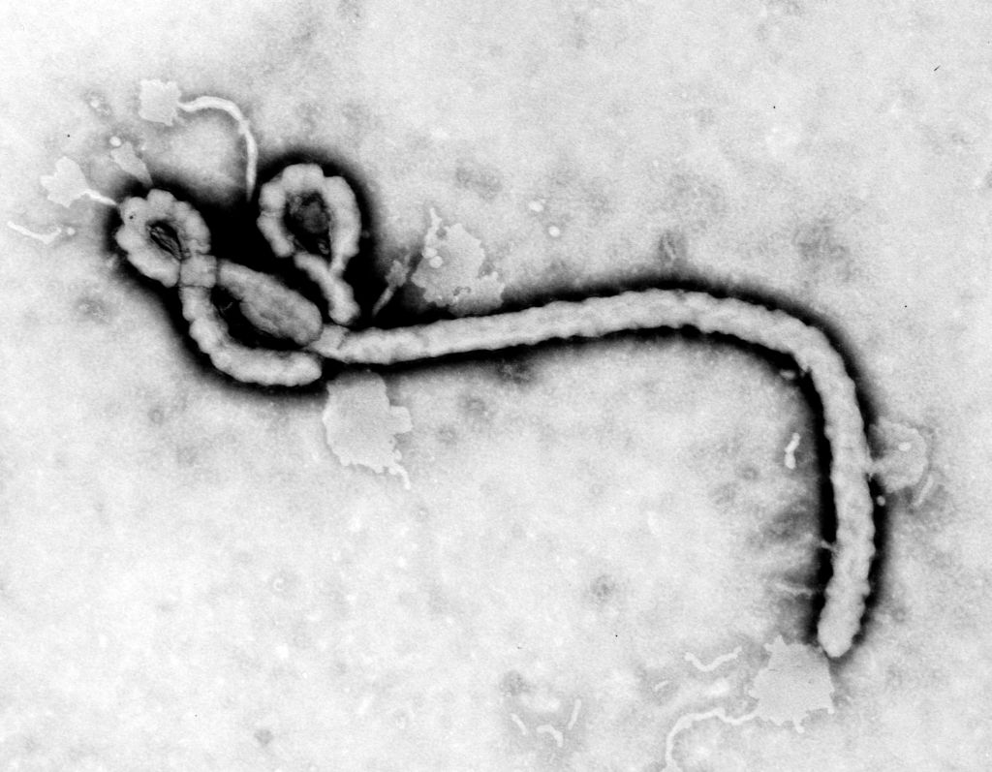
IV. Viruses and Living Cells
A.Viruses are parasites:
an organism that depends entirely upon another living organism for its existence in such a way that it harms that organism

Slide 19
Are viruses living or non-living?
Evidence for “non-living”:
- viruses cannot grow and develop independently
- viruses cannot reproduce independently
- viruses cannot obtain and use energy independently
2. Evidence for “living”:
        contains DNA

Slide 20
Origin of Viruses
A. More likely that viruses developed after living cells because they are completely
dependent upon living cells for growth and reproduction

Slide 21
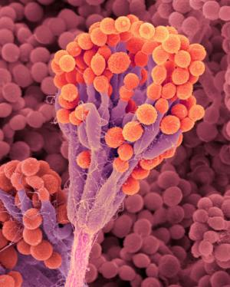
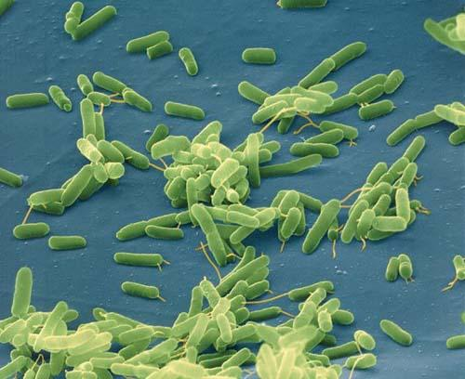
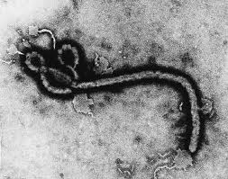
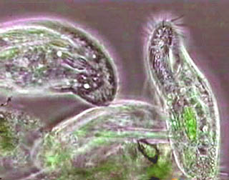
44-1:The Nature of Disease
Introduction
A. Disease: any change, other than an
injury, that interferes with the normal
functioning of the body
B. Infectious diseases are produced by
pathogens
Pathogens: are disease-causing
microorganisms such as viruses, bacteria, fungi, and protozoans

Slide 22
I. What is Disease?
A. Infection: when the body is successfully
invaded by a pathogen
1. The numbers of micro-organisms
around us is so large that infection is a daily event
2. Sickness is not a daily event because
not all infections produce disease
3. Infectious disease results only when the growth of a pathogen begins to injure the cells and tissues of an infected person

Slide 23
II. How is Infectious Disease Spread?
Pathogens require only opportunity to enter the body.
Examples:
Bacterium Clostridium tetani lives in soil and enters thru a cut or puncture in the skin
Common cold, measles, mumps, influenza spread thru coughing or sneezing
Others spread thru contaminated water supplies
Through food handled by an infected person
Spread by infected animals (e.g. ticks and mosquitoes)
- sexual contact

Slide 24
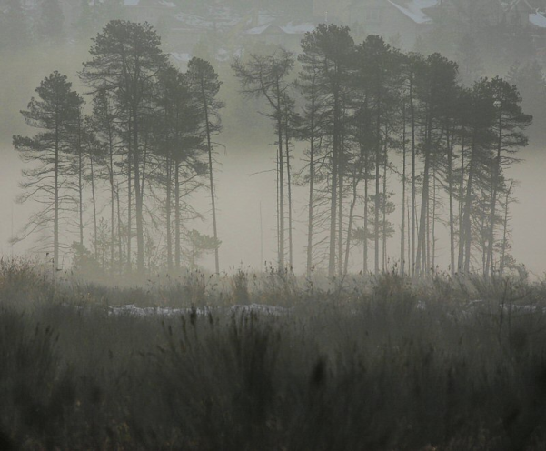
III. The Germ Theory of Infectious Disease
A. In the past is was believed disease was
caused by: evil spirits, magic or miasmas (vapors rising from marshes or decaying plant or animal matter)
B. People who became ill were thought to be
cursed or had bad luck

Slide 25
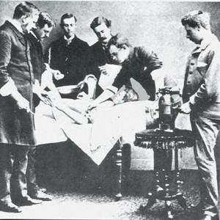
C. Germ Theory of Infectious Disease: idea
that infectious diseases are caused by
microorganisms

Slide 26
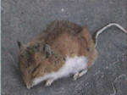
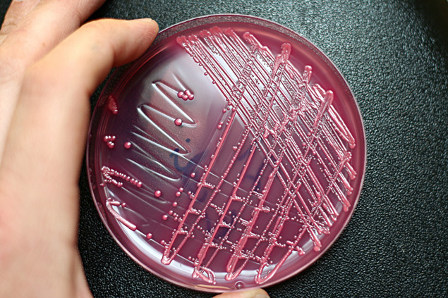
Koch's postulates:
Microbiologist Robert Koch was born in 1843. Koch's postulates are a series of ground rules to determine whether a given organism can cause a given disease. Koch theorized that:
1. The microorganism should always be
found in the body of the host organisms
and not in a healthy organism
2. The microorganisms must be isolated
and grown in a pure culture away from
the host.

Slide 27
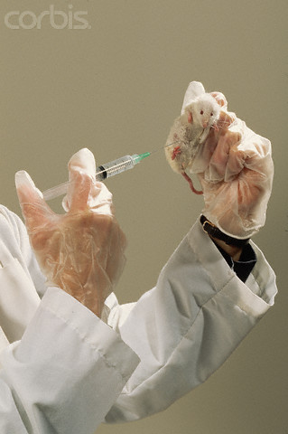

3. When the microorganisms grown in pure culture are injected into a new host organism, they produce disease.
4. The same microorganisms should be reisolated from the second host and grown in a pure culture, after which the microorganisms should still be the same as the original microorganisms.

Slide 28
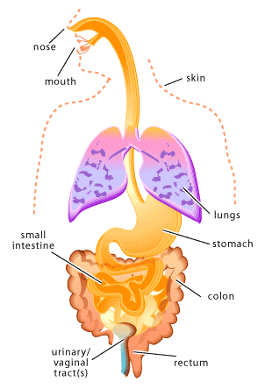
44-2 Agents of Disease
I. Introduction
A few micro-organisms find the human body an inviting home
  It is warm, protected, and full of nutrients
  Friendly ones settle in and live in certain parts of the body
Teacher note: These are called normal flora; our skin, mucus membranes, digestive system, etc. are host to billions; they actually help to keep us healthy by taking up niches that could otherwise be invaded by the pathogenic varieties!
Locations of Normal Flora

Slide 29
B. Some may invade and multiply in tissues,
or travel through the bloodstream
1. Unchecked, they may cause serious illness
C. Diseases are grouped according to the kind of pathogen that causes them

Slide 30
II. Viruses
A.Complete the following chart :
Disease | Organism that Causes the Disease | Methods of Spreading the Disease
Chicken Pox | one virus | droplets in air; direct contact with infected person
Common Cold | many viruses | droplets in air; direct contact with infected person
German Measles | one virus | droplets spread; direct contact with infected person
Influenza | two important types (A, B) of virus and many subtypes | direct contact with infected person; droplet infection; also may be airborne
Mumps | one virus | droplets spread; direct contact with infected person
Polio | three types of virus | direct contact with infected person

Slide 31
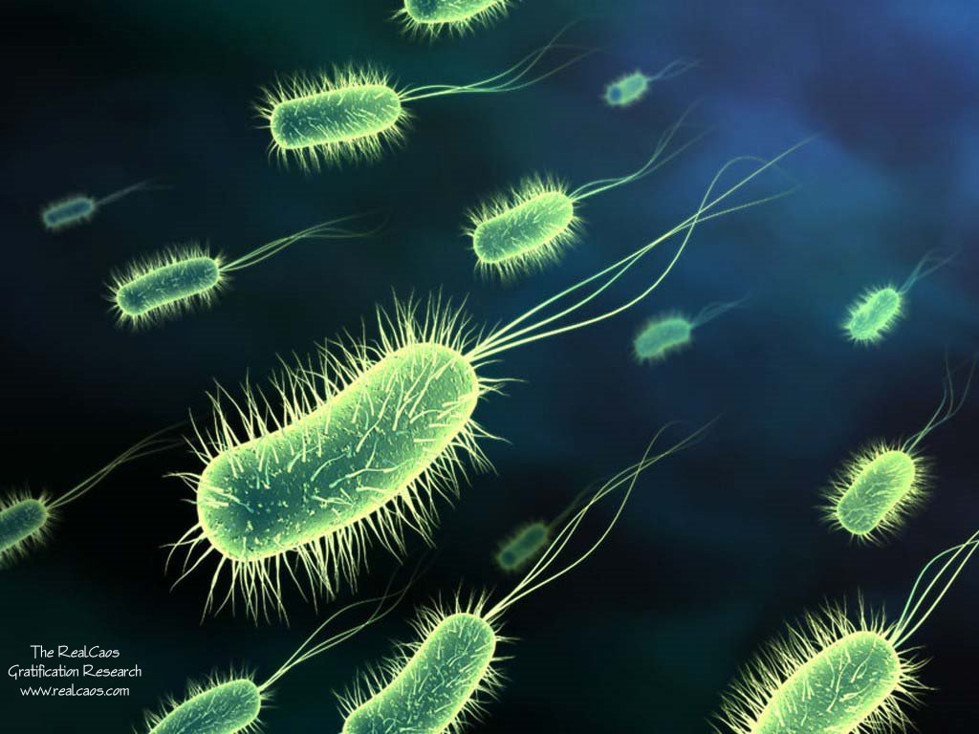
17-2: Monerans - Prokaryotic Cells
Monerans - Prokaryotic Cells
A. Prokaryotes: single-celled organism whose cells do not have a nucleus
They are found everywhere

Slide 32
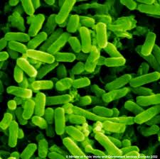
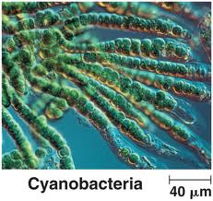
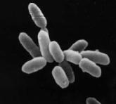
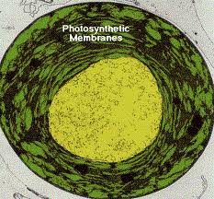
II. Classification of Monerans
A. All prokaryotes belong to the kingdom Monera
B. Divided into 4 Phyla:
1. Eubacteria
2. Cyanobacteria
3. Archaebacteria
4. Prochlorobacteria
E. C oli - Eubacteria
Archaebacteria
Prochlorobacteria

Slide 33
C. Bacteria: one-celled prokaryote; chiefly
parasitic or saprophytic
(saprophytic = lives on dead organic material)
1. Size: 1 to 10 micrometers
2. Smaller than eukaryotic cells because:
bacteria do not contain the complex range of membrane-enclosed organelles that are found in most eukaryotic cells

Slide 34
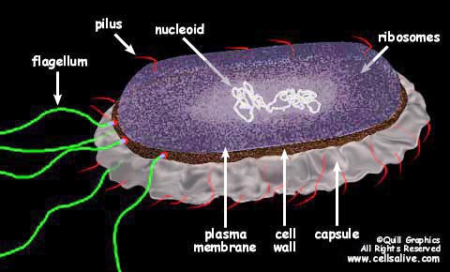
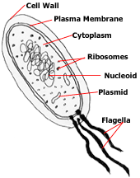
D. Eubacteria
1. Commonly called: bacteria
2. General appearance:
a. Cell wall composed of: complex carbohydrates
b. Within the cell wall is a cell membrane that surrounds the cytoplasm
c. Some have long whip- like flagella that protrude from cell membrane through the cell wall; these are used for movement.

Slide 35
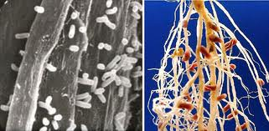
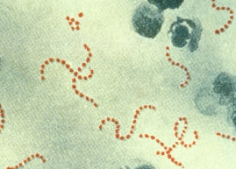
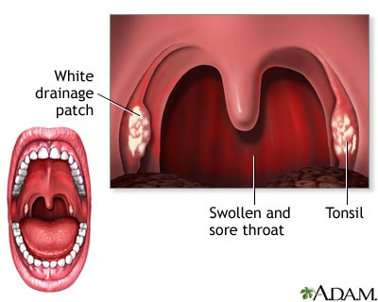
3. Lifestyles of bacteria include:
a. Live in the soil
eg: Rhizobia
b. Infect larger organisms and produce disease
eg: Streptococcus pyogenes
(causes Strep throat)
c. Photosynthetic

Slide 36
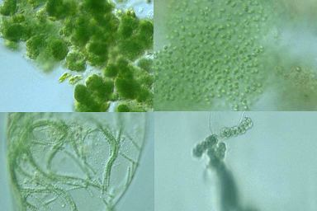
E. Cyanobacteria
Commonly called: blue-green bacteria
Origin of the name: are blue-green in colour
All cyanobacteria can carry out the reactions of photosynthesis

Slide 37
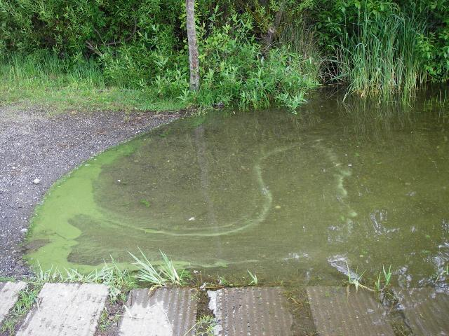
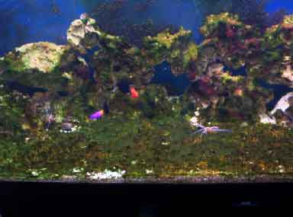
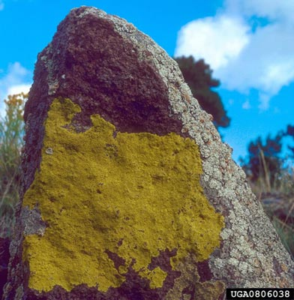
4. Habitat:
Fresh water
Salt water
Land

Slide 38
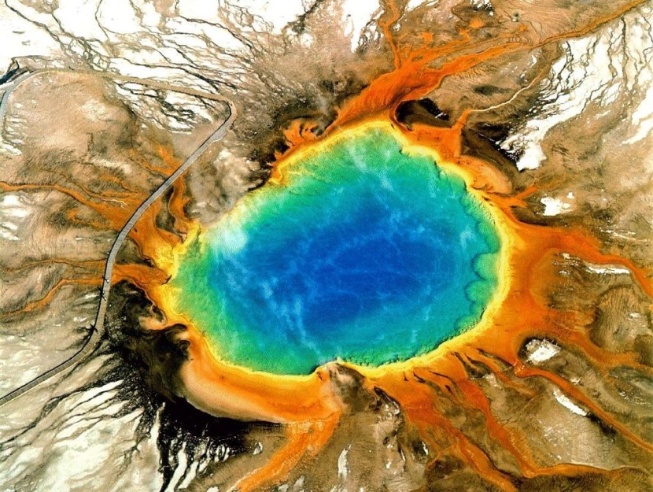
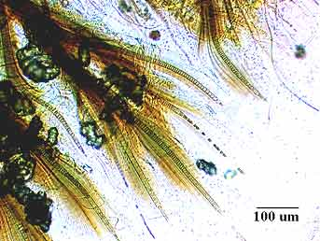
5. Some “extreme” habitats:
a. Hot springs b. Arctic
Tapered cyanobacteria filments
from Nunavut
The Grand Prismatic Hot Spring and its
famous thermophilic cyanobacteria

Slide 39
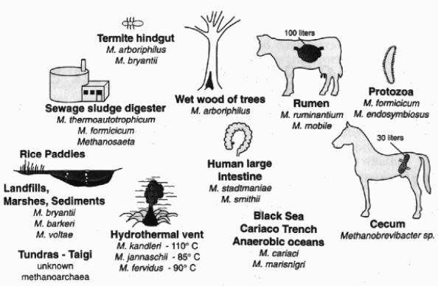
F. Archaebacteria
Habitat: extremely harsh environments
2. Methanogens:
a. Habitat: oxygen-free environments
  Examples: thick mud & animal digestive tracks

Slide 40
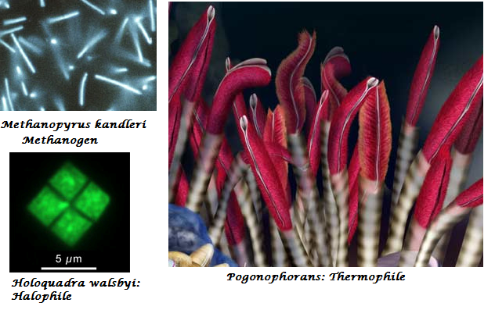
b. Origin of name: these bacteria produce methane gas
c. Other “extreme” habitats:
i. salty environments
  ii. extremely hot environments

Slide 41
III.Identifying Monerans
Name and sketch the basic shapes of bacteria:
Shape: | Name: | Sketch:
Rod | Bacilli
Sphere | Cocci
Spiral | Spirilla

Slide 42
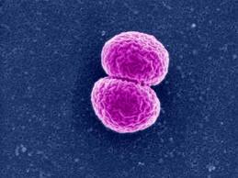
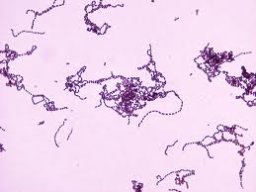
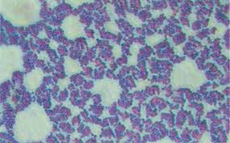
B. Sketch: 2 cocci together (diplococci):
Sketch: long chain of cocci
Sketch: a big clump of cocci:
Neisseria sp.
Streptococcus sp.
Staphlococcus sp.

Slide 43
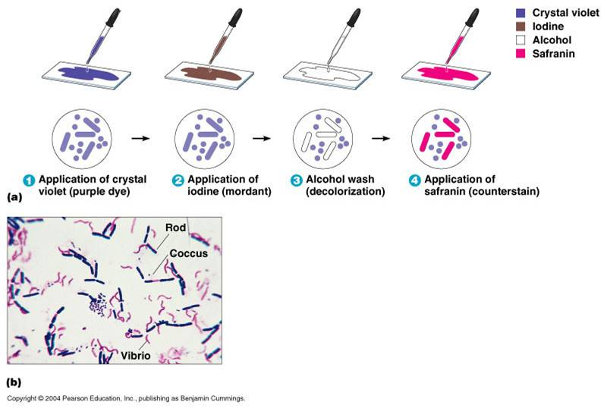
C. Cell wall
Gram Stain: Gram staining studies the chemical nature of the bacterial cell wall
Gram-positive bacteria have a thick mesh-like cell wall made of peptidoglycan (50-90% of cell wall), which stains purple while Gram-negative bacteria have a thinner layer (10% of cell wall), which stains pink.

