Slide 1
III. Blood Pressure
  1. Pressure of the blood against the wall of a blood vessel.
  2. Created by the pumping action of the heart.
  3. When the heart contracts, the blood is forced into the arteries under a great deal of pressure.
http://www.sumanasinc.com/webcontent/animations/content/bloodpressure.html

Slide 2
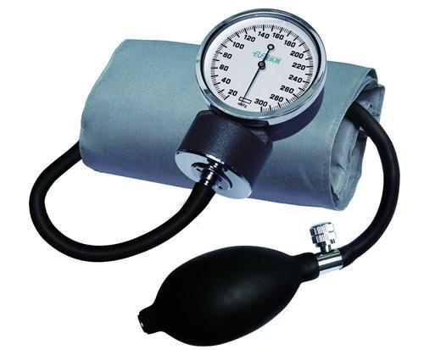
IV. Measuring Blood Pressure
Measured by a sphygmomanometer.
SYSTOLIC BLOOD PRESSURE is the highest arterial pressure reached during ejection of blood from the heart

Slide 3
  DIASTOLIC BLOOD PRESSURE is the lowest arterial pressure when the ventricles are relaxing.
  Blood pressure decreases with distance from left ventricle.

Slide 4
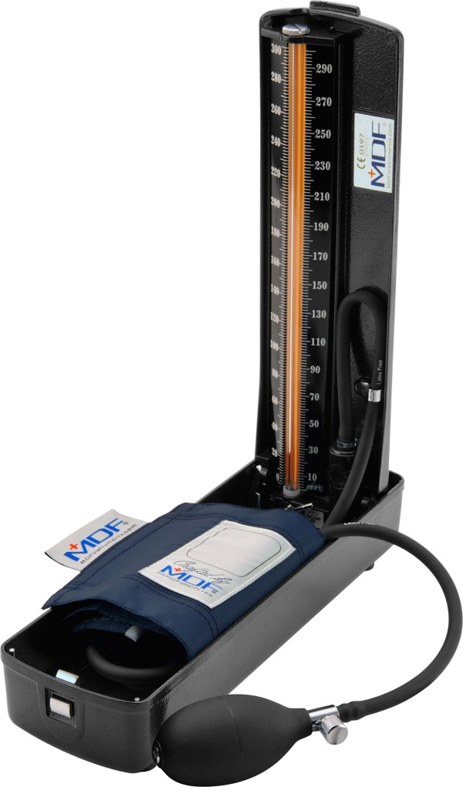
Normal resting blood pressure is 120 mm Hg over 80 mm Hg in brachial artery of arm.
120 mm Hg is how high a column of mercury would be pushed as soon as the ventricles contract.
As the ventricles relax, pressure decreases down to 80 mm Hg.
It would continue to decrease except that at this time the ventricles fill up and contract again pushing the pressure up to 120 mm Hg (again).

Slide 5
  The drop in pressure from 120 mm Hg to 80 mm Hg is due to:
    Elastic nature of the arteries.
    Blood being distributed throughout the body.
    c. Blood pressure drops as the blood is distributed to a "low" of about 10 mm Hg in the capillaries.

Slide 6
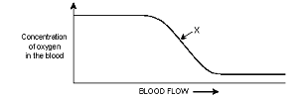
By the time the blood reaches the venules and veins it does not have enough pressure to reach the heart on its own.
Minute contractions of the skeletal muscle will push the blood back to the heart.
Valves prevent backward flow.

Slide 7
Transport Fluids
I. Body Fluids
  Human beings are approximately 70% water by body weight.
  Most of the water is within cells.
  A smaller amount of water is found within:
      1. Tissue fluid (surrounds cells)
      2. Lymph vessels
      Blood vessels

Slide 8
Blood
  BLOOD is a liquid connective tissue.
  Average person has about 5 to 6 liters of blood.
  Blood is required by the body to maintain homeostasis.
  Blood functions in
    1. Transport of gases, wastes, and nutrients
    2. Clotting to seal injuries
    Infection fighting

Slide 9
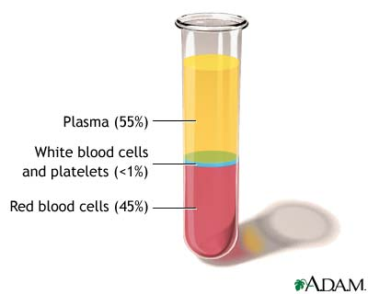
  Two Main Components of Blood
  PLASMA (the liquid portion of blood)
    1. Makes up about 55% of blood volume.
    2. Contains water.
    Contains organic and inorganic substances (proteins, gases, salts, nutrients, wastes).

Slide 10
B. FORMED ELEMENTS (the solid part of blood)
  1. Makes up about 45% of blood volume.
  2. About 30 trillion blood cells in an adult.

Slide 11
  Each cubic millimeter of blood contains 2 main types of formed elements
    A. Red blood cells (RBC)
      4 - 6 million per mL of blood
      More RBC/mL in males than females
      iii. Number in blood cells is related to O₂ concentration in air
        ex. People who live at high altitudes have more RBC
      iv. Increasing the number of RBC/mL can aid athletic performance (“blood doping”)

Slide 12
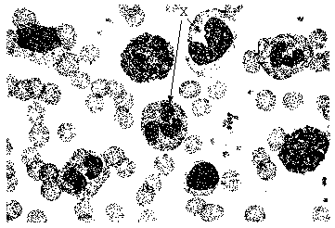
  b. White blood cells
  i. Average total of 7,500 per mL of blood

Slide 13
Plasma Components
Plasma Constituent | Function | Source
Water | Maintains blood volume and transports molecules | Absorbed from large intestine
Plasma Proteins: a. Albumin b. Fibrinogen c. Globulins | All maintain blood osmotic pressure & buffer pH Transport Clotting Fight Infection | Liver Liver Lymphocytes
Gases: a. Oxygen b. CO₂ | Cellular Respiration End product of metabolism | Lungs Tissues
Nutrients: Fats, glucose, amino acids, nucleotides, etc. | Food for cells | Absorbed from intestinal villi

Slide 14
Salts: Na⁺, K⁺, Cl⁻, NaHCO_{3,} etc. | Maintain blood osmotic pressure/pH, aid metabolism | Absorbed from intestinal villi
Wastes: (urea, ammonia) | End products of metabolism | Tissues
Vitamins | Cofactors for enzymes | Absorbed from intestinal villi
Hormones, (Thyroxin, adrenalin, estrogen etc.) | Varied | Varied Glands

Slide 15
Blood Proteins
  Are required for the transport of many molecules.
  For example, cholesterol is a lipid that is insoluble in plasma so it must be carried by proteins.
  Blood proteins also contribute to the viscosity of blood which aids in transport.
  D. Blood proteins also contribute to osmotic pressure, which maintains blood volume.

Slide 16
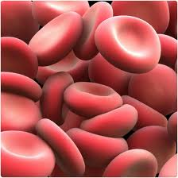
J9. Blood Cells
  Red Blood Cells (Erythrocytes)
  Red blood cells (RBC) are small, biconcave, disk-shaped cells without nuclei.
  B. Makes up over 95% of the formed elements.

Slide 17
  Transport O₂, hydrogen ions and some CO₂
  .
  D. RBC are made by cells called STEM CELLS in red bone marrow
    1. Over 2 million produced per second!
    2. Made in the skull, ribs, vertebrae, and ends of the long bones.
    3. Stem cells continuously divide.
      a. Pass through several developmental stages during which they lose a nucleus, gain hemoglobin and gets much smaller.

Slide 18
4. Oxygen levels in blood determine the rate of RBC formation.
  a.When oxygen tension is low, the kidneys produce a chemical called renal erythropoietic factor (REF) that, after combining with globulin from the liver, causes the bone marrow to produce more RBC.
5. RBC live for only 120 days.
  a. RBC are destroyed in the liver and spleen.
  b. Iron is recovered from the hemoglobin and sent to the bones, while the heme portion is chemically degraded and is excreted by the liver in the bile as bile pigments.

Slide 19
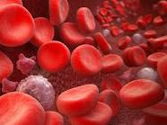
II. White Blood Cells (Leukocytes)
White blood cells (WBC) are usually larger than RBC (8 - 20 um), have a nucleus, and appear white (stained blue).
There is 1 WBC for every 600 RBC.

Slide 20
WBC fight infections
Primarily dependent on neutrophils and lymphocytes.
Red bone marrow continually produces WBC, except lymphocytes and monocytes, and keeps a reserve ready.
Lymphocytes and monocytes are produced by lymphatic tissue located in the lymph nodes and spleen.
When a parasite or virus invades, the reserves of WBC are released and more are manufactured.
Fever is caused by the increased production of WBC.
WBC are very specific for various illnesses so their count can help doctors diagnose patients.
  a. E.g. mononucleosis characterized by greater numbers of dark staining lymphocytes.

Slide 21
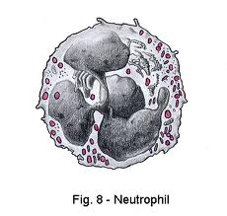
There are two main types of WBC
  Granulocytes - have granules in the cytoplasm and a many-lobed nucleus joined by nuclear threads (called "polymorphonuclear").
  a. Neutrophils
    i. 55 - 70% of WBC.
    ii. Phagocytic primarily bacteria.
    iii. The granules are lysosomes.

Slide 22
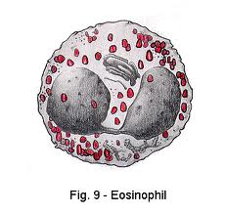
  b. Eosinophils
    i. 1 - 4% of WBC.
    ii. Phagocytizes and destroys antigen-antibody complexes.
    Involved in inflammatory and allergic responses.
  c. Basophils
    i. 0.5 - 1% of WBC.
    ii. Involved in inflammatory and allergic responses.
    iii. Congregates in tissues, releases histamine when stimulated.

Slide 23
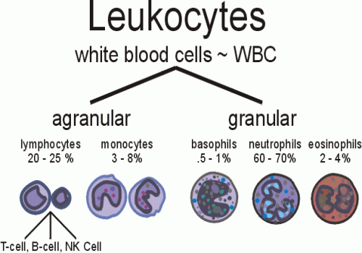

Slide 24
2. Agranulocytes: Do not have granules, and have a circular (lymphocytes) or indented (monocytes) nucleus.
  a. Lymphocytes
    i. 20 - 30% of WBC.
    ii. Are the smallest white blood cells.
    iii. Different types: T and B cells
      1. Type T lymphocytes kill virus-containing cells.
      2. Type B lymphocytes produce antibodies in blood and lymph.

Slide 25
  iv. Secrete a protein called IMMUNOGLOBULINS.
      Antibodies combine with foreign substances to inactivate them
      When microbes invade the body, lymphocytes begin to multiply and they become transformed plasma cells.
      Each microbe stimulates only one type of lymphocyte to multiply and form one type of plasma cell.
      The type of plasma cell formed is the type that can make a specific antibody to destroy the particular microbe that has invaded the body.

Slide 26
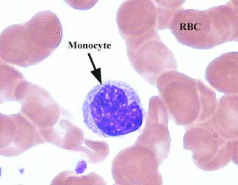
  Monocytes
  i. 2 - 8% of WBC.
  ii. Become macrophages.
  Enlarge greatly in size at infections

Slide 27
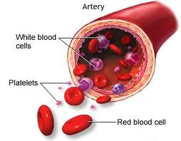
Platelets (Thromobocytes)
From fragmentation of large cells called megakaryocytes in red bone marrow.
Produces 200,000,000,000 per day!
C. Function in blood clotting

Slide 28

IV. Hemoglobin (Hb)
  Made of 4 amino acid chains (2 alpha () and 2 beta ()).
  Each chain has iron-containing heme group which attaches to oxygen.
  Hemoglobin is an excellent carrier of oxygen because it weakly binds with oxygen in the cool, neutral conditions in the lungs, and easily gives O₂ up in the warmer and more acidic tissues.

Slide 29
Hemoglobin is a red pigment so red blood cells appear red.
  1. Colour can change based on what the hemoglobin is attached to.
    a. Oxyhemoglobin (HbO₂)
      i. Hemoglobin bound to oxygen
      ii. Bright red
    b. Reduced hemoglobin
      i. Hemoglobin that has lost its oxygen
      ii. Dark purple

Slide 30
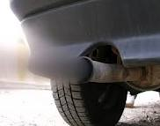
Carbon monoxide (CO) is a poison found in car exhaust.
It binds to Hb better than oxygen, and stays bound for several hours regardless of the environmental conditions.
CO poisoning can lead to death.

Slide 31
Infection Fighting
  Body's first line of defense against invading pathogens like bacteria and viruses is the skin.
  B. Second line of defense is the blood
    1. White blood cells
    2. Gamma globulins

Slide 32
VI.The Inflammatory Reaction
  Whenever the skin is broken due to a minor injury, a series of events occur that are known as the inflammatory response because there is swelling and reddening at the site of the injury.
  This response is designed to get the body's defenses marshaled as quickly as possible at the site where they are needed.
  http://www.sumanasinc.com/webcontent/animations/content/inflammatory.html

Slide 33
When blood vessels and tissue cells get ruptured by an injury, they release precursors of BRADYKININ
  A chemical with several jobs
  Bradykinin initiates nerve impulses that signals PAIN
  Bradykinin causes MAST CELLS (a type of cell that resides in tissues that is derived from Basophils) to release histamine, which together with bradykinin causes a capillary to become enlarged and more permeable.

Slide 34
Enlarged capillary causes the skin to redden and its increased permeability allows proteins and fluids to escape so that swelling results.
Meanwhile, bacteria and viruses are also entering through the rupture.
Lymphocytes release antibodies that attack the invading pathogens, preparing them for phagocytosis by neutrophils or monocytes.
Once monocytes have arrived on the scene, they swell up to five to ten times their original size and become macrophages (large phagocytic cells that are able to devour a hundred invaders and still survive).
Dead neutrophils plus cells, bacteria, and WBC form pus, a thick yellowish fluid.

Slide 35
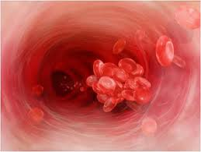
Blood Clotting
http://health.howstuffworks.com/human-body/systems/circulatory/adam-200077.htm
After an injury, coagulation or “clotting” takes place to prevent excessive blood loss.
Requires the action of platelets, prothrombin and fibrinogen.
Prothrombin and fibrinogen are manufactured and deposited in the blood by the liver.
Vitamin K is required for the
production of prothrombin.

Slide 36
A simplified summary of the steps involved in clot formation:
  Platelets clump at the site of the puncture and partially seal the leak.
  Platelets and injured tissues release the enzyme prothrombin activator that activates prothrombin to thrombin. Calcium ions (Ca²⁺) are necessary for this step.
  Thrombin acts as an enzyme and severs two short amino acid chains from each fibrinogen molecule.
  These activated chains join end to end to form long ends of fibrin.

Slide 37
  5 Fibrin threads entangle red cells and platelets in the damaged area and form the framework of
the clot.
  Red cells trapped in the clot give it its red colour.
  Clotting takes place faster at warmer temperatures than cold because it is controlled by enzymes.
  Serum is plasma from which the fibrinogen has been removed due to clotting.
  9. A fibrin clot is only a temporary repair and eventually, an enzyme called plasmin destroys the fibrin network and restores the fluidity of plasma.

Slide 38
1.ANTIGENS and ANTIBODIES
Antigens
A foreign substance (usually a protein, sometimes a carbohydrate) that stimulates the release of antibodies to it.
Usually organic and usually small enough to enter via the respiratory, circulatory or digestive system

Slide 39
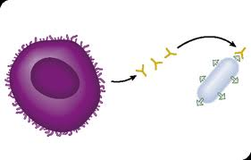
E.g. Protein coat of a viruses, bacteria, the cells of transplanted organs, etc.
C. If the immune response is overly sensitive,
responding to small organic materials that
do not, in themselves, usually cause
disease (e.g. pollen grains, food molecules)
person has ALLERGIES to such materials

Slide 40
Antibodies
http://www.youtube.com/watch?v=Ys_V6FcYD5I
Very specific proteins that attach to invading pathogens.
Lymphocytes produce antibodies in response to invading pathogens
Each lymphocyte produces one type of antibody that is specific for one type of antigen.
Antibodies combine with antigens in such a way that the antigens are rendered harmless.

Slide 41
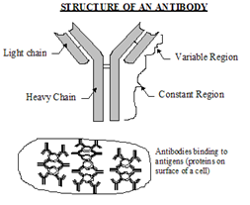

Slide 42
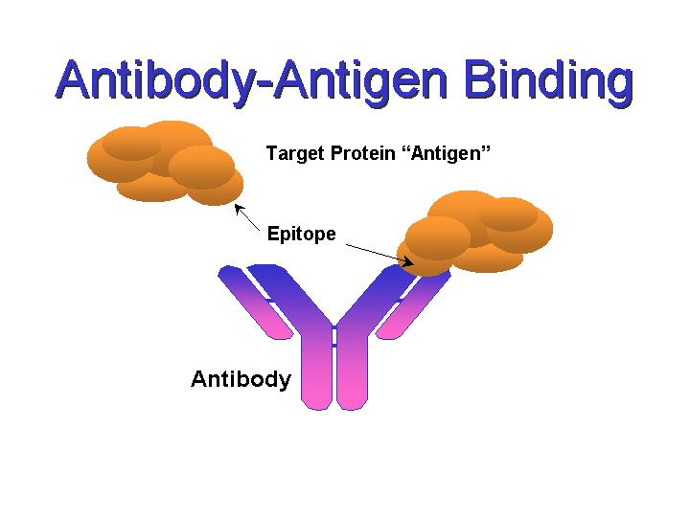
E. Each antibody fits its antigen like a lock and key.

Slide 43
Are immune if a person has antibodies for a particular antigen.
The blood contains lymphocytes that can remain in the system for years, ready to produce antibodies if that antigen is detected.
Exposure to the antigen, either naturally or by way of a vaccine, can cause active immunity to develop.

Slide 44
1.BLOOD TYPING
ABO Blood Types
Human blood is classified according to the antigens present on the surface of the red blood cells.
Two antigens called "A" and "B" may be present on the red blood cells

Slide 45
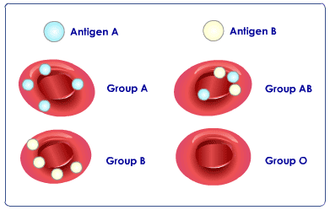

Slide 46
  Each individual also carries antibodies in his/her plasma to the antigens not present on that individual's red cells.
  D. Group ABO Type Summary
Type | Antigen | Antibody
A | A | b
B | B | a
AB | A,B | none
O | none | a,b

Slide 48
II. Rh System
Rh factor is another antigen found on RBC.
People with this Rh antigen on the RBC are Rh positive.
People without this Rh antigen on the RBC are Rh negative.
Rh negative individuals do not normally make antibodies to the Rh factor, but they will make them when exposed to the Rh factor.

Slide 49
E. It is possible to extract these antibodies and use them for blood type testing, since Rh positive blood will agglutinate when mixed with Rh antibodies.

Slide 50
F. The Rh factor is very important during pregnancy.
If the mother is Rh negative and the father is Rh positive, the child may be Rh positive.
During gestation, it is normal that a few red cells from the child will find their way into the mother's system
If the mother becomes pregnant with another Rh positive baby, Rh antibodies may cross the placenta and destroy the child's red cells → fetal erythroblastosis.

Slide 51
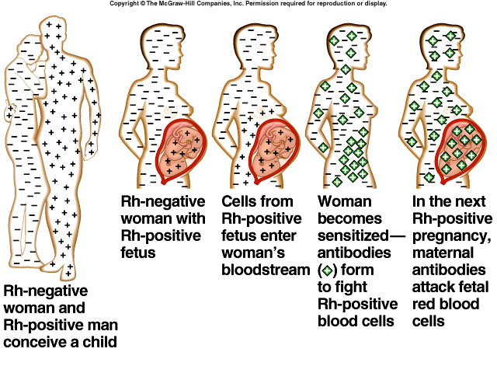

Slide 52
Can give Rh⁻ women an Rh immune globulin injection called RhoGAM just after the birth of any Rh⁺ child. This injection will destroy any red cells left over from the baby, before the mother has a chance to start producing her own antibodies.

Slide 53
III. Blood Transfusions
A. Blood recipients may only receive donated blood for which they have no antibodies in their plasma.
B. If the same antigen and antibody are present, agglutination (or clumping) of red cells will occur and can cause death.
C. AB⁺ people are universal acceptors because they can receive any blood type in transfusion and not react.
D. O⁻ people are universal donors because their RBCs can be given to anyone, since they do not have any antigens on their surface to trigger an immune response

