Slide 1
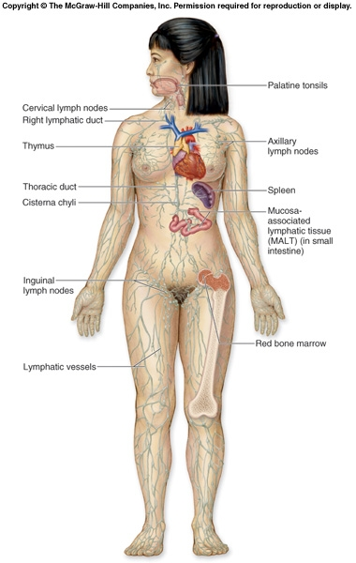

Slide 2
V. Other Parts of the Lymphatic System
A. Lacteal
1. Blind ends of lymph vessels in villi of the small intestine.
Products of fat digestion enter here.
B. Lymph Nodes
1. Small oval or round structures that occur along strategic places on lymph vessels.
2. They produce and store lymphocytes
3. These fight infection by producing antibodies which attach to and “flag” or deactivate foreign proteins
4. Filter lymph of damaged cells, bacteria and spreading cancer cells as well as debris.

Slide 3
C. Spleen
1. Located behind the stomach.
Contains white blood cells and stores blood.
D. Thymus Gland
1. Located in the upper thoracic cavity.
2. Functions in production and maturation of some lymphocytes.
3. Decreases in size with age.

Slide 4
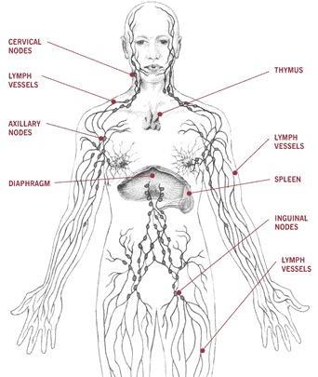

Slide 5
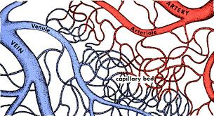
Capillary – Tissue Fluid Exchange
I. Exchange of Gases
A. Oxygen
1. 95% is carried by oxyhaemoglobin (HbO₂)
a. 200 million hemoglobin molecules per RBC
Each hemoglobin carries four oxygen molecules
2. 5% dissolved in plasma

Slide 6
B. Carbon dioxide (CO₂)
1. 9% dissolved in plasma
2. 27% picks up CO₂ to form carbaminohemoglobin (HbCO₂).
3. 64% of CO₂ is transported as bicarbonate ion (HCO₃⁻)
a. It is formed after CO₂ combines with water, forming carbonic acid which then dissociates.
b. Note the following reaction:
CO₂ + H₂O ←→H₂CO₃←→H⁺ + HCO₃⁻
c. The enzyme CARBONIC ANHYDRASE speeds up this reaction.
d. The H⁺ released by reaction changes the blood pH.
e. To prevent this H⁺ is picked up by the globin portion of hemoglobin (to become HHb) so that pH is maintained.

Slide 7
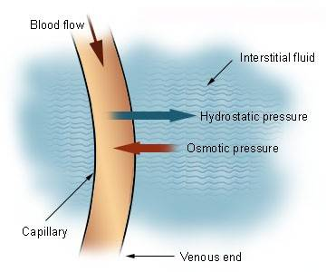
II. Mechanism of Gas Exchange
Intro Animation
Due to a pressure differential between blood pressure and osmotic pressure.
Blood pressure is the pressure of blood in blood vessel would tend to push molecules out of the blood.

Slide 8
At arterial side of a capillary bed, blood pressure is (40 mm Hg) HIGHER than blood osmotic pressure (25 mm Hg).
2. Thus plasma constantly “leaks” out through the walls of the capillaries, forming INTERSTITAL FLUID that bathes tissues.
The interstitial fluid contains water, nutrients, hormones, gases, wastes.
Plasma proteins and blood cells are too big so they are left behind in the capillaries.

Slide 9
Oxygen, sugars and amino acids in the fresh plasma diffuse into/taken up by local cells.
D. CO₂ and waste molecules produced in the
tissue cells diffuse out of the tissues and into the interstitial fluid.

Slide 10
Osmotic pressure is the opposing force trying to force molecules into the blood.
At the venule side of the capillary beds, blood pressure is now reduced (10 mm Hg) whereas osmotic pressure is about the same (25mm Hg).
Therefore, water, ammonia, and carbon dioxide laden interstitial fluid is now pulled by osmotic pressure back into the blood vessels tend to enter the bloodstream.
3. Osmotic pressure is basically constant, but blood pressure varies considerable around a capillary bed. This causes some natural movement of molecules.

Slide 12
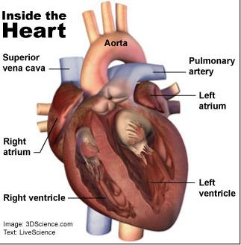
K1. Heart Anatomy
Function of the Heart
The pump that circulates the blood throughout the body.
B. A very muscular organ about the size of a fist.

Slide 13
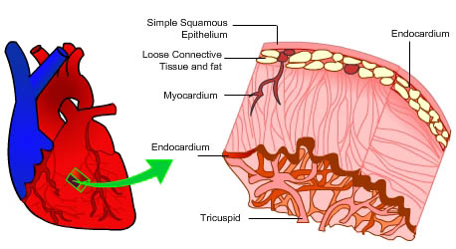
A. Consists of three tissue layers:
1. Outer pericardium layer composed of epithelial and fibrous tissue.
a. Pericardium forms a PERICARDIAL SAC that contains the heart.
b. Has lubricating liquid within the sac.
Middle myocardial layer composed of cardiac muscle.
3. Inner smooth endothelial layer

Slide 14
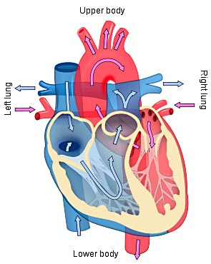
B. The two pumps
1. Right side pumps blood to the lungs.
2. Left side pumps blood to the rest of the body.
3. The left and right side of the heart is divided by the SEPTUM.

Slide 15
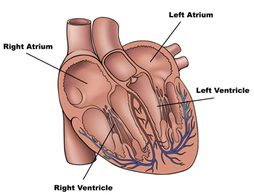
C. The 4 chambers
There are two chambers on each side of the septum.
Smaller chamber, located on the top, is called the ATRIUM (plural = ATRIA).
3. Larger chamber, located on the bottom, is called the VENTRICLE.
a. Right side is thinner because the lungs are close to the heart.
b. Left side is thicker because the body is further from the heart

Slide 16
D. Valves
1. ATRIOVENTRICULAR VALVES are located between the atria and ventricles.
Control the flow of blood between the chambers, and prevent blood backflow.
Atrioventricular (AV) valve between the right atrium from the right ventricle is called the TRICUSPID VALVE (has 3 flaps or "cusps").
Atrioventricular valve between the left atrium and left ventricle is called the BICUSPID VALVE or MITRAL VALVE (has 2 cusps).

Slide 17
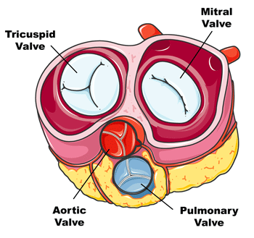

Slide 18
CHORDAE TENDINAE are very strong, fibrous strings that support the AV valves and prevent them from inverting.

Slide 19
SEMILUNAR VALVE are located between the heart and the artery.
Look like half-moons.
Pulmonary semilunar valve is located between the right ventricle and the pulmonary artery.
Aortic semilunar valve is located between the left ventricle and the aorta.
d. No chordae tendinae with semilunar valves.

Slide 20
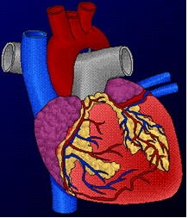
Coronary arteries and veins
Vitally important blood vessels that supply blood to the heart muscle itself
Heart does not use the blood in its inner chambers.
Arteries branch off the aorta just above the aortic semilunar valve, and lie on the outside of the heart.
Coronary veins empty into the right atrium.

Slide 21
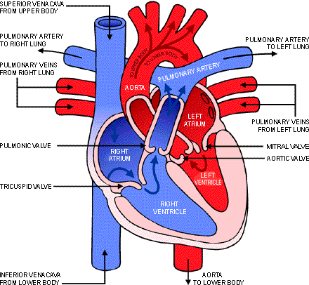
III. Path of Blood Through the Heart
Interactive – Map of the human heart
http://www.sumanasinc.com/webcontent/animations/content/human_heart.html
Blood low in oxygen (“deoxygenated”) enters the right atrium through the SUPERIOR and INFERIOR VENA CAVA, the body's largest veins.
The RIGHT ATRIUM contracts, forcing blood through the TRICUSPID VALVE and into the RIGHT VENTRICLE.

Slide 22
The right ventricle contracts, sending blood through the
PULMONARY SEMILUNAR VALVE and into the PULMONARY TRUNK.

Slide 23
The pulmonary trunk divides into PULMONARY ARTERIES, which take the deoxygenated blood to the capillaries of the LUNGS.
At the lungs, carbon dioxide diffuses out of the blood, and, oxygen diffuses into it. The blood is now OXYGENATED.
The oxygenated blood feeds into the PULMONARY VEINS, which take it from the lungs to the LEFT ATRIUM

Slide 24
The left atrium CONTRACTS, forcing blood through the bicuspid valve into the LEFT VENTRICLE.
The left ventricle CONTRACTS, forcing blood through the AORTIC SEMILUNAR VALVE into the AORTA, the body's largest artery.

Slide 25
The aorta divides into smaller arteries, which carry oxygenated blood to all body tissues.
Deoxygenated blood NEVER MIXES with oxygenated blood.
Two atria contract simultaneously, and the two ventricles also contract simultaneously.

Slide 26
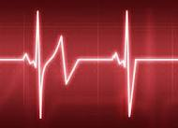
IV. Heartbeat
A. The heartbeat that you can hear can be divided into two phases:
1. "Lub" is due to the closing of atrioventricular valves.
a. atria contracting
b. ventricles relaxing
2. “Dupp” sound is due to the closing of the semi-lunar valves.
a. atria relaxing
b. ventricles contracting

Slide 27
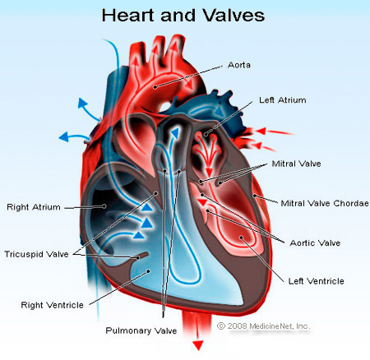
If there is a problem with a valve closing, this can cause HEART MURMURS.
1. Rheumatic fever caused by a bacterial infection can cause a faulty valve (usually the bicuspid valve).
2. Surgery or replacement with an artificial valve can often cure this.

Slide 28
K2. Heart Beat Co-ordination
Characteristics of Cardiac Cells
Heart muscle tissue can contract on its own
1. Each cardiac cell can contract independently.
Will co-ordinate their contractions if the cells are touching.
Video Clip – Dissection - Frog Heart Beating outside body

Slide 29
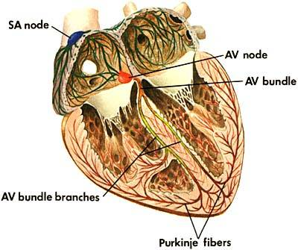
Heart Nervous Tissue
Heart contains NODAL TISSUE, which has characteristics of both nerve and muscle tissue to ensure rapid and coordinated heart contractions.
B. Sinoatrial (SA) Node
Located in the upper back wall of the right atrium.

Slide 30
The SA node initiates the heartbeat by sending out a signal automatically about every 0.85 seconds to make the atria contract.
Called the “pacemaker” because it keeps the beat regular.
An implanted artificial pacemaker can send out an electric signal every 0.85 seconds to stabilize the heart rate if the SA node doesn’t work.

Slide 31
C. Atrioventricular (AV) Node
Located in the base of the right atrium near the septum.
Branches from the SA node are spread over the atria and also to the AV node.
When the pulse sent out by the SA node reaches the AV node, the AV node sends out a signal along special conducting fibers called AV bundle (“Bundle of His”) down the septum to the Purkinje fibres that spread through the ventricles.

Slide 32
D. Purkinje fibers stimulate cardiac muscle at the base of the heart ventricles and moves up like a wave to cause the ventricles to contract.

Slide 33
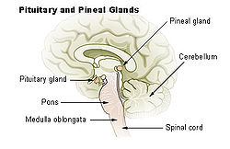
III. Control by the Brain
Nervous control controls the heart rate
Controlled in a part of the brain called the MEDULLA OBLANGATA

Slide 34
1. The medulla sends messages via the autonomic nervous system.
a. Sympathetic nerve branches tells the heart to "SPEED UP!"
Parasympathetic nerve branches tells the heart to “SLOW DOWN!“
2. Various factors, such as stress, oxygen levels, and blood pressure determine how the autonomic system will affect heart rate.

Slide 35
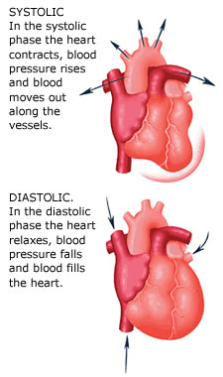
K6. Systolic and Diastolic Pressures
I. Systole and Diastole
SYSTOLE = CONTRACTION of heart muscle.
DIASTOLE = RELAXATION of heart muscle.

Slide 36
II. The Cardiac Cycle
Occurs about 70 times per minute.
B. Each heartbeat can be divided as follows:
Time (Duration) | Atria are in... | Ventricles are in...
0.15 SEC. | Systole | Diastole
0.30 SEC. | Diastole | Systole
0.40 SEC. | Diastole | Diastole

Slide 37
Each contraction will force 70 mL of blood to be circulated.
Results in a total blood volume pumped per minute of ≈ 5L.
Entire body's blood volume is circulated each minute.

Slide 38
PULSE is the alternate expanding and recoiling of an arterial wall that can be felt in any artery that runs near the surface of the body.
Radial artery in wrist, carotid artery in neck are common places to check.
Pulse rate indicates the rate of heartbeat.

