Slide 1
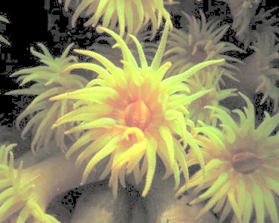
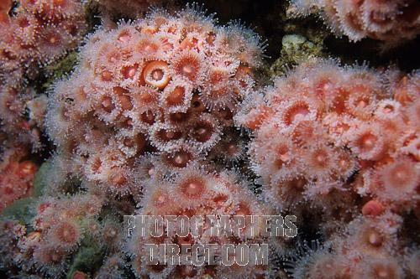
I. What is a Cnidarian?
A. Characteristics of Phylum Cnidaria:
1. Soft-bodied
2. Stinging tentacles arranged in circles around their mouth
3. Live as single individuals or as a group connected into a colony

Slide 2
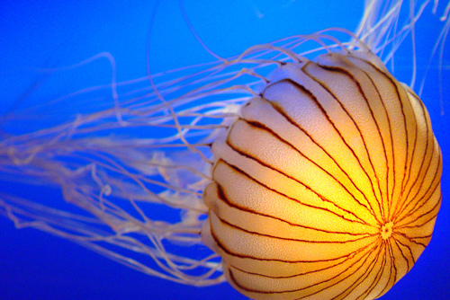
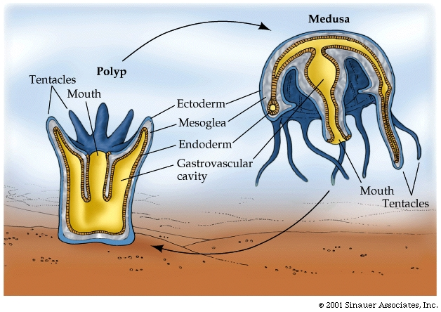
Symmetry: radial
Have specialized cells
and tissues
6. Life cycles with two stages:
a) Sessile flowerlike polyp b) Motile bell-shaped medusa

Slide 3
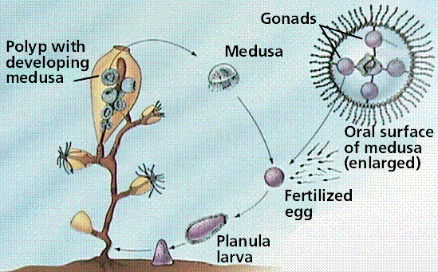
Cnidarian Life Cycle

Slide 4
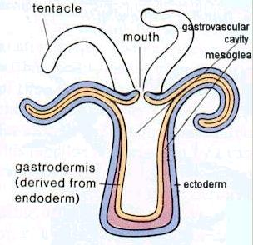
B. Body Plan
1. Have a body wall that surround an internal space called the gastrovascular cavity
a) Function of cavity: digestion

Slide 5
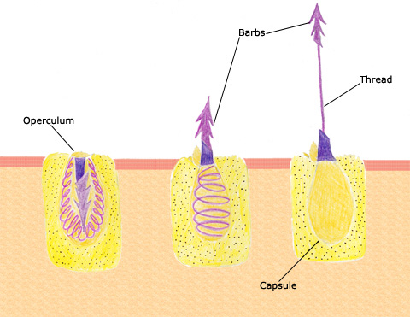
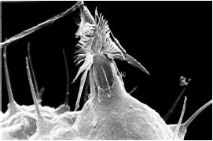
II. Form and Function in Cnidarians
Nematocyst: stinging structure on the tentacles of cnidarians that is used to paralyze or kill prey
1. Each nematocyst is a poison-filled sac containing a tightly coiled "spring-loaded" dart
Nematocysts in action
Nematocysts explained

Slide 6
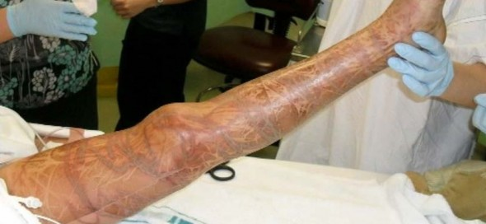
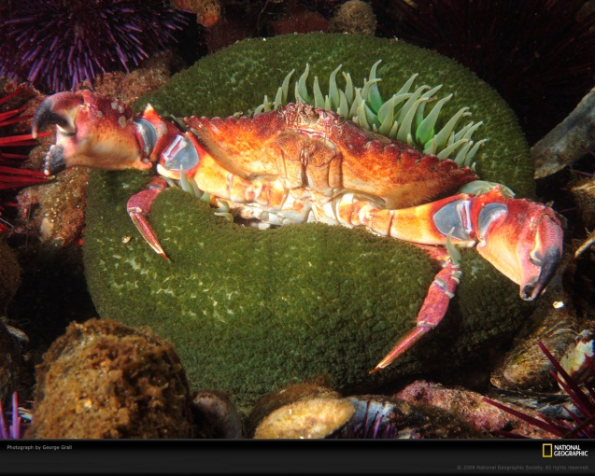
Stung by a box jellyfish

Slide 7
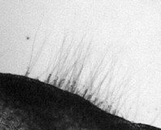
2. Feeding/Digestion:
a) When another animal touches a nematocysts,
the dart explodes and buries itself in the skin of the animal
b) The dart carries enough poison to paralyze or kill the prey.
Video – Anemone Eating Dead Shrimp

Slide 8
c) The cnidarian's tentacles push the food
through the mouth and into the gastrovascular cavity.
There the food is broken up into tiny pieces. These food fragments are taken up by cells in the gastroderm that digest them further

Slide 9
e) The nutrients are then transported throughout the body by diffusion
f) Undigested material passes out through the
gastrovascular cavity.

Slide 10
Form and Function in Cnidarians Cont’d..
B. Respiration by diffusion
C. Excretion by diffusion
D. Nervous System
1. Composed of nerve nets concentrated around the mouth
2. Sensory cells are in the epidermis
a) Detect chemicals from food
b) Detect touch of foreign objects

Slide 11
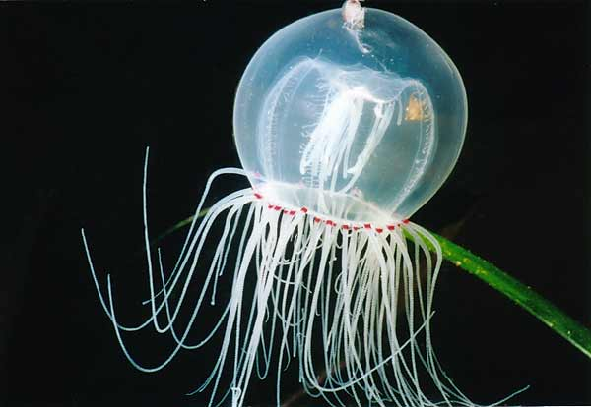
3. Medusae may have simple sense organs:
a) Statocysts involved with balance
b) Ocelli, or Eyespots, detect light

Slide 12
E. Movement
1. Cnidarians lack muscle cells.
2. Epidermal cells can change shape when stimulated by nerve net
3. Polyps can expand, shrink and move their tentacles by relaxing or contracting these cells
4. Medusae can move by jet propulsion by causing their bodies to "close" like a folding umbrella. This contraction of the body pushes water out of the bell
Lionsmane Jellyfish Swimming
More jellyfish

Slide 13
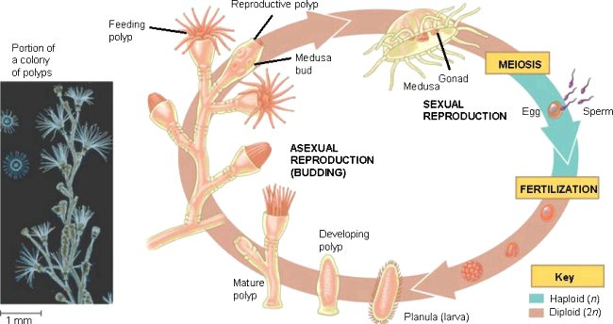
F. Reproduction
1. Describe asexual reproduction:
Budding - begins with a swelling on the side of an
existing individual

Slide 14
.
2. Describe sexual reproduction:
When the medusae mature, they reproduce sexually by releasing gametes into the water.
Fertilization occurs either in open water or inside an egg-carrying medusa. They zygote grows into a ciliated larva that swims around and settles down, attaches to a surface, and changes into a polyp

Slide 15
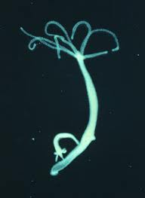
III.Hydras and Their Relatives
A. Class: Hydrozoa
B. Spend most of life as polyps:
C. Grow in branching, sessile colonies
D. Hydras
1. Hydras are not typical Class Hydrozoa because they live as solitary polyps and lack the medusa stage in their life cycle.
2. Hydras can move by doing a somersaulting movement
3. Reproduction:
a) Asexual: budding
b) Sexual: producing of eggs and sperm in their body walls

Slide 16
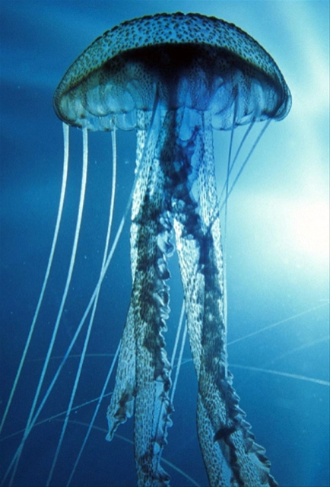
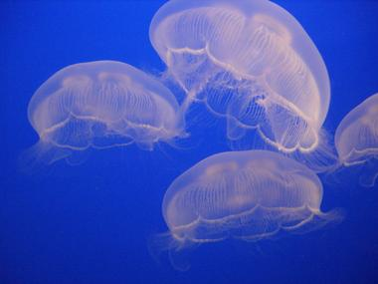
IV. Jellyfish
A. Class: Scyphozoa
B. The medusa is large & long-lived (dominant)
C. Nematocysts mostly harmless to humans; some can cause painful stings or death

Slide 17
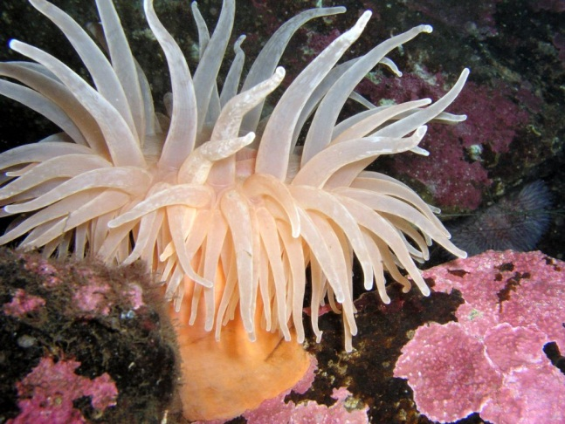
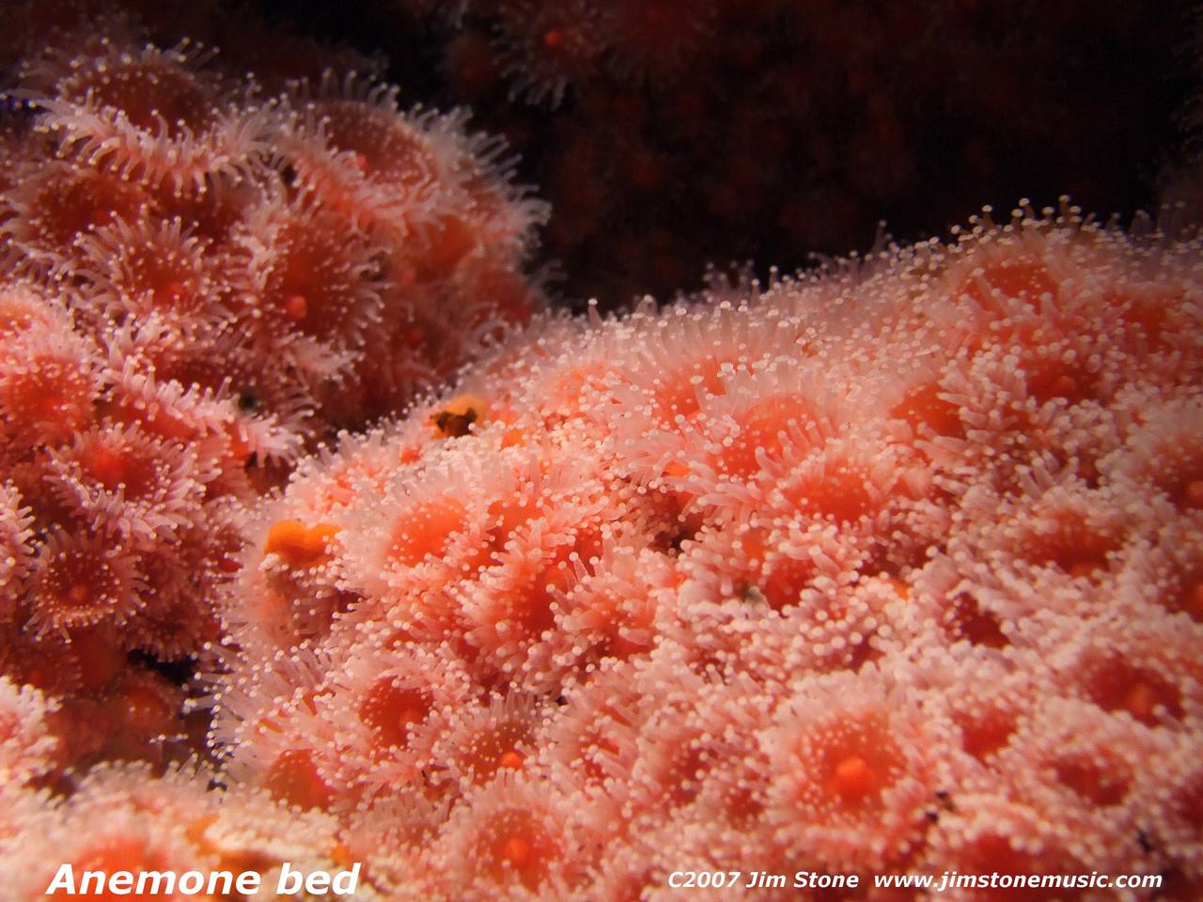
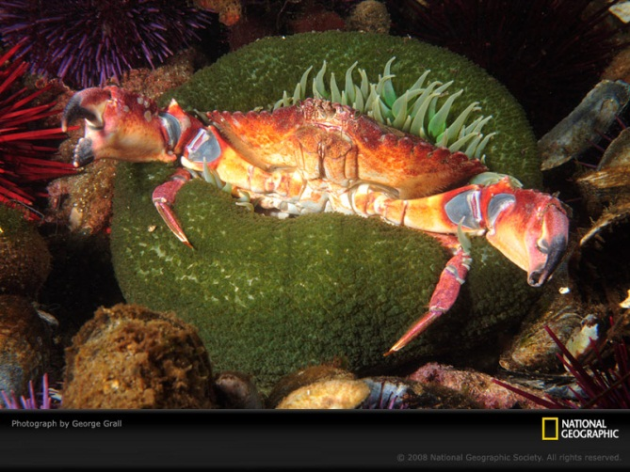
V. Sea Anemones and Corals
A. Class: Anthozoa
B. Life Cycle: only the polyp stage
C. Sea anemones:
1. Habitat: sea from the low-tide line to great depths

Slide 18
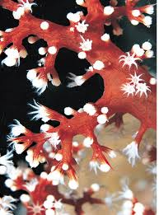
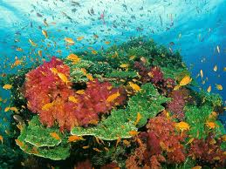
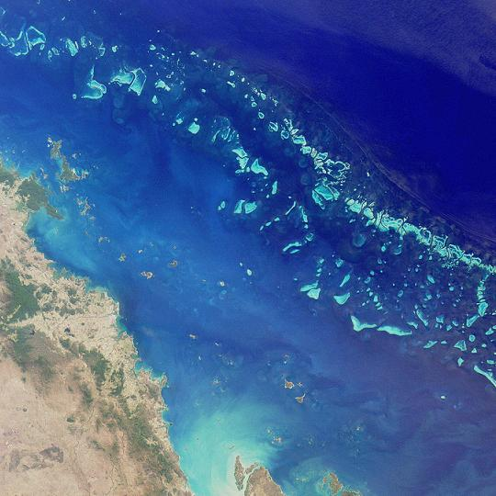
D. Corals:
1. Habitat: shallow tropical waters
2. Skeleton: made of calcium carbonate (limestone)
3. Colonies produce coral reefs, which can contain
more rock and living tissue than the largest human
cities
e.g.: The Great Barrier Reef (Australia) is more than 2000 km long and 80 km wide

Slide 19
VI. How Cnidarians Fit into the World
A. Coral Reefs:
1. Ecological importance: provide tunnels, caves and deep channels for other animals to live
2. Benefits to Humans:
a) Provide a home for food organisms
b) Protect the land from the destructive action of waves
c) Aids in the location of oil deposits

Slide 20
B. Chemicals:
1. Potential anti - cancer drugs
2. Nerve toxins reveal how nerve cells and systems work

Slide 21
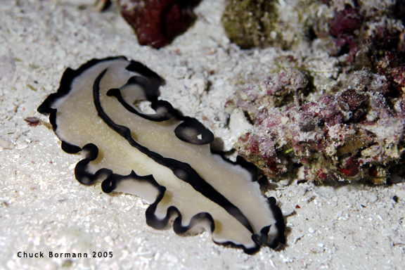
26-4 Unsegmented Worms

Slide 22
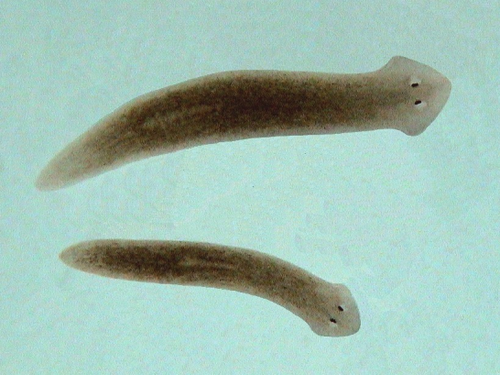
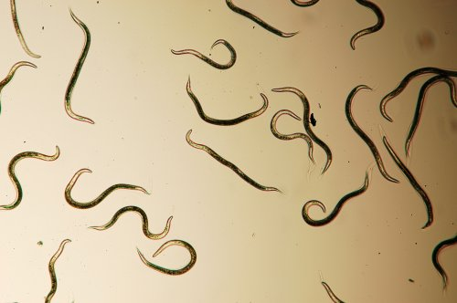
I. Unsegmented Worms:
A. (def’n): Bodies are not divided into special segments
B.Divided into 2 phyla:
1.Platyhelminthes (Flatworms)
Platy = flat;
Helminth = worm
2. Nematoda (Roundworms)

Slide 23
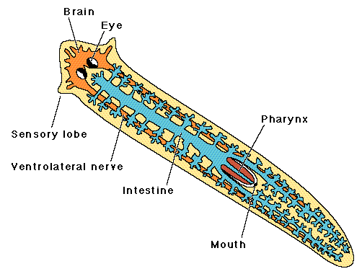
II. Flatworms
A. Characteristics
Symmetry: Bilateral symmetry
2.Exhibit cephalization (Have a “head”)

Slide 24
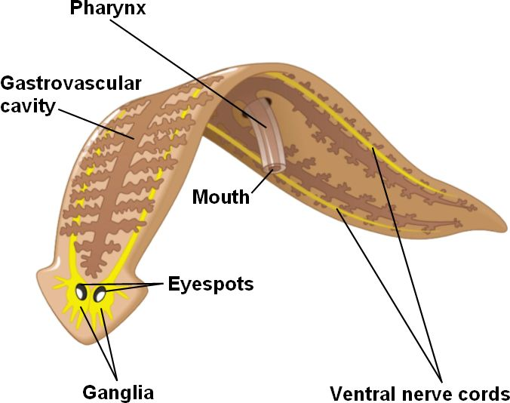
III.Form and Function in Flatworms
A. Describe how a free-living flatworm ( like
Planarian) eats:
Use their pharynx to suck food into the gastrovascular cavity

Slide 25
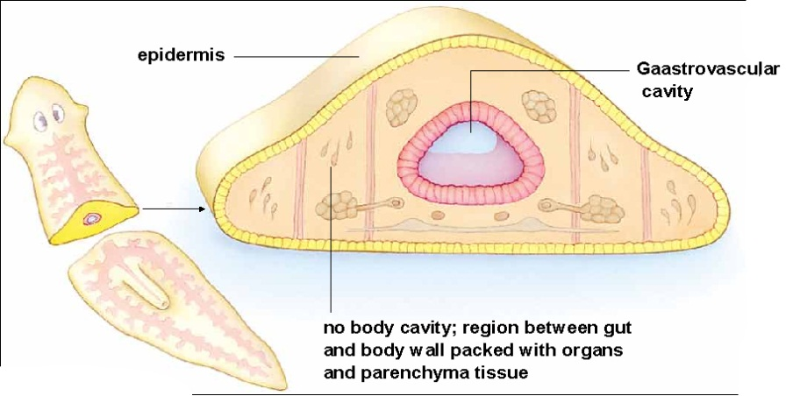
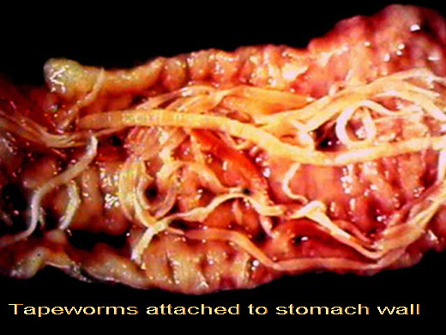
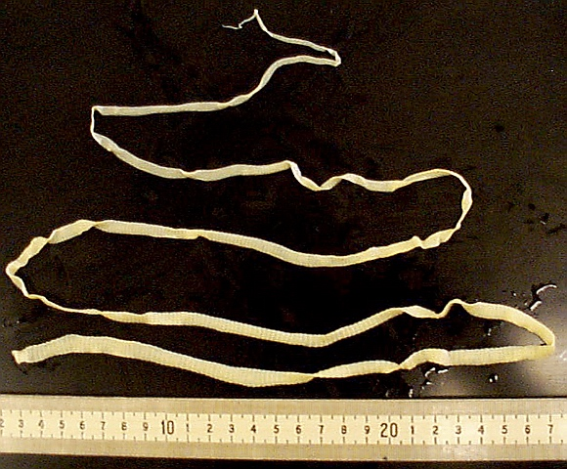
B. Why do tapeworms not have a g-v cavity?
They can absorb the predigested food in the host’s digestive tract

Slide 26
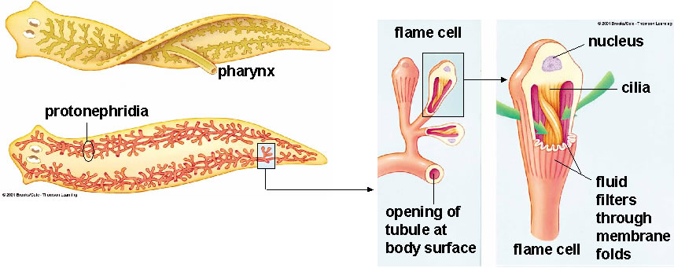
C. Circulatory and respiratory system:
1. Why do flatworms have no specialized circulatory or respiratory system?
They are able to diffuse the material into and out through their body walls.
2. What special structures do freshwater flatworms have?
Flame cells to help get rid of extra water

Slide 27
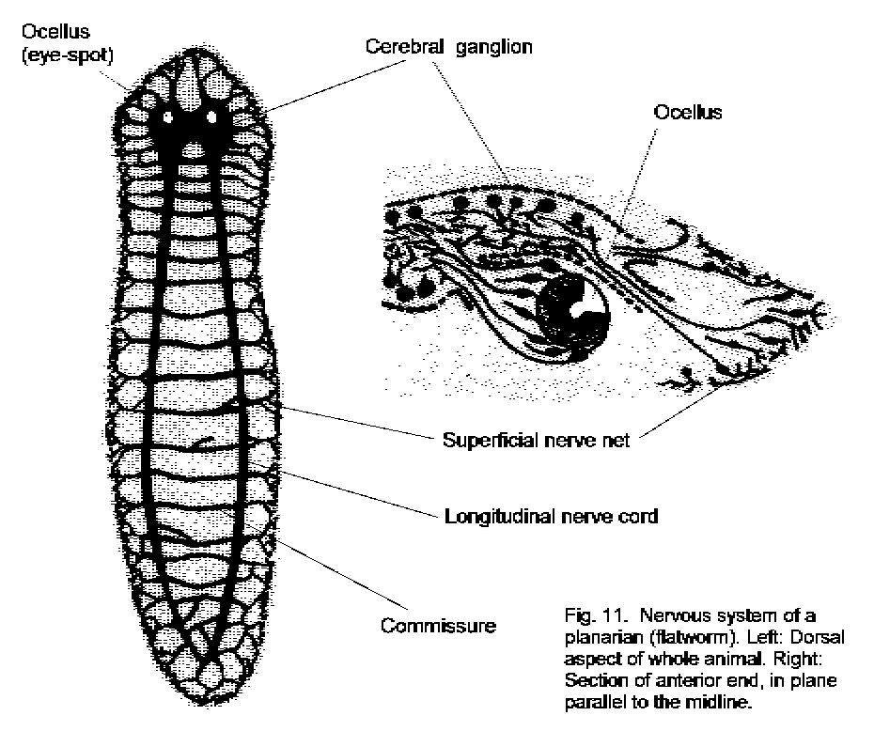
D. Nervous system
1. Brain: Located in the head
2. Nerve cord: Run from the brain down the length of the body on either side
3. Eyes: Ocelli can detect light or dark
4. Chemical sensors: Can find food and tell the direction of water flow

Slide 28
How does their nervous system help free-living flatworms?
Helps it locate food and to find dark hiding places beneath stones and logs during the day
Why do parasitic flatworms not have much of a nervous system?
Because they mainly hang onto an intestinal wall and absorb food—a much less demanding lifestyle

Slide 29
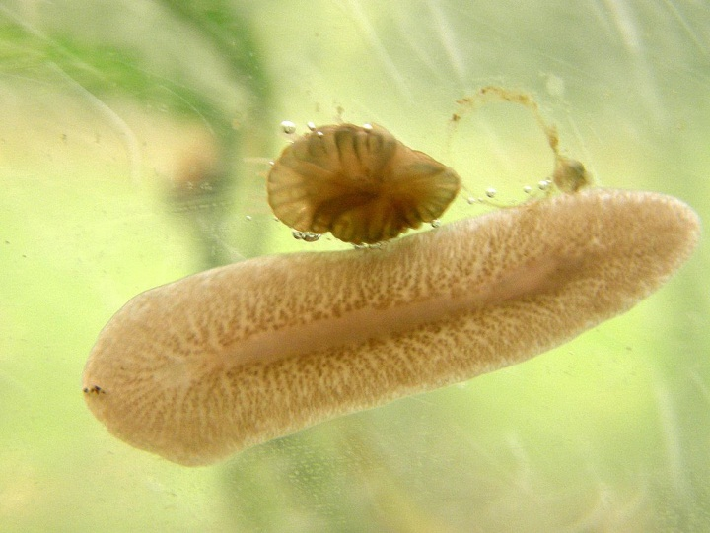
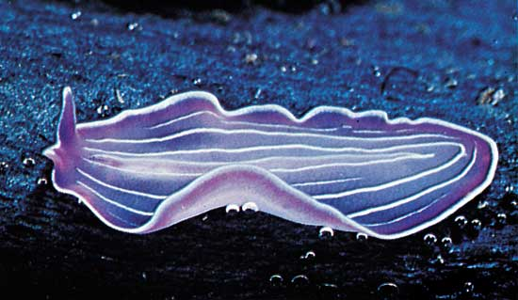
E. Locomotion
1. 2 methods of locomotion at once:
a. Cilia to help glide through the water and over the bottom
b. Muscle cells allow them to twist and turn to react rapidly

Slide 30
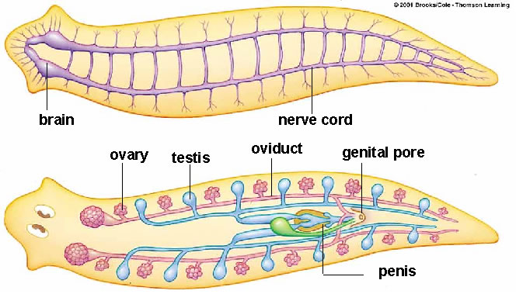
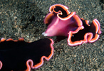
F. Reproduction
1. Hermaphrodites: Organisms has both male and female organs
2. Describe how flatworms reproduce
a) Sexually: The worms join in pairs. One worm delivers sperm to the other worm while receiving sperm from its partner at the same time. The eggs laid in small clusters, hatch within a few weeks.

Slide 31
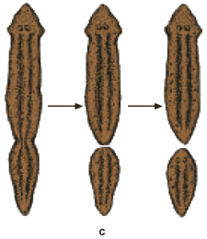
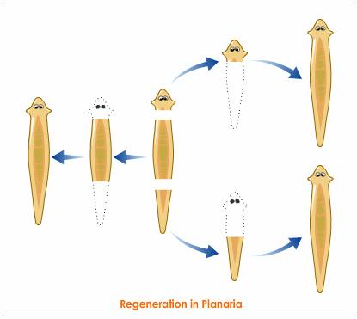
b) Asexually: Regeneration

Slide 32
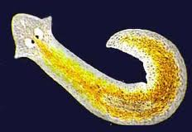
G. Planarians
1. Description: “Cross-eyed” and can vary
in color, form and size
2. Habitat: Freshwater

Slide 33
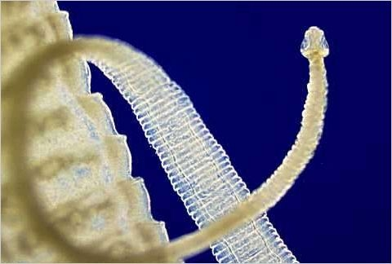
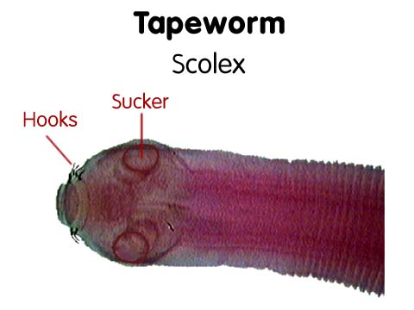
H. Tapeworms
Description: Head called a scolex on which there are several suckers and a ring of hooks
Moving tapeworm

Slide 34
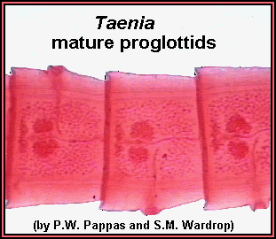
2. Reproduction
a) Proglottid: Section that makes up most of the body of the tapeworm

Slide 35
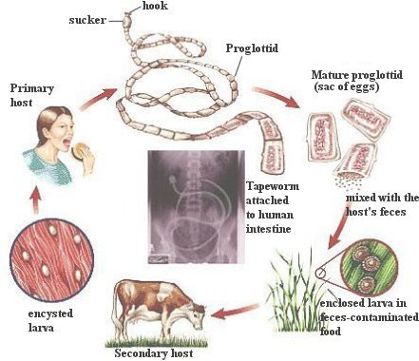
Describe how tapeworms reproduce and how their eggs get out of the host:
Sperm produced by the testes can fertilize eggs in the proglottids of other tapeworms or in the same individual. Fertilized tapeworm eggs are released when mature proglottids break off the posterior end of the tapeworm and burst open.
A mature proglottid may rupture either in the host’s intestine or after it has been passed out of the host’s body with the feces

Slide 36
Describe how tapeworm eggs get into their intermediate host and then back to a human:
If food or water contaminated with tapeworm eggs is consumed by cows, pigs, or fish, the eggs enter these intermediate hosts and there hatch into larvae. These larvae grow for a time and then burrow into the muscle tissue of the intermediate host and form a dormant protective stage called a cyst.
If a human eats raw or completely cooked meat containing these cysts, the larvae become active within the human. Once inside the intestine of the new (human) host, they latch onto the intestinal wall and grow into adult worms.

Slide 37
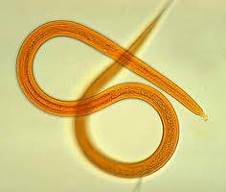
IV. Roundworms
Phylum: Nematoda
1. Simplest animals to have a digestive system with two openings - a mouth and an anus. Food enters through the mouth, and undigested food leaves through the anus.
2. Size: Microscopic to a meter in length

Slide 38
V. Form and Function in Roundworms
A. Digestive System
2 feeding methods:
a. Free-living b. Parasitic
2.Physical description of the digestive system
a. Sketch figure 26-32
b. How does digestion work in roundworms? Food enters through the mouth and continue straight through the digestive tract. Any undigested material leaves through an anus

Slide 39
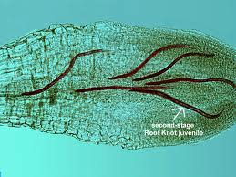
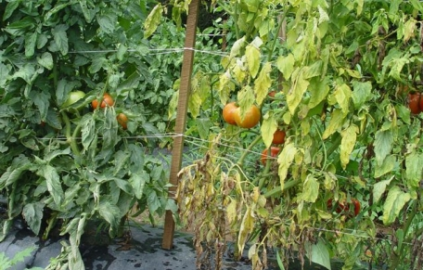
3. Food:
a. Small animals
b. Small algae, fungi or pieces of decaying organic matter
c. Bacteria and fungi that break down dead animals and plants
Plant juices
Give an example of how roundworms cause damage to plants.
Tomato plant

Slide 40
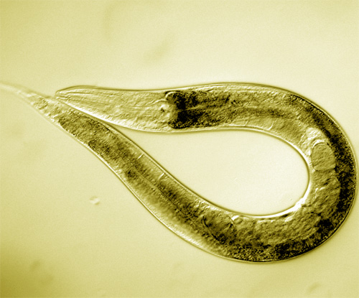
B. Circulatory and Respiratory System
1. Respiration: Diffusion through the body walls
2. Excretion: Diffusion through the body
walls

Slide 41
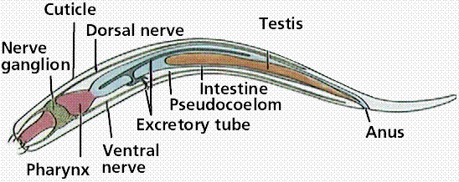
C. Nervous System
1. Brain: Several ganglia
2. Nerve cord: Several that extends from
the ganglia down the body
3. Chemical sensor: Can detect chemicals given off by prey or hosts.

Slide 42
D. Locomotion
1. Structure of muscles: Run in strips down the length of their body walls
2. Describe how roundworms move.
Aquatic roundworms contract these muscles to move like snakes through the water. Soil-dwelling roundworms push their way though the soil by thrashing around.
Roundworms in a cats intestine
Pinworm infection in children

Slide 43
E. Reproduction
1. Method: Sexually
2. Describe how roundworms reproduce.
Fertilization takes place inside the body of the female. Eggs are produced

Slide 44
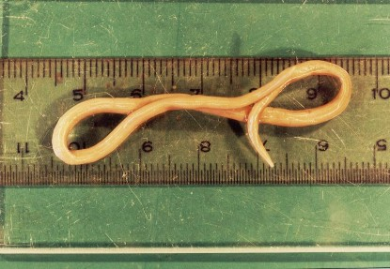
G. Ascaris
Describe how Ascaris can affect
humans.
Can live in humans!
Giant intestinal roundworms are a serious pig and human parasite in tropical areas with poor sanitation.

Slide 45
2. How does it reproduce in the human body?
The worms live in the intestines, where they produce many eggs that leave the host’s body in the feces. If food or water contaminated with these feces is eaten by another host, the eggs hatch in the small intestine of the new host. The young worms burrow into the walls of the intestines and enter surrounding blood vessels. They are carried around in the blood and end up in the lungs. Here they break out into the air passages and climb up into the throat, where they are swallowed. Carried back into the intestine, they mature and the cycle repeats.

Slide 46
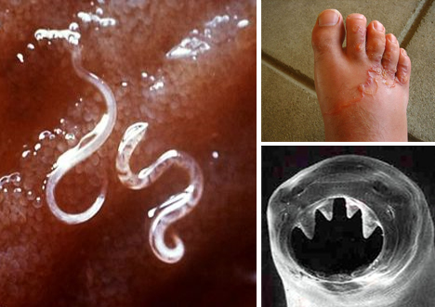
VI. How Unsegmented Worms Fit into the World
A. 4 examples of parasitic roundworms and how they affect humans:
1. Hookworms suck the blood out of the host’s intestinal wall. It can cause weakness and poor growth
2. Trichinosis burrow into organs and tissue of the host. It cause terrible pain.
3. Filarial worms can block passages of fluids in the lymph vessels. This cause elephantiasis.
4. Eye worms live and burrow through the tissue below the skin of their host. It can move across the surface of the eyes.

