Slide 1
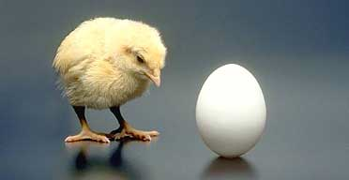
Reproduction
A hen is only an egg's way of making another egg. –Samuel Butler

Slide 2
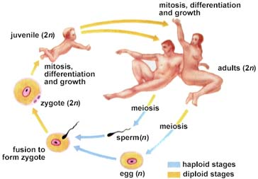
I. Humans reproduce sexually
A. Offspring carry a genetic complement from both the mother and the father
B. Results in genetic variability which is advantageous to the species
Functions of the reproductive
system:
A. Produce cells capable
of combining their
genetic information
to form a new
individual
B. Organs for bringing the cells close together so that they can fuse
C. Provide a place for the new individual to develop into a viable human being
D. Hormones required for coordination

Slide 3
Female Reproductive System
I. Overview
A. Main functions:
1. Produce a haploid female gamete
(EGG/OVUM)
2. Provide a place to receive the male gamete
3. Provide a place for fertilization
4. Provide a place for growth of the offspring

Slide 4
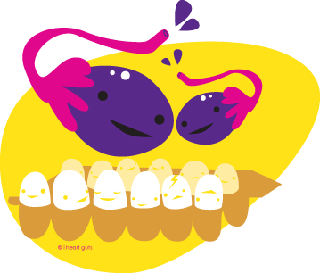
A. Ovaries
1. Two egg-shaped on each side of uterus in the pelvic abdominal cavity
a. Each measures 3 cm by 1 cm
b. Held in place by ligaments to oviduct and uterus
2. Produce eggs from follicles
a. Follicles contain oocyte and follicle cells
i. Born with 2 million follicles
ii. Reduced to 350,000 – 400,000 at
puberty
iii. About 400 eggs mature during the
reproductive years
b. Oogenesis is the process of forming an egg
i. Cell that will form the egg undergoes meiosis to form two haploid (1n) cells
ii. One of these develops into an egg and the other into a polar body
iii. Each undergo a second division
iv. Polar body forms two polar bodies while the egg forms the egg and another polar body

Slide 5
c. OVULATION occurs when an egg bursts from an ovary
Note: This figure represents the sequences in 1 complete cycle (28 days), all these parts
are not present at any one time
3. Produces sex hormones
a. Estrogen (from follicles)
b. Progesterone (from corpus luteum)

Slide 6
Fallopian tubes/Oviducts
1. Connected to uterus and lie close to ovaries
2. Lined with cilia and surrounded by circular muscles
3. Sweep up eggs from ovary using cilia lining and wafting fimbria at end of oviducts
4. Functions:
a. Site of
FERTILIZATION
i. Sperm meets
and fertilize
an ovum
ii. Ectopic
pregnancy is
any implantation
outside central body of uterus
iii. Tubular pregnancies occur when embryo
implants in the oviduct
b. Propels the egg towards the uterus
C. Fimbria
1. Fingerlike projections on the tubes at the ovary end that helps catch the egg when it is release

Slide 7
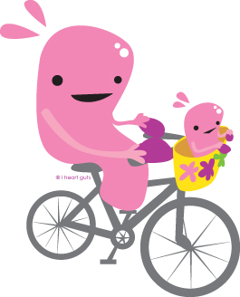
D. Uterus/Womb
1. Thick-walled muscular, hollow, pear-shaped organ
2. Size and shape of an inverted, flattened pear
3. Lies above and slants forward over the bladder
4. Can stretches from 5 cm wide to over 30 cm with a growing baby
5. Lined with a layer called the ENDOMETRIUM
a. Endometrium is composed of:
i. Connective tissue
ii. Highly vascularized
iii. Glands that lubricate the uterus
b. Endometrium has a basal layer and a functional layer that varies with the uterine cycle
c. Forms the placenta during pregnancy
6. Myometrium is a muscular layer that is used to expel the fetus when birth occurs
7. A HYSTERECTOMY is the surgical removal of the uterus
8. Uterus is the site of nurturing the developing embryo

Slide 8
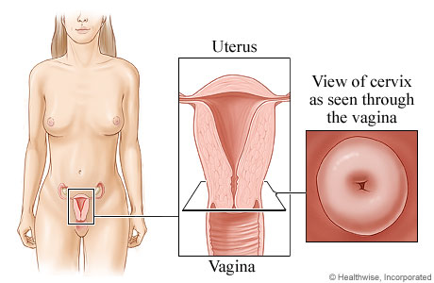
E. Cervix
1. Located at back of vaginal canal
2. Contains the entrance to the uterus
3. Functions:
a. Provides a path for sperm to swim through
b. Produces mucin strands to facilitate sperm movement
c. Holds the fetus in the uterus
d. During pregnancy, is closed off by a mucus plug

Slide 9
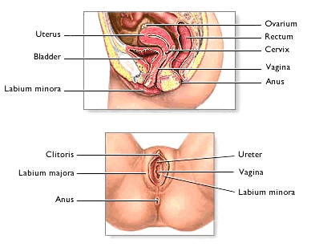
F. Vagina/Birth Canal
1. Muscular tube with mucosa lining
2. Makes 45º degree angle with small of back
3. Leads to the exterior from the cervix
4. Functions:
a. Provides a receptacle for the male's penis
i. Vaginal walls contain tissue that is erectile and will form closely to the penis during intercourse
ii. This close fit will cause tactile stimulation of the glans to ensure ejaculation and deposition of the sperm at the cervix
        Serves as the birth canal during childbirth

Slide 10
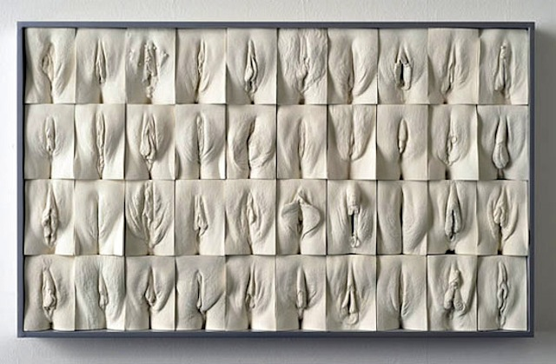
G. Vulva
1. External genitals
2. MONS PUBIS is the fatty prominence under the pubic hair
3. Labia are the two sets of skin folds
a. LABIA MAJORA are the outermost pair of fat- padded skin folds
b. LABIA MINORA are the smaller pair of skin folds enclosed within the labia majora
H. Clitoris
1. Located above the
labia minora
2. Equivalent to the
glans of the penis
3. Consists of erectile
tissue and has
many nerves going
to it
4. Tactile stimulation
of the clitoris
results in the
female orgasm Link

Slide 11
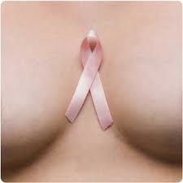
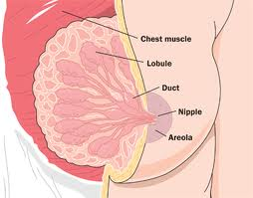
I. Hymen
1. A ring of tissue that may partially close the vaginal opening
2. If unbroken as a child it is broken by the first sexual intercourse
H. Breasts
1. Develops under hormonal control
2. Most breast tissue in non-lactating women is adipose (fat) tissue
3. Amount of glandular tissue is about the same in all females

Slide 12
The Female Hormones
Anterior Pituitary
A. Makes 2 Gonadotrophic hormones that act on ovaries
1. FSH - Follicle Stimulating Hormone
a. Stimulates the follicle to mature and cause it to produce estrogen
2. LH - Leutinizing Hormone
a. Maintains the corpus luteum and causes it to produce progesterone
Regulates the ovary's production of female sex hormones
Ovary
A. Makes 2 hormones that act on the endometrium
1. Estrogen
a. Made by the follicle
b. Stimulates:
i. Growth of uterus and vagina
ii. Secondary sex characteristics (body hair/fat distribution, increased pelvic girdle, breasts)
iii. Egg maturation
iv. Endometrium thickening
2. Progesterone
a. Made by the corpus luteum
b. Causes endometrial glands to mature

Slide 13
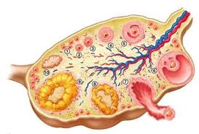
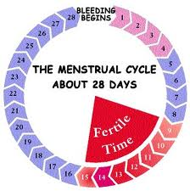
The Female Cycles
I. Cycles and Phases
A. Ovarian cycle (ovaries point of
view)
1. Follicular phase
(before ovulation)
2. Luteal phase (after
ovulation)
B. Uterine (Menstrual) cycle (uterus’ point of view)
1. Menstruation
2. Proliferative phase (after menstruation but before ovulation)
3. Secretory phase (after ovulation)
II. Menstruation
A. Menstrual cycle about 28 days
B. Day 1 is first day of menstruation
C. During menstruation, some of the
uterine lining, plus a small amount of blood, is released through the vagina
D. Endometrium is the thinnest at this point

Slide 14
III.Ovarian cycle Animation
A. Days 1-13 (follicular phase)
1. Day 1-5
a. Low levels of female hormones detected by the hypothalamus, causes it to release GnRH
b. GnRH is sent to the anterior pituitary gland
c. Anterior pituitary gland releases FSH and LH
2. Day 6 –13
a. A follicle matures with increasing FSH
b. Follicle begins to secrete ESTROGEN
c. As estrogen levels rise, this causes the release of more GnRH, which causes the release of more LH (positive feedback loop)
d. Estrogen will
i. Inhibit FSH production
ii. Stimulate LH production
iii. Cause thickening of uterine lining
e. High levels of estrogen cause the hypothalamus to release a large amount of GnRH, which cause the release of a large amount of LH from the pituitary on day 13
f. This “LH surge” causes ovulation

Slide 15
B. Day 14 (ovulation)
1. Mature follicle ruptures and releases the egg from the ovary
2. Follicle cells staying behind are called the corpus luteum
C. Day 15-28 (luteal phase)
1. Corpus luteum (under the influence of LH) secretes estrogen and progesterone
2. Estrogen and progesterone will inhibit FSH production and affect the uterus
3. Progesterone inhibits LH production
4. Progesterone levels controlled by a negative feedback loop
a. When progesterone levels reach their highest levels, negative feedback to the anterior pituitary gland causes the release of less LH
b. Corpus luteum requires high levels of LH to maintain itself
c. As LH levels drop, the corpus luteum begins to degenerate
d. As the corpus luteum degenerates, it makes less progesterone and estrogen
5. Without high levels of progesterone,
a. Uterine lining will not be maintained and is lost
b. FSH is not inhibited and levels will rise causing a new follicle to develop
c. Cycle begins again!

Slide 16
IV. Uterine (Menstrual) Cycle Animation
A. Days 1-5
1. Low level of estrogen and progesterone
2. Thickened uterine lining degenerates and is shed in menstruation
B. Days 6-13
1. Estrogen (from follicle) is increasing
which causes a thickening of the endometrium
2. Increase vascularization and mucus glands in the lining (“proliferate phase”)
C. Day 14
1. Ovulation: follicle becomes corpus luteum
D. Day 15-28
1. Increased levels of progesterone causes endometrium to double its thickness
2. Mucus glands begin secreting a thick, mucus material (“secretory phase”)
3. Endometrium is ready to receive fertilized egg (zygote)
E. Normally
1. Egg is not fertilized therefore corpus luteum begins to degenerate therefore progesterone falls
2. Low progesterone and estrogen cause endometrium to be shed

Slide 17
Male Reproductive Structures
I. Overview
A. Main functions:
1. Produce a haploid male gamete (sperm)
2. Deposit sperm in the female so fertilization may occur

Slide 18
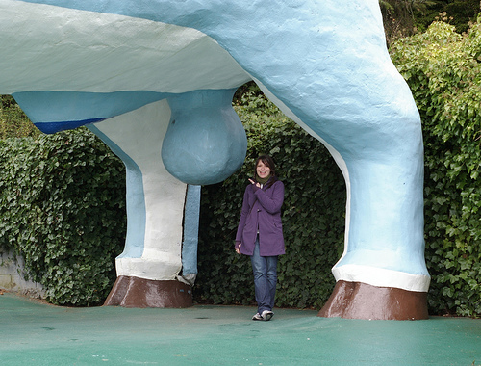
A. Scrotum
1. Muscular pouch that holds the testes
outside of the body cavity
2. Spermatogenesis occurs optimally a few degrees less than internal body temperature
3. Muscular scrotum aids in temperature control for the testes
a. At high temperatures, testes will be lowered by the scrotum relaxing to cool by increased air circulation and increased sweat production which will cool the scrotum through evaporation

Slide 19
B. Testes (1)
1. Pair of organs that develop from gonads within abdomen of fetus
a. Descend through a canal into scrotal sacs during the last 2 months of fetal development
2. Located outside the abdominal cavity in the scrotum
3. Contains sections called lobules
a. Each has many coiled SEMINIFEROUS TUBULES
b. Total length of 250 meters
4. SPERMATOGENESIS is development of sperm
a. Involves meiosis
b. Produce about 300 million
sperm per day
c. Starts at puberty and stops at
death
d. New sperm are constantly
being produced in males
e. Takes about 9 or 10 weeks

Slide 20
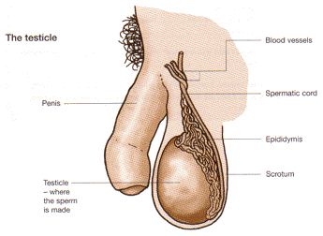
f. Occurs inside the seminiferous tubules
g. SERTOLI CELLS, inside the seminiferous tubules nourish the developing sperm cells and regulate the cells that generate sperm cells
5. INTERSTITIAL CELLS lie in the area of the testis between the seminiferous tubules
a. Produce male sex hormones
i. Testosterone
ii. Androgens
C. Epididymis (2)
1. Area where seminiferous tubules join to a highly convoluted tube lying on top of and down the side of the testis
2. Area where sperm mature

Slide 21
D. Vas Deferens (3)
1. Sperm stored here
2. Long tube from epididymis to urethra
E. Seminal Vesicles (6)
1. 2 small glands
2. Joins vas deferens at the base of the bladder
3. Makes most of the seminal fluid
a. High in fructose which is a nutrient for sperm
b. Prostaglandins which is a hormone that causes contractions of the vagina to help move sperm
F. Prostate Gland (5)
1. Donut shaped gland that surround the urethra at the union of the vas deferens and the urethra
2. Makes 1/3 of the seminal fluid
a. Alkaline secretions that aids sperm motility and survival because it helps to neutralize the acidic environment in the vagina
3. Prostate gland enlargement is common in older men
4. It can constrict the urethra and makes urination difficult
5. Prostate cancer is 3rd largest cancer killer of men

Slide 22
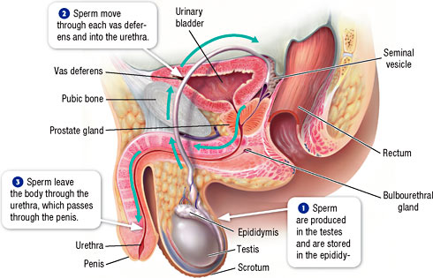
G. Bulbourethral Glands/Cowper's glands
1. 2 small glands
2. Located below the prostrate
3. Makes a small part of the seminal fluid
a. Secretes mucus that lubricates and readies the urethra prior to ejaculation
b. Secretes alkaline fluid to neutralize urine in urethra
H. Urethra (7)
1. Functions:
a. Exit for
the urine
b. Exit for semen
c. Cannot do both at the same time
2. Semen is expelled out of urethra by rhythmic muscular contractions → male orgasm

Slide 23
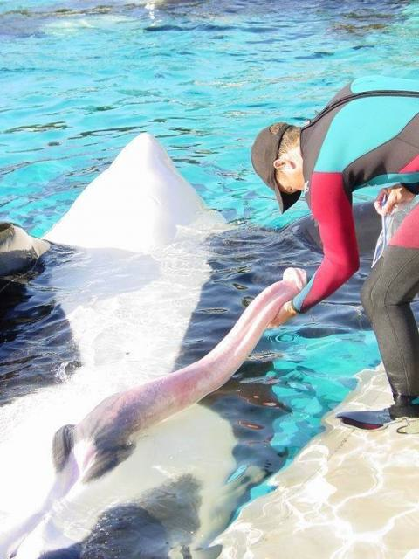
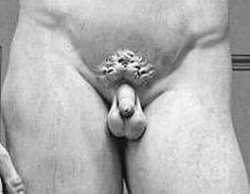
I. Penis (8)
1. A cylindrical-shaped organ that hangs in front of scrotum
2. Spongy tissue inside shaft of penis is flaccid (soft) with normal blood flow in the penis
3. ERECTION occurs from increased blood flow filling spongy
tissue
4. Penis needs to be erect and hard to allow semen to be deposited in the vagina near the cervix
5. IMPOTENCY is failure to become
erect

Slide 24
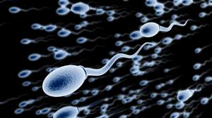
I. Path of Sperm
A. Testes
B. Epididymis
C. Ductus (vas) deferens
D. Prostate Gland
E. Urethra
II. Process of Ejaculation
A. EJACULATION is a process in which semen is forced from the penis
B. Sexual arousal can cause an erection
1. Penile artery will dilate and there will be more blood entering the spongy tissue of the penis
2. Penile vein will be forced shut and the blood entering the penis will engorge the tissue causing an erection and allowing insertion of the penis into the female's
vagina
3. Average length of flaccid (relaxed state) penis is about 8 cm
4. Average length of erect penis is about 13 cm

Slide 25
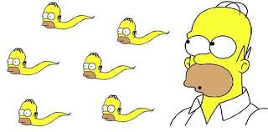
C. Tactile stimulation of the glans of the penis results in nerves to the ductus deferens, glands and the urethra being stimulated
D. These will all cause muscular contractions and ejaculation to occur
1. Sperm enters the ejaculatory duct
2. Seminal vesicles, prostate gland, and Cowper's gland release their secretions
E. Penis able to deposit the sperm at the cervix so that it has a shorter journey to the egg
F. Following orgasm and ejaculation the penile artery will constrict so that the blood flow exiting the penis is greater than that entering the penis and the organ returns to it flaccid state
G. “Refractory period” is typical time following ejaculation during which erection cannot occur
1. Time tends to increase as a man ages

Slide 26
Functions of Seminal Fluid
I. Seminal Fluid
A. Thick, whitish fluid SECRETIONS from three organs
1. SEMINAL VESICLES
2. PROSTATE GLAND
3. BULBOURETHRAL GLANDS
(COWPER'S Glands)
II. Semen
A. SEMINAL FLUID and SPERM
B. Passed out of the penis during ejaculation
C. Average about 20–150 million sperm per milliliter
D. 1.0–6.5 milliliters (mL) per ejaculation
E. Contains
1. Basic fluids
2. Fructose (sugar)
3. Prostaglandins
III. Functions
A. Lubricate the vagina
B. Provide energy for swimming sperm (fructose)
C. Stimulate mild contractions of the vagina (prostaglandins)
D. Buffers to counteract acidity in vagina

Slide 27
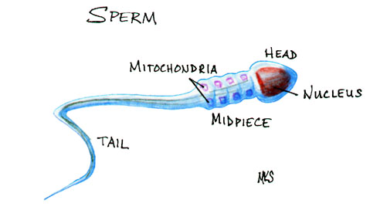
Sperm Consists of 3 Regions
A. Head
1. Includes the1N nucleus for fertilization and the ACROSOME
2. Acrosome
a. An aggregation of lysosomes from the original cell
b. Allows for penetration of the eggs membrane for fertilization to occur
B. Middle piece
1. Has a concentration of mitochondria
2. Powers the tail region
3. Glucose (from seminal vesicle secretions) will allow the mitochondria to produce ATP to power the tail of the sperm
C. Tail
1. To propel the sperm up through the cervix, uterus and oviduct to the site of fertilization
2. Has the same structure as a flagella 9 + 2 microtubule arrangement

Slide 28
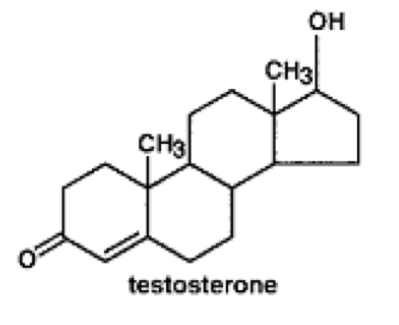
D. Normal male releases over 100 million sperm per ejaculation
E. Fewer than 100 reach vicinity of egg
F. Only one sperm can fertilize an egg
G. Egg is actually 100,000 times larger than a sperm
Functions of Testosterone
I. Testosterone
A. Is the major sex hormone of the male
II. Functions
A. Promotes normal development and function of primary male sexual organs
1. High levels of testosterone in puberty stimulate the maturation of the penis and testes
B. Causes development of secondary sexual characteristics during
puberty
1. Second hair (facial hair, pubic etc.)
2. Deepens voice
3. Greater muscle growth
C. Development of sperm
1. FSH causes spermatogenic cells in testes to take up testosterone
2. Causes these cells to produce sperm

Slide 29
D. Increases secretions from oil and sweat glands
1. Contributes to acne and body odor
E. Contributes to male pattern baldness
F. Related to aggressiveness and aggressive behavior
G. Related to sex drive
H. Athletes use testosterone and other anabolic steroids to artificially boost their body’s natural male hormone levels because testosterone causes an increase in muscle mass
I. Many negative side effects of anabolic steroids:

Slide 30
Control of Testosterone
I. Control of Testosterone
A. Interaction of hormones maintains fairly constant production of sperm and testosterone.
1. Four hormones involved
a. GONADOTROPIC-RELEASING HORMONE (GnRH)
b. FOLLICLE-STIMULATING HORMONE (FSH)
c. LUTEINIZING HORMONE (LH)
(also called INTERSTITIAL CELL- STIMULATING HORMONE - ICSH)
d. INHIBIN
B. Hypothalamus ultimately controls testes by secreting gonadotropic-releasing hormone (GnRH)
C. GnRH triggers anterior pituitary to produce two hormones
1. Follicle-stimulating hormone (FSH)
a. Released by the anterior pituitary
b. Promotes spermatogenesis in seminiferous
tubules
i. Does this by entering the Sertoli cells and causing them to take up more testosterone

Slide 31
ii. This in, turn, enhances sperm
production
c. Sertoli cells in the seminiferous tubules also release hormone inhibin as sperm is made
i. More sperm made, more inhibin released
ii. Inhibin travels in the blood and is detected by the hypothalamus and anterior pituitary gland
iii. Inhibin levels in the blood are the keep track of sperm levels
iv. As inhibin (and therefore sperm) levels rise, hypothalamus reduces the release of GnRH.
v. With less GnRH, the anterior pituitary to reduces FSH, which reduces the amount of sperm and inhibin being released
vi. Negative feedback cycle!

Slide 32
2. Luteinizing hormone (LH)/Interstitial cell- stimulating hormone (ICSH)
a. Controls production of testosterone by interstitial cells
b. LH causes increased testosterone levels in the
blood
i. High levels of testosterone is detected by the hypothalamus
ii. Hypothalamus reduces its release of GnRH
iii. Anterior pituitary reduces LH
iv. Less LH cause less testosterone to be produce
v. Another negative feedback loop!

Slide 33
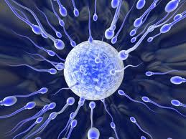
Implantation
I. Fertilization
A. Several hundred sperm might make it to the egg, only one will fertilize the egg
B. Acrosome releases its enzymes which break through the outer layer of the egg
C. Plasma membranes of the egg and sperm fuse, and the nucleus from the sperm enters the egg
D. Sperm nucleus fuses with the egg nucleus
E. New individual is called a zygote
II. Implantation
A. Fertilized egg develops as travels
down oviduct to uterus
B. Fertilized egg attaches to
endometrium (implantation)
several days after fertilization

Slide 34
C. Developing offspring needs to grow in the uterus undisturbed, the menstrual cycle must be interrupted for 9 months
1. Hormones are produced by the zygote to prevent menstruation
a. HCG - Human Chorionic Gonadotrophin
i. Maintains the corpus luteum, which continues to produce estrogen which prevents the endometrium from
shedding
ii. Pregnancy test uses monoclonal antibodies to test for this hormone iii. Corpus luteum persists for 3 - 6
months
D. Placenta forms from both maternal and fetal tissues
1. Provides exchange of molecules between fetal and maternal blood
2. Continues production of HCG, and also produces progesterone and estrogen
i. Higher levels of these 2 hormones shut of release of FSH from anterior pituitary preventing ovulation and maintaining the endometrium
ii. Birth control pill does this too

Slide 35
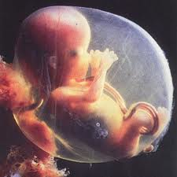
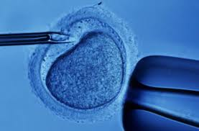
III. In Vitro Fertilization
A. Where the egg is removed from the mother by means of laparoscopy and fertilized by the male’s sperm which has been collected
B. Egg and sperm are mixed and the egg is cultured for a few days and then implanted into the uterus
Pregnancy and Oxytocin
I. Fetus
A. Fetus rotates with head pointed toward cervix
B. If not in position, breech birth (rump first) may require Cesarean section
C. End of ninth month, the fetus averages:
1. Length: 525 mm (20 inches)
2. Weight: 3,380 grams (7.5 pounds)

Slide 36
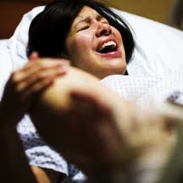
II. Labour
A. Mild, indiscernible contractions occur throughout pregnancy
B. Contractions become stronger and more frequent near end of pregnancy
C. labor involves contractions lasting over 40 seconds occurring every 15 - 20 minutes
D. Trigger of childbirth involves prostaglandins and oxytocin (though we don't have all the details worked out yet) from mother's pituitary

Slide 37
III.Oxytocin
A. A hormone made in the hypothalamus
B. Stored in the posterior pituitary gland
C. Functions:
1. Causes the uterus to contract
2. Used to artificially induce labour
3. Stimulates the release of milk from the mammary glands for nursing
D. Controlled by a positive feedback system
1. In a positive feedback system, the level of the hormone in the blood feeds back to the posterior pituitary and increases release of Oxytocin
2. Just before birth, the growing baby's head exerts pressure against the cervix
3. This pressure triggers sensory nerves in the cervix to send a nerve signal to the posterior pituitary to release oxytocin
4. The oxytocin is released into the blood

Slide 38
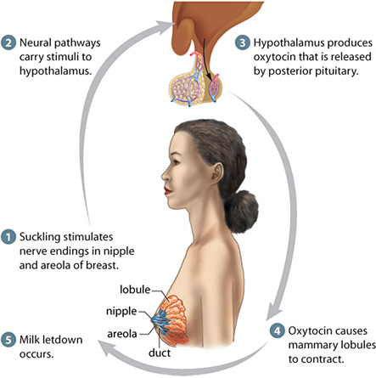

Slide 39
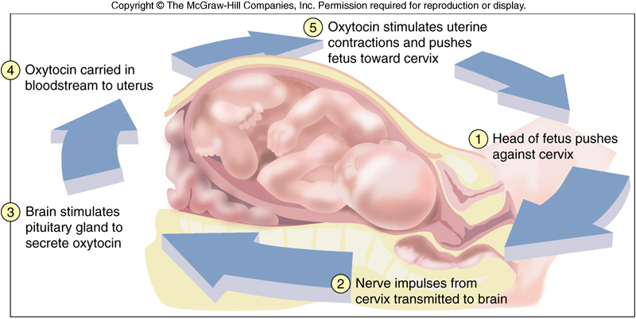
5. When it gets to the uterus, it causes stronger uterine contractions, which causes greater stimulation of the sensory nerves, which causes more oxytocin to be released, which causes stronger uterine contractions, and so
on
6. The cycle ends when the baby is pushed out of the uterus, stopping the stimulation of sensory nerves to the pituitary
7. A positive feedback system is unstable and does not lead to homeostasis
IV. Childbirth (called Parturition)
A. Childbirth includes labor and expulsion of fetus

Slide 40
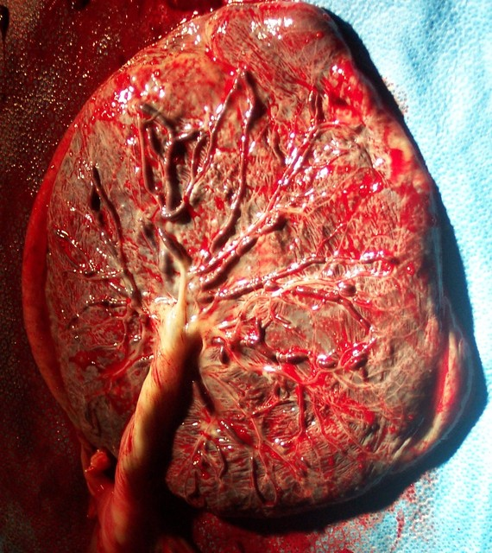
B. Three stages Movie
1. Stage 1
a. Cervix dilates
b. Mucus plug from cervical canal is expelled
c. Amniotic membrane ruptures to release amniotic fluid ("water" breaks)
d. Stage ends when cervix is fully dilated
2. Stage 2
a. Baby emerges from uterine contractions that occur every 1 - 2 minutes lasting one minute each
b. If vagina cannot expand enough, an episiotomy is performed and baby is born
c. Umbilical cord is cut, shriveling and leaving scar that becomes navel
3. Stage 3
a. Placenta (afterbirth) is expelled from uterus about 15 minutes after delivery of baby

Slide 42

V. Breasts
A. Produce milk
B. Contains one to two dozen lobules, each with many mammary ducts that end in blind sacs called alveoli
C. Areola (pigmented area of nipple) lacks hair and sweat glands but has saliva-resistant lubricant
D. Prolactin hormone:
1. Stimulates alveoli to produce milk
2. Feedback inhibition suppresses milk production during pregnancy
E. During couple of days after childbirth and before milk production is underway, a watery, yellowish- white fluid termed COLOSTRUM is secreted
1. Contains more protein and less fat

Slide 43
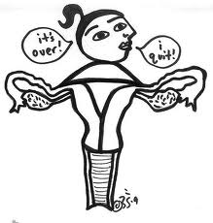
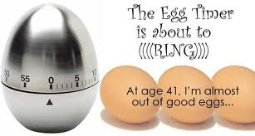
VI. Menopause
A. Ovarian and uterine cycles cease
B. Occurs when the ovaries do not respond to FSH and LH
C. Stop producing estrogen and progesterone
D. Occurs between ages 45 and 55
E. Menstruation becomes irregular
1. Menopause completed after one year of no menstrual
cycle
2. Highly variable symptoms include:
a. "hot flashes" from irregular circulation
b. dizziness
c. headaches
d. depression
e. either insomnia or sleepiness
f. Increased sex drive due to androgens produced by adrenal
cortex
g. ...or no
symptoms
at all!

