Slide 1
1. Moved by carrier proteins in the cell membrane
2. Are highly specific - each carrier passes only one type molecule
3. Allows for the movement of certain molecules that are not normally able to pass through the lipid membrane
4. Examples: Sugars, amino acids, etc.
5. Movement of certain molecules goes with the concentration gradient (i.e. in the same as diffusion)
6. Moves molecules from area of higher concentration to area of lower concentration.
7. No energy is needed

Slide 2
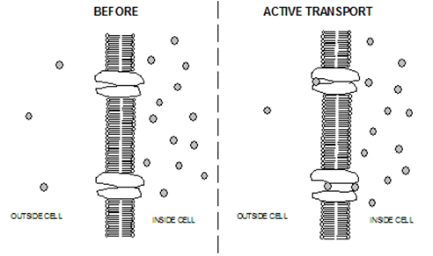
B. Active Transport

Slide 3
1. Also moved by carriers proteins in the cell membrane
2. Movement of certain molecules goes against the concentration gradient (i.e. in the opposite direction of diffusion).
3. Moves molecules from area of lower concentration to area of higher concentration
4. Requires energy (ATP) and carrier proteins in the cell membrane
5. Important in nerve cells and others

Slide 4
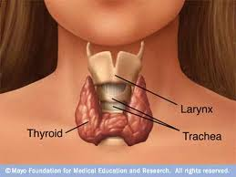
Active Transport is vitally important to organisms
a. Iodine & Thyroid Gland
i. [I+] is low in blood, high in Thyroid Gland
Active transport moves I+ from blood to thyroid
(The thyroid produces hormones involved in
metabolism)
b. Na+ is actively transported out of urine by kidney tubule cells

Slide 5
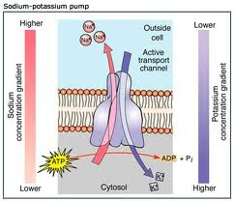
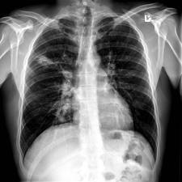
c. Sodium/potassium pump in nerve/muscle cells
Moves Na+ from inside to outside of cell and K+ from outside to inside
d. Cystic fibrosis
i. Genetic disease
ii. Usually fatal
iii. Caused by blockage of Cl- transport channels
Animation

Slide 6
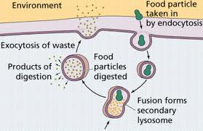
V. Endocytosis and Exocytosis
Another way to get molecules, especially large particles, in and out of cell
B. Uses energy

Slide 7
C. Endocytosis: ("Endo" means "in")
1. The taking in of molecules or particles by invagination of the cell membrane forming a vesicle
2. Phagocytosis
a. Large particles
b. Visible with light microscope
c. Examples: White blood cells, amoeba

Slide 8
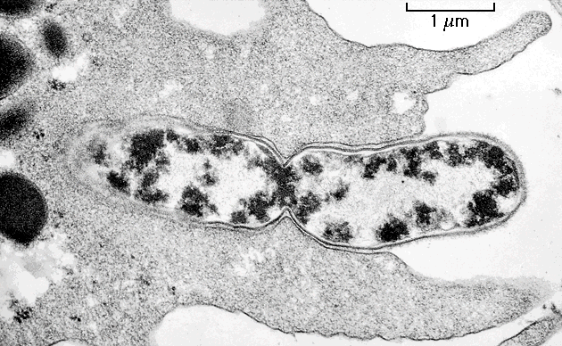

Slide 9
3. Pinocytosis (“Cell drinking”)
a. Smaller particles
b. Visible with an electron microscope
c. Ex. Intestine cells

Slide 10
D. Exocytosis: ("Exo" means "out")
Reverse of endocytosis
Vacuole/vesicle within cell fuses with cell membrane and the vacuole contents are deposited on the outside
Important in secretion and excretion in cells
4. Ex. Waste from Amoeba, cell products from Golgi Apparatus

Slide 11
