Slide 1
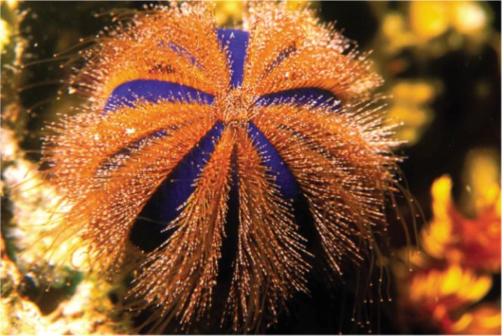
29-1 Echinoderms

Slide 2
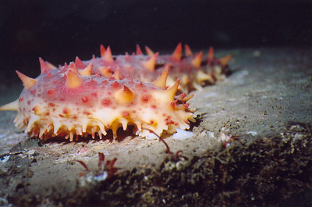
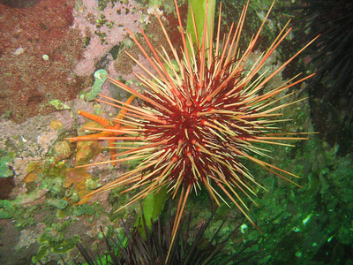
I. Echinoderms
A. Origin of the Phylum name Echinodermata
1. echino = Spiny; dermis = Skin

Slide 3
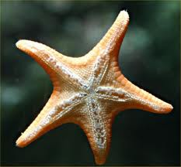
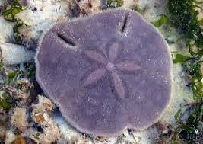
II. What is a Echinoderm?
A. Characteristics of Phylum Echinodermata
1. Spiny skin
2. Five-part radial symmetry

Slide 4
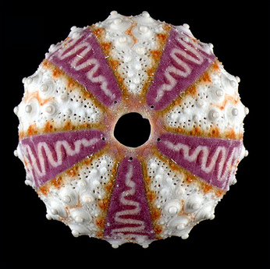
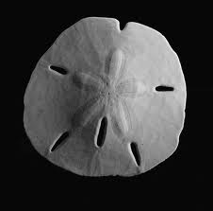
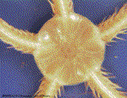
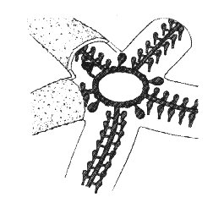
Internal skeleton
4. Water vascular system
The water vascular system is a complex series of tubes and bladders, used like a hydraulic pump. Water is pumped up through the madreporite (a small hole on the ventral surface) and pumps water into the central disc and into the arms.
The water vascular system extends to the tube feet which use this hydraulic system to suction things for movement along surfaces and for feeding.

Slide 5
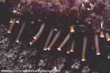
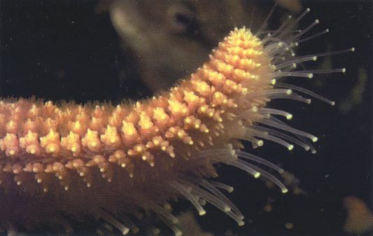
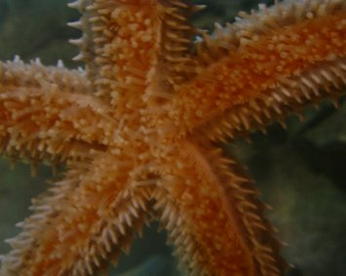
Suction-cuplike structures (tube feet)
6. Skeleton made of calcium carbonate

Slide 6
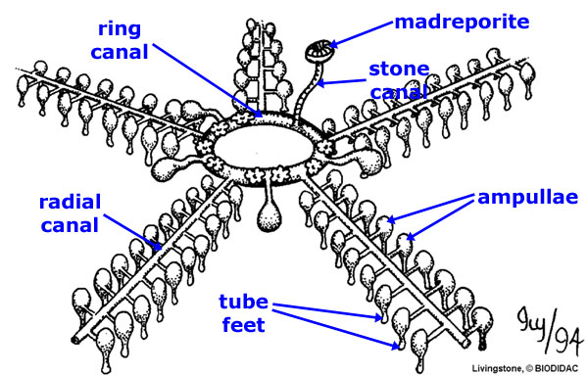
B. Water vascular system
Description: internal network of fluid-filled canals connected to external appendages called tube feet
2. Water vascular system is involved in 5
essential life functions:
a) Feeding
b) Respiration
c) Internal transport
d) Elimination of waste products
e) Movement

Slide 7
C. What do Echinoderms have in common with vertebrates?
Go through similar developmental stages as vertebrates
2. Internal skeleton

Slide 8
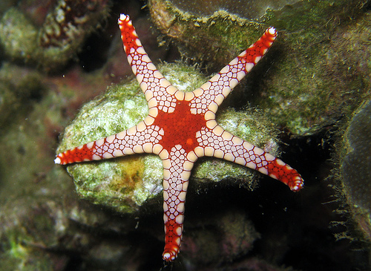
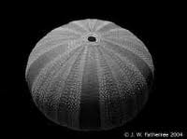
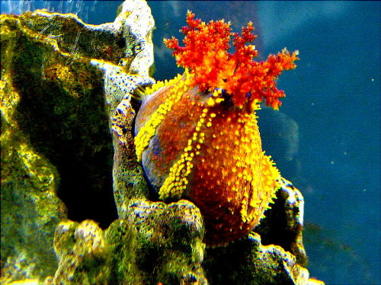
III.Form and Function in Echinoderms
A. Body Plan: five parts organized
symmetrically around a center (“pentaradial”)
1. No anterior nor a posterior end and no brain
2. But, most are two sided
a) Mouth is located on oral surface, opposite side is called the aboral surface

Slide 9
B. All echinoderms have a water vascular system
Opens to outside through a madreporite
2. In starfish:
Madreporite connects to a tube called the ring canal
b) From the ring canal, 5 radial canals extend into each arm
Attached to each radial canal are hundreds of movable tube feet

Slide 10
System operates like a series of living hydraulic pumps:
a) When water is pushed into a tube foot, the tube foot expands
b) When water is pulled out, the cup on the end of the tube foot shrinks, creating a partial vacuum that holds on
c) One tube foot cannot accomplish much, but hundreds acting together create enormous force

Slide 11
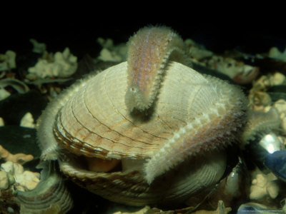
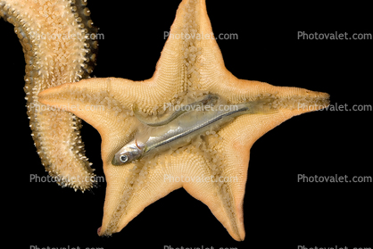
D. Feeding
1. Describe how starfish feed
Use their tube feet to pry open the shells of bivalve mollusks. Once the shell is opened, the starfish flips its stomach out of its mouth, pours out enzymes, and digest its prey in the prey’s own shell. When the starfish has finished eating, it retracts stomach back through mouth

Slide 12
E. Respiration
1. Most species use tissue of thin -walled tube feet
Others (e.g. starfish) have small outgrowths called skin gills
F. Internal transport
Nutrient distribution done by digestive glands and fluid in body cavity
G. Excretion
1. Solid wastes released through anus
2. Ammonia excreted by tube feet & skin gills

Slide 13
H. Response
1. Most echinoderms have a nerve ring that
surrounds the mouth and radial nerves that connect the ring with the body sections
2. Scattered sensory cells detect food
3. Starfish have clusters of light-sensitive
cells called eyespots at arm tips
4. Statocysts tell if organism is right side up

Slide 14
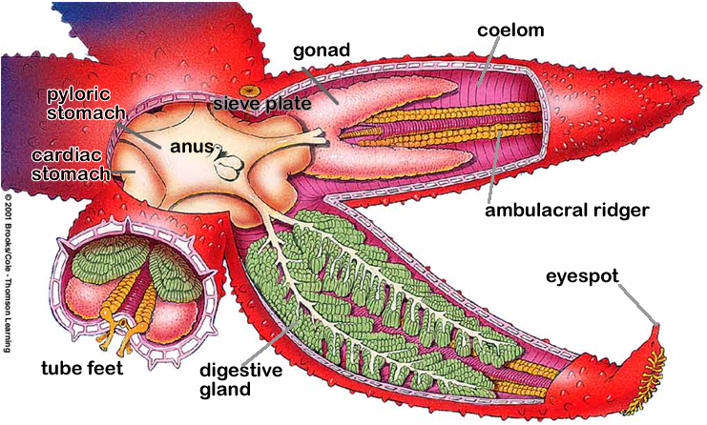
J. Reproduction
1. Most echinoderms are male or female
2. Egg and sperm are released in the water when other eggs and sperms are detected so fertilization occurs in open water
3. Larvae swims in the plankton community until they mature and metamorphose into adults at the bottom of the ocean

Slide 15
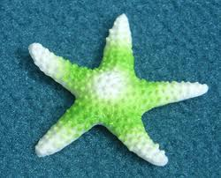
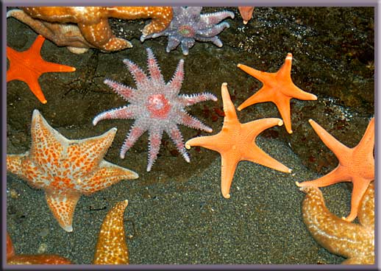
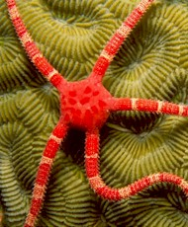
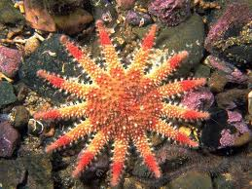
IV. The Echinoderm Classes
A. Echinoderms are NOT found:
1. Fresh water 2. Land
Starfish
1. Also known as: Sea stars
2. Physical Description: Occur in many
color and many species have more than
five arms

Slide 16
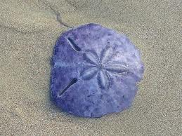
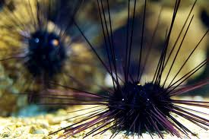
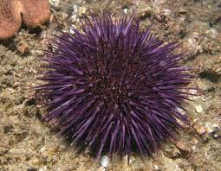
D. Sea Urchins and Sand Dollars
1.Physical description:
a) Sand dollars are disk-shaped;
Sea urchins are oval/round-shaped

Slide 17
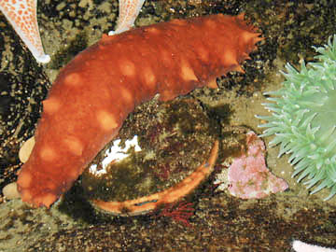
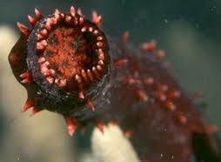
E. Sea Cucumbers
1. Physical description: Warty moving
pickles with a mouth and an anus

Slide 18
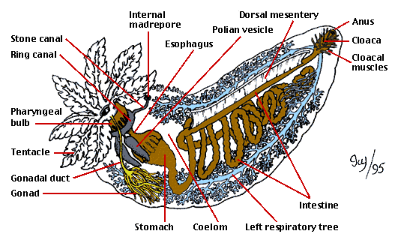

Slide 19
V. How Echinoderms Fit into the World
A. Ecological roles:
1. Starfish are important carnivores that control population of other animals
2. Sea urchins control algae, but can “overeat” and destroy habitats
Army of Sea Urchins
Otters Urchins and Kelp! Oh My!

Slide 20
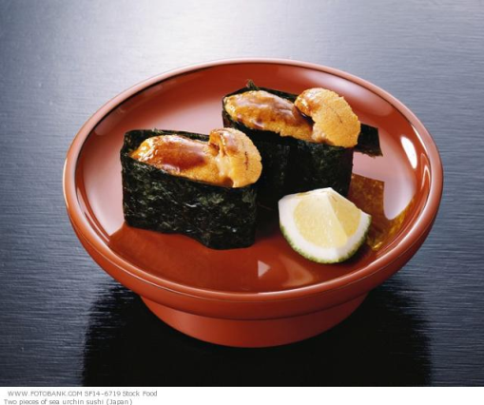
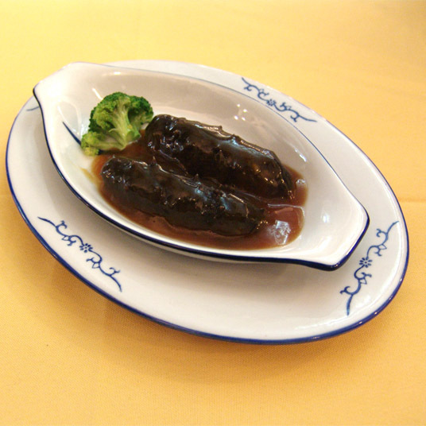
B. Use by humans:
As food: sea urchins,
sea cucumbers
2. Sources of chemicals used as potential drugs against cancer and viruses
Sea urchins used to study embryological
development because: they produce large
eggs that are fertilized externally and develop in plain sea water

