Slide 2
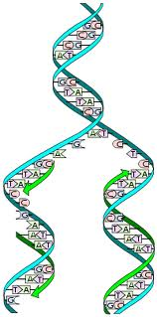
DNA
REPLICATION
Chapter 26 and 28

Slide 3
DNA Replication
  DNA making identical copies of itself
  Inherent in DNA’s structure is a mechanism for reproducing itself. Before a cell can divide, all of the DNA must be duplicated.
  This duplication process is called replication.

Slide 4
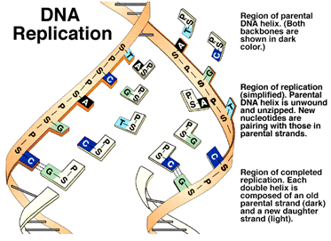

Slide 5
each strand of DNA can be viewed as a template:
like a potter's mold, it can produce a "reverse image" copy of itself (a complementary copy).
Each new strand of DNA produced has a sequence of bases exactly complementary to the template strand

Slide 6
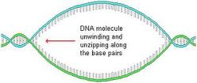
Sequence of Events in Replication:
1. UNZIPPING: the DNA double helix unwinds, and the two strands of DNA separate; hydrogen bonds between the bases break

Slide 7
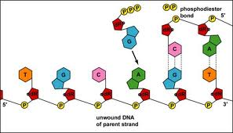
COMPLEMENTARY BASE PAIRING:
  new nucleotides move in to pair up with bases of each template strand of DNA. These new nucleotides are always floating around within the nucleoplasm.

Slide 8
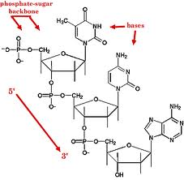
3. ADJACENT NUCLEOTIDES BOND:
sugar-phosphate bonds form between adjacent nucleotides of the new strand to complete the molecule. The new molecule winds into a double helix.

Slide 9
• each new strand of DNA produced contains one "old" strand (the template) and one new strand. This is known as "SEMI-CONSERVATIVE" replication. Since half of the original molecule is conserved in each of the new molecules, this ensures that there will be very, very accurate replication of the parent molecule.
• this process proceeds by the action of several very specific enzymes (e.g. DNA Polymerases, gyrase, helicase)
• product of replication by on DNA molecule is two complete double-stranded DNA molecules, each with one new strand and one original stand that acted as a template for replication.

Slide 10
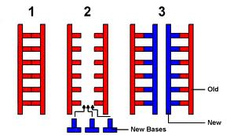

Slide 11


Slide 13
D3-D4: Recombinant DNA
I. Recombinant DNA
Use of various techniques and enzymes to recombine DNA from different organisms
Genes from one species can be cut out and inserted into the DNA of an entirely different species
C. The new gene can then be expressed by the
recipient species

Slide 14
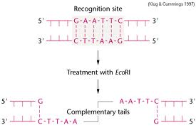
Recombinant DNA technology involves the use of special enzymes as tools:
  Restriction enzymes cleave DNA at specific sites
  2. Other enzymes such as DNA polymerase, Ligase, Reverse transcriptase

Slide 15
Uses for Recombinant DNA
There are many possibilities for uses of recombinant DNA:
  1. Protein production
  It is possible to isolate a gene from one organism (e.g. Human insulin), and using recombinant DNA techniques, insert that gene into a different organism (e.g. E. coli)
  b. The new organism can then produce that protein
  c. By culturing large quantities of the bacteria it is possible to collect large amounts of Human insulin inexpensively
  d. Many other useful human proteins are being produced in this manner (interferon, Growth Hormone, interleukins etc.)

Slide 16
2. Gene therapy
  It is possible to correct genes in individuals that have non-functional (mutated) genes
  Example: the corrected gene for the protein that, when mutant, causes Cystic Fibrosis has been inserted into a virus that infects human lung cells (the virulent parts of the virus genes have been deactivated)
  The virus then injects the corrected cystic fibrosis gene into the cells of the cystic fibrosis patient, and their symptoms are greatly reduced!

Slide 17
Transgenic organisms
(have a foreign gene inserted into them)
The Glofish – GFP inserted into a zebrafish. Originally constructed to detect pollution levels
But now commercially available for aquariums

Slide 18
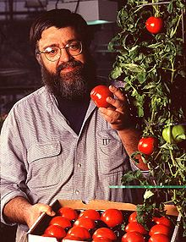
a. Selected genes can be inserted into a plant to give it features that were not possible through breeding
The Flavrsavr tomato!
The first transgenic crop to be approved in US
The tomato was made more resistant torotting by adding an antisense gene which interferes with the production of the enzyme polygalacturonase. The enzyme normally degrades pectin in the cell walls and results in the softening of fruit which makes them more susceptible to being damaged by fungal infections. The modified tomatoes are picked before fully ripened and are then artificially ripened using ethylene gas which acts as a plant hormone.

Slide 19
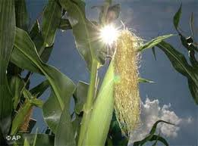
Monsanto became very constructed
A very controversial GM corn and other
Products that are resistant to
Round-Up.
Round Up is a herbicide, so farmers could
Spray their fields with Round Up, kill off
Alll the weeds and the corn would survive

Slide 20
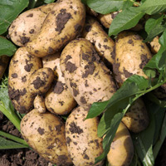
b. Example: a bacterial insect toxin (Bacillus thuringiensis) gene can be inserted into a plant (eg. potato) so the plant is now toxic to insects, and fewer insecticides are needed in order to grow it!
NewLeaf^{tm} Potato is resistant to the
Colorado Potato Beetle

Slide 21
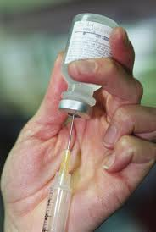
4. Safer Vaccines
4. Safer Vaccines
a. vaccines: historically made with treated
pathogens
b. some “treated” vaccines not attenuated
enough, and caused the disease!
c. can make vaccines out of only the surface
proteins from these pathogens (which is what human antibodies would normally bind to, anyway) to train immune system to ‘recognise’ and attack these pathogens without risking exposure to the actual pathogen
(Many more examples: Mader Chapter 24)

Slide 22
III. Techniques of Genetic Engineering
A "vector" is something that can get the DNA from one species into the other species' DNA.
Often, this can be a "plasmid", a circular piece of DNA found in some bacteria.

Slide 23
3. A human gene, such as the gene for insulin, is inserted into the plasmid and then the plasmid is taken up by bacteria. The bacteria reproduces the plasmid along with its own DNA when it reproduces, and translates the human gene, producing human protein.
4. This technique can be used to produce cloned DNA by allowing the bacteria to multiply themselves.

Slide 24
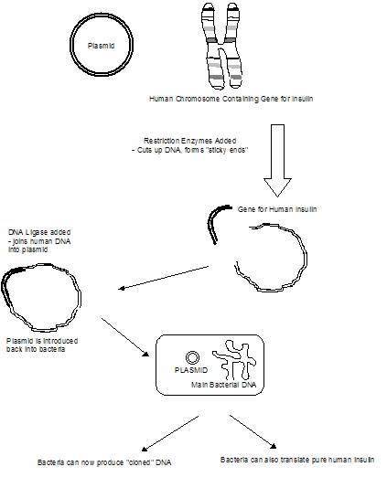

Slide 26
B. Polymerase Chain Reaction (PCR)
PCR can also make large amounts of a desired gene or piece of DNA.
2. PCR can be done without bacteria, inside test tubes, and can amplify billions of times samples with very little DNA (e.g. a single hair from a crime scene, or inside some fossils).

Slide 27
3. PCR makes huge amounts of any gene, quickly by:
  a. Heat the DNA to about 93ºC, which unwinds the DNA and separates the two strands.
  b. Add some replication primers, and allow to cool
  c. Add heat resistant DNA polymerase (Taq polymerase) (the replication enzyme) and free nucleotides. The DNA will copy itself.
  d. Heat and repeat. The DNA will go on doubling itself each “generation”.

Slide 28
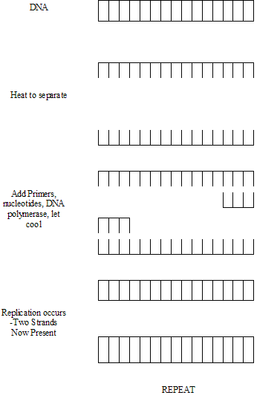

Slide 29
4. After PCR has been performed, a variety of thing can be done:
  Sequence of bases on DNA can be determined (e.g. using the “Sanger Method”) and is useful for:
      I Study evolutionary relationships between organisms (e.g. humans and chimpanzees), and trace the origin of human races.
      ii. Map every single nucleotide on all human chromosomes (“the Human Genome Project”)

Slide 30
Other uses for PCR include: paternity tests, crime fighting etc…

Slide 32
b. DNA can be analyzed using a DNA probe
  i. DNA probe is a specially synthesized single strand of radioactive DNA nucleotides that will bind to a complementary DNA strand on the DNA being tested.
  ii. This can be used to detect viral infections, diagnose genetic disorders, and diagnose some cancers.

Slide 33
c. Comparing DNA from two different organisms by using RFLP analysis. (Restriction Fragment Length Polymorphisms)
  This can provide a “DNA fingerprint” that is unique to each individual (except identical twins).
  RFLP analysis uses specific restriction enzymes that cut DNA at specific sequences.
  This produces fragments that, when separated using gel electrophoresis, produce patterns of bands that can be compared to another person’s pattern of bands

Slide 34
This produces fragments that, when separated using gel electrophoresis, produce patterns of bands that can be compared to another person’s pattern of bands.
If the band pattern is identical, the DNA must have come from the same person.
v. This can be used to identify a criminal from a blood or semen stain. It can also determine who the father of a child is, with a high degree of accuracy.

Slide 35
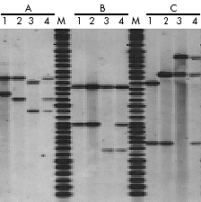
Paternity testing by RFLP
Analysis
Three paternity cases tested with DNA from blood samples.
Mother
Child
Alleged father
Child + Alleged father
M. DNA markers
Outcome A – alleged father excluded
Outcome B – alleged father excluded
Outcome C – Alleged father confirmed

Slide 36
  RFLP analysis is also used to see whether a person carries a gene for a genetic disorder like cysticfibrosis or sickle-cell anemia, and can be used for prenatal diagnosis.
  vii. RFLP analysis also contributes to our knowledge of evolution and evolutionary relationships by comparing human and animal DNA.

Slide 37
RNA: RIBONUCLEIC ACID:
how DNA communicates its message.
RNA is the genetic material of some viruses and is necessary in all organisms for protein synthesis to occur. RNA could have been the “original” nucleic acid when life first arose on Earth some 3.8 billion years ago.
Like DNA, all RNA molecules have a similar chemical organization, consisting of nucleotides.

Slide 38
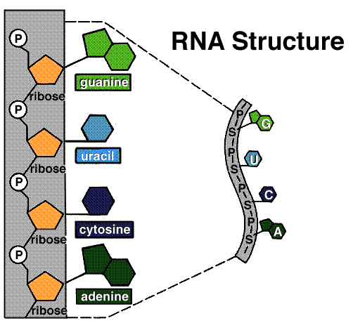
Like DNA, each RNA nucleotide is also composed of three subunits:
  a 5-carbon sugar called ribose.
  a phosphate group that is attached to one end of the sugar molecule
  3. one of several different nitrogenous bases linked to the opposite end of the ribose.

Slide 39
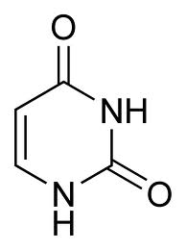
There is one base that is different from DNA -- the base Uracil is used instead of thymine.(G, A, C, are otherwise the same as for DNA)
RNA is SINGLE-STRANDED, unlike DNA which is double stranded. RNA, therefore, is not a double helix.
Uracil

Slide 40
• RNA is produced from DNA by a process called TRANSCRIPTION. The steps of transcription are as follows:
  1. A specific section of DNA unwinds, exposing a set of bases
  2. Along one strand of DNA (called the "sense" strand), complementary RNA bases are brought in. In RNA, Uracil binds to the Adenine on DNA. As in DNA, cytosine binds to guanine. The other strand of the DNA molecule (the “missense” strand), isn’t read in eukaryotic cells.
  3. Adjacent RNA nucleotides form sugar-phosphate bonds.
  4. The RNA strand is released from DNA (RNA is a single-stranded nucleic acid).
  5. The DNA molecule rewinds, and returns to its normal double helix form.

Slide 41
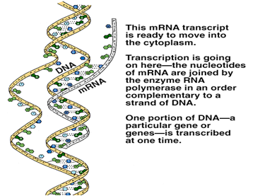

Slide 42
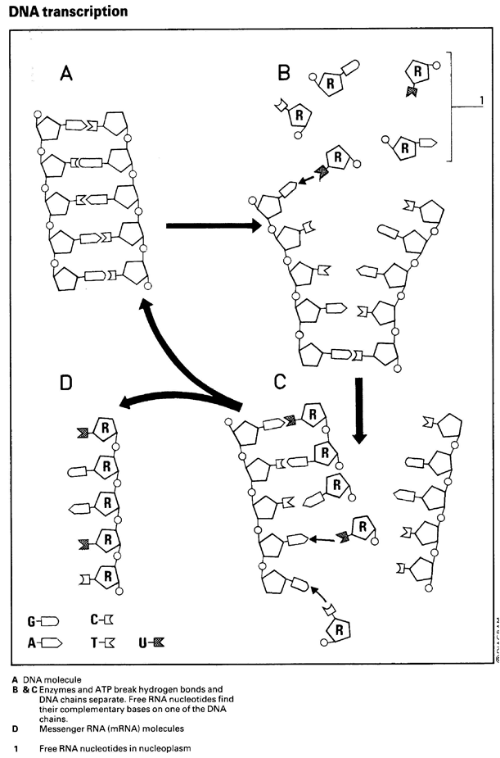

Slide 43
Once produced, the mRNA strand is often processed (certain sections called introns are cut out, a "Poly-A" tail is added to the 3' end, and a "cap" is added to the 5' end).
RNA can then leave the nucleus and go into the cytoplasm.
The enzyme involved in transcription is known as RNA polymerase.
  This process occurs in the nucleus (and, in particular, dark coloured spots in the nucleus called nucleoli (singular = nucleolus)

Slide 44
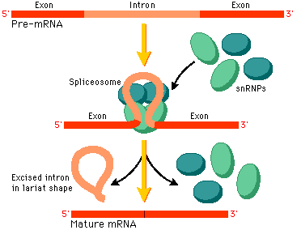

Slide 46
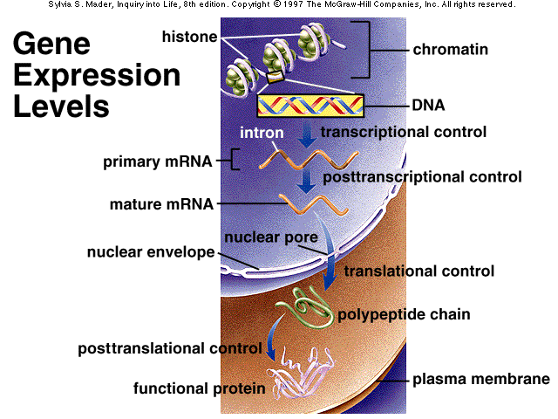

Slide 47
Please transcribe the following DNA strand
G | A | C | A | A | C | T | G | G | A | T | C | G | A | C | DNA
III | II | III | II | II | III | II | III | III | II | II | III | III | II | III
 |  |  |  |  |  |  |  |  |  |  |  |  |  |  | mRNA

Slide 48
G | A | C | A | A | C | T | G | G | A | T | C | G | A | C | DNA
III | II | III | II | II | III | II | III | III | II | II | III | III | II | III
C | U | G | U | U | G | A | C | C | U | A | G | C | U | G | mRNA

Slide 49
There are 3 types of RNA, each with different functions.
rRNA
tRNA
mRNA
– The agents of Protein Synthesis
RNA that is involved in protein synthesis belongs to one of three distinct types:
ribosomal RNA (rRNA),
transfer RNA (tRNA),
messenger RNA (mRNA).

Slide 50
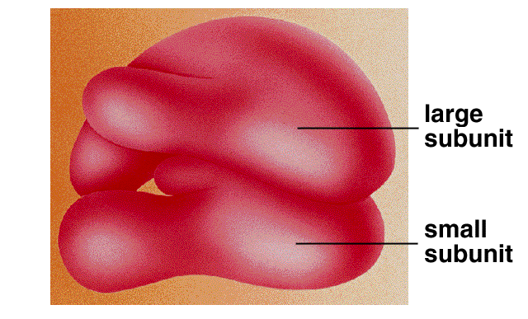
RIBOSOMAL RNA (rRNA)
becomes a structural part of ribosomes and serves as a genetic link between mRNA and tRNA. Ribosomal RNA is associated with protein, forming bodies called ribosomes.
Ribosomes are the sites of protein synthesis.
Notes:
. Ribosomal RNA provides a mechanism for decoding mRNA into amino acids and interacts with tRNAs during translation by providing peptidyl transferase activity. The tRNAs bring the necessary amino acids corresponding to the appropriate mRNA codon.

Slide 51
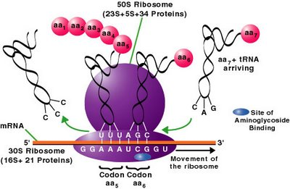
Ribosomal RNA varies in size and is the most plentiful RNA. It constitutes 85% to 90% of total cellular RNA.

Slide 52
Transfer RNA (tRNA) - is used to deliver amino acids from the cytoplasm to the ribosome.
There is a different tRNA for each amino acid. The function of each type of tRNA is to bring its specific amino acid to a ribosome.
The tRNA molecules consist of about 80 nucleotides and are structured in a cloverleaf pattern. They constitute about 5% of the cell's total RNA.

Slide 53
Messenger RNA (mRNA) - carries the genetic code contained in the sequence of bases in the cell's DNA from the nucleus to the Ribosome.
mRNA: acts as a "go-between" for DNA in the nucleus and the ribosomes in the cytoplasm.
mRNA constitutes 5% to 10% of the cell's RNA.

Slide 54
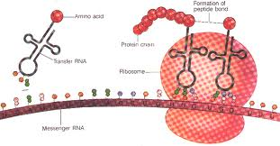

Slide 55
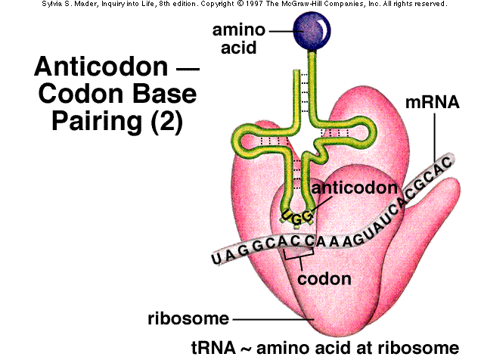

Slide 56
The Central Dogma of Molecular Biology
DNA → → mRNA → → Protein
transcription translation
mRNA, once produced, leaves the nucleus through pores in the nuclear envelope, and enters the cytoplasm. This is where TRANSLATION occurs.
Translation is the process that changes the RNA message into the actual protein. It occurs at the surface of the RIBOSOME.

Slide 57
