Slide 2
Human Physiology & Digestive System
Biology 12

Slide 3
I. Human Organization
A. Human body has several levels of organization:
1. Cells of the same type joined together are called TISSUES
2. Different Tissues are joined together to form ORGANS
3. Various organs are arranged into an ORGAN SYSTEM

Slide 4
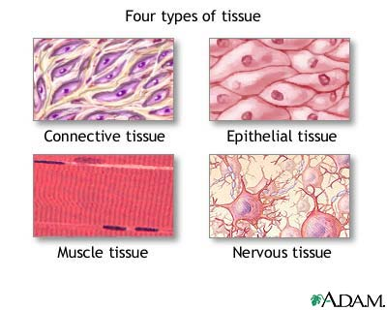
II. Tissues
Epithelial
1. Covers body, lines cavities
2. Covers entire body surface and most of the body's inner cavities.

Slide 5
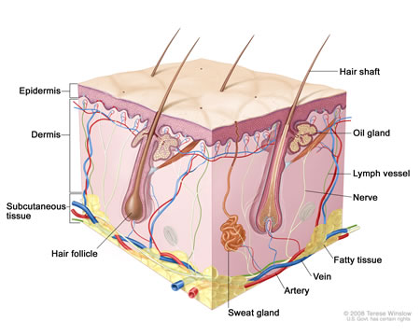
3. Outer epidermis (skin) protects from injury and drying out
4. Inner epidermal tissue protects and secretes mucus (e.g. along digestive tract)

Slide 6
5. Types:
a. Squamous Epithelium
i. Function in protection, diffusion, filtration
ii. Made of flat cells
iii. e.g. lines alveoli and walls of capillaries, blood vessels
b. Cuboid Epithelium
i. Function in secretion, absorption and protection
ii. Cube shaped cells
iii. e.g. line kidney tubules, surface of ovaries.

Slide 7
c. Columnar Epithelium:
i. Column-shaped cells
ii. Often have microvilli or cilia to aid function
iii. e.g. lining of intestine, oviduct lining, lining of uterus
iv. Each type can exist as a single layer or be stratified (layers stacked on top of each other).
v. e.g. mouth, nose, vagina lined by stratified squamous epithelium.

Slide 8
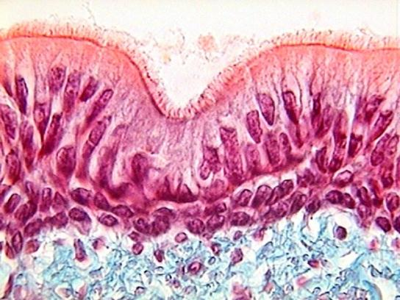
d. Pseudostratified Columnar:
i. Appear to be layered but is really just one layer of cells
ii. e.g. lining of respiratory tract.

Slide 9
B. Connective
1. Functions:
a. Bind structures together
b. Fill up spaces
c. Provide support and protection
d. Stores fat
2. Structure:
a. Cells in connective tissue usually in matrix usually made up of either collagen or elastin

Slide 10
3. Types:
a. Loose
i. Join tissues, hold organs in place, fat storage
b. Fibrous
i. Bundles of collagen fibers, very strong
ii. Used in tendons (connect muscle to bone) and ligaments (connect bones to other joints

Slide 11
c. Cartilage
i. Flexible matrix rich in protein and fibers
ii. e.g. nose, ears, vertebrae, ends of bones
d. Bone
i. Rigid connective tissue
ii. Matrix of calcium salts

Slide 12
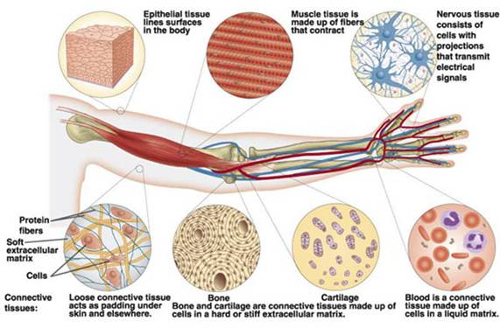
e. Blood
i. Matrix is liquid called plasma

Slide 13
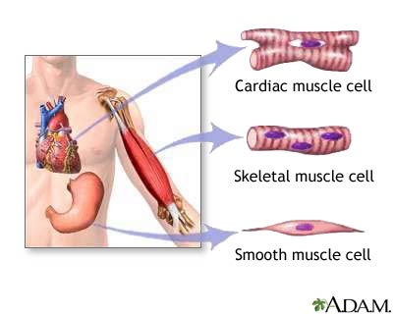
C. Muscle Tissue
1. Contracts for movement
2. Composed of fibers made of actin and myosin proteins whose interaction is responsible for movement.

Slide 14
3. Types
a. Skeletal muscle
i. Striated (alternating light and dark bands)
ii. Attached to bones and used for movement
iii. Voluntary control
iv. Can contract quickly and strongly but will fatigue in time

Slide 15
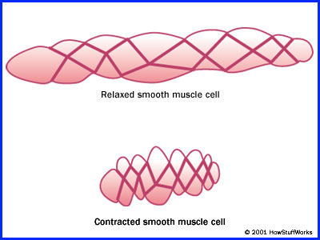
b. Smooth muscle
i. Non-striated
ii. Involuntary control
iii. Found in walls of internal organs (intestine, stomach, blood vessels)
iv. Contracts more slowly, but can contract over a longer period of time.

Slide 16
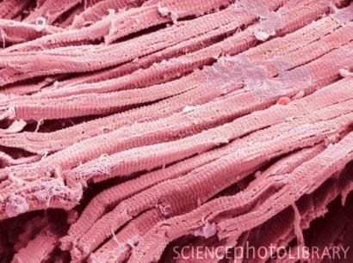
c. Cardiac muscle
i. Striated
ii. Involuntary
iii. Forms heart muscle
iv. Found only in the heart
v. Can contract quickly, and beats your whole life through

Slide 17
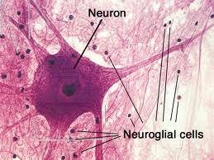
D. Nervous Tissue
1. Responds to stimuli and transmits impulses from one body part to another

Slide 18
2. Conduct electrical and chemical messages along special cells called neurons
a. Composed of:
i. Cell body
ii. Dendrites: conduct messages to cell body
iii. Axon: send messages away from cell body
iv. Axons and dendrites are nerve fibers
b. Bundles of nerve fibers are called nerves.

Slide 19
3. Nerves conduct messages to and from spinal cord, brain, and sense organs to register sensation and trigger muscle movement
4. Glial cells surround nerve cells
a. Help to support, protect, and nourish nerve cells
b. Provide nutrients to the neurons and help keep the tissue free of debris

Slide 20
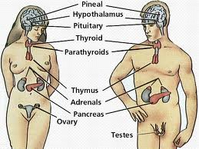
E. Glands
1. A single cell, or a collection of cells that secrete something

Slide 21
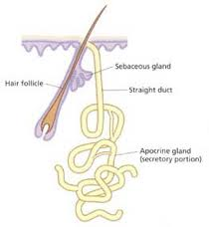
2. Types
a. Exocrine glands
i. Secrete into ducts
ii. e.g. gall bladder is an exocrine gland because it secretes bile in a duct
iii. e.g. sweat glands are exocrine glands

Slide 22
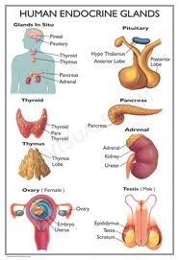
b. Endocrine glands
i. Secrete chemicals (especially hormones) into bloodstream
ii. e.g. pancreas secretes insulin into the blood

Slide 23
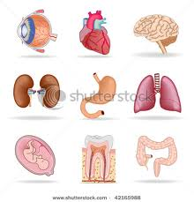
III.Organs
A. Tissues working together
B. Organs are made up of one or more types of tissues (usually more)
C. Each located in specific location, with specific functions

Slide 24
D. Human Organ Systems Overview:
Digestive | convert food to usable nutrients
Circulatory | transport of necessary molecules to cells
Immune | defense against invading pathogens
Respiratory | gas exchange
Excretory | gets rid of metabolic wastes
Nervous & Sensory | regulation and control, response to stimuli, processing information
Muscular & Skeletal | support and movement
Hormonal | regulation of internal environment, development
Reproductive | producing offspring

Slide 25
E. Many internal organ systems enclosed within coelom, a cavity within the body
F. Organ systems contribute to maintaining a stable internal environment (homeostasis)
G. e.g. Temperature, pH, [glucose], blood pressure

Slide 26
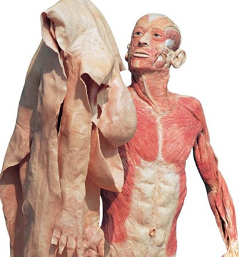
IV. Skin
A. An example of an organ VIDEO

