Slide 1
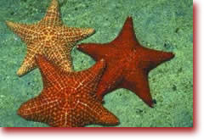
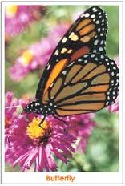
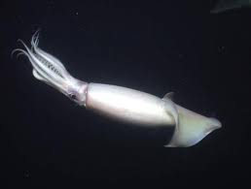
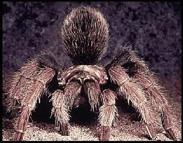
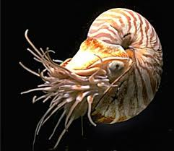
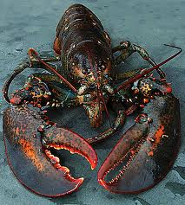
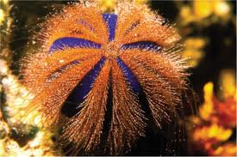
Complex Invertebrates: Chapters 27, 28 and 29

Slide 2
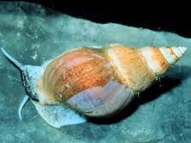
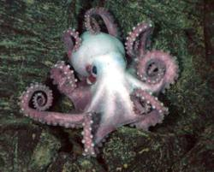
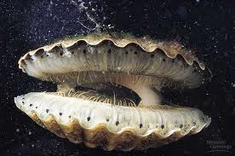
27-1 Mollusks
I. What is a Mollusk?
A. Phylum Mollusca Origin: from Latin Molluscus = soft
B. Contains animals that look and act very differently from each other
C. Mollusks: Soft-bodied animal that have an internal or external shell

Slide 3
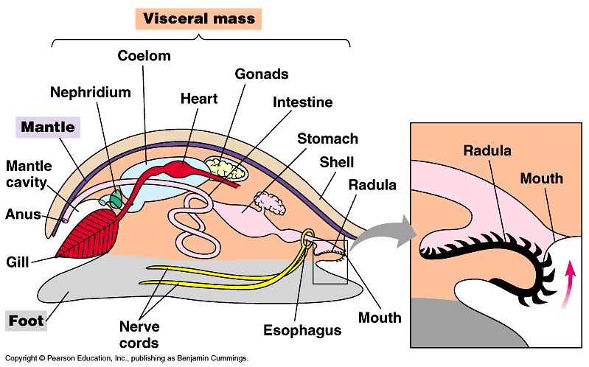
II. Form and Function in Mollusks
A. Body plan have 4 basic parts:
1. Foot
2. Mantle
3. Shell
4. Visceral Mass

Slide 4
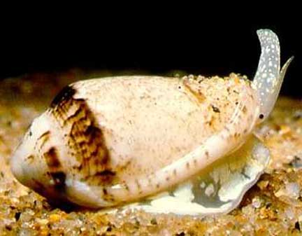
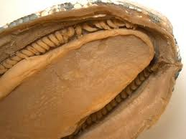
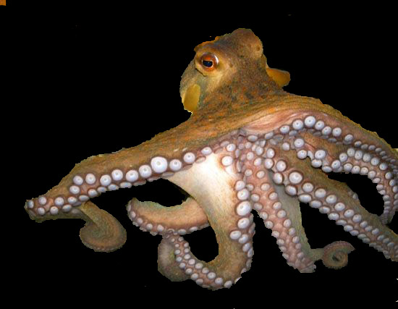
B. Foot
1. Usually contains the mouth and other structures associated with feeding
2. Many different shapes:
a) Flat -- for crawling
b) Spade-shaped -- for burrowing
c)Tentacles -- for capturing prey

Slide 5
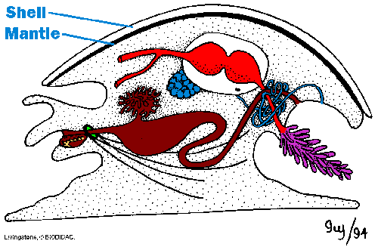
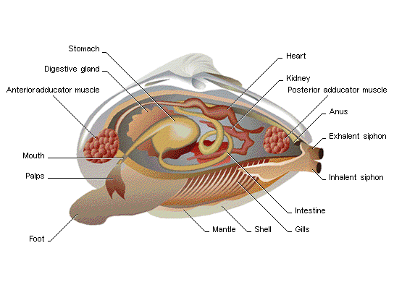
C. Mantle: Thin, delicate tissue layer that covers most of a mollusk’s body
D. Visceral Mass contains: Internal organs

Slide 6
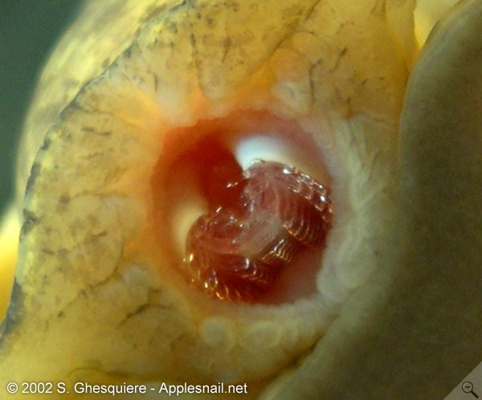
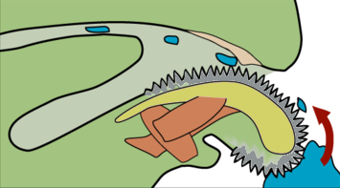
E. Radula:
1. A tongue-shaped structure used in feeding
2. A layer of flexible skin covered with tiny
teeth
3. Acts like sandpaper to scrape/tear off food

Slide 7
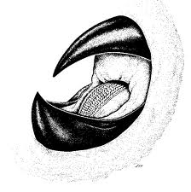
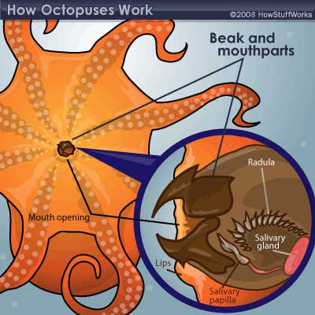
F. Carnivores have a radula or sharp jaws; some produce poisons to subdue prey

Slide 8
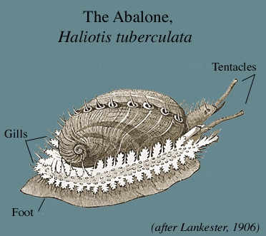
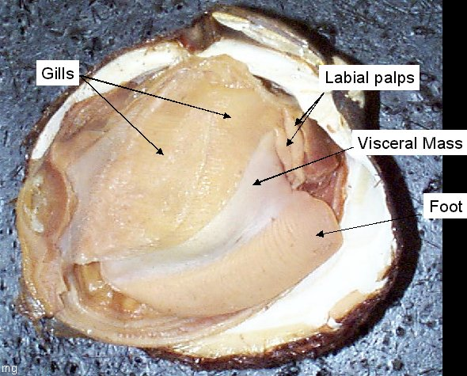
G. Filter feeders use gills to sift food from water.
Mucus and cilia on gills trap plankton and
move it to mouth

Slide 9
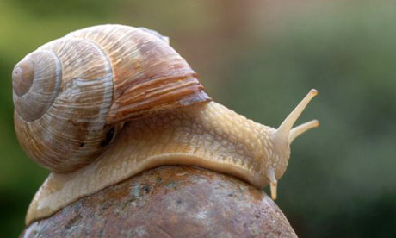
H. Respiration
Aquatic species: use gills inside the mantle
2. Land species: mantle cavity is lined with
blood vessels, folded and kept moist so O₂ can enter cells

Slide 10
Transport
1. Slow-moving species: Open circulatory system
The blood is pumped by a simple heart
Blood works its way through body tissues in open spaces called sinuses
c) Sinuses drain into vessels that pass first through the gills for O₂/ CO₂ exchange, then back to the heart
2. Fast-moving species: Closed system (more efficient)

Slide 11
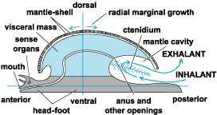
J. Excretion
1. Undigested food leaves through the anus as feces
2. Ammonia is removed from the body fluids by tube-shaped organs called nephridia

Slide 12
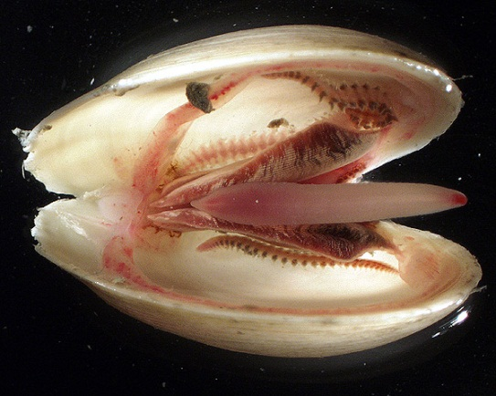
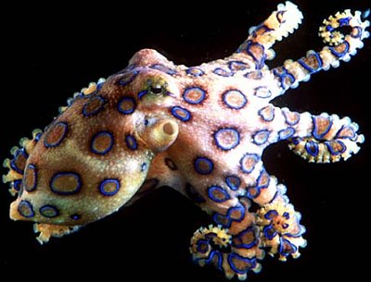
K. Response
1. Simple nervous systems
a) In mollusks that live inactive lives e.g. clams
i) Several small ganglia near the mouth
ii) A few nerve cords
iii) Simple sense organs: chemical and touch receptors, statocysts (balance) & ocelli (eyespots)
2. Complex nervous systems
a) In active predators. e.g. Octopus
i) Well-developed brain = memory &intelligence
ii) Complex sense organs e.g. image- forming eyes

Slide 13
L. Reproduction
1. Most commonly: separate sexes and external fertilization; eggs and sperm are released into the open water and find each other by chance. A free-swimming larvae develop from the resulting fertilized eggs
2. Tentacled mollusks: separate sexes and internal fertilization
Many snails: hermaphrodites internal fertilization
Slug Sex

Slide 14
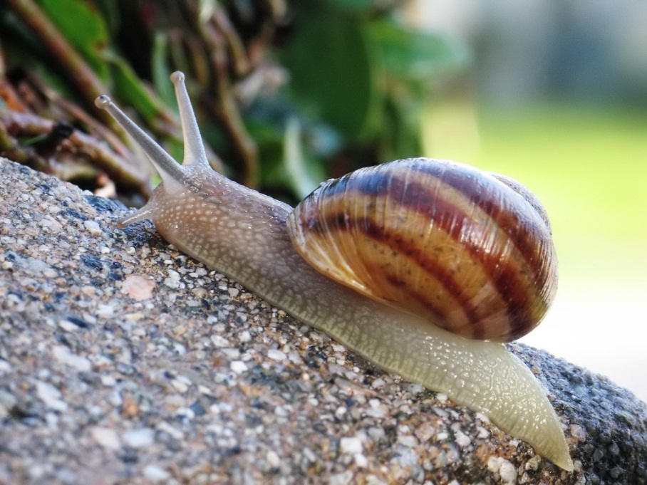
III. Snail, Slugs, and Their Relatives
A. Class Gastropoda; origin of name: Stomach
Foot
B. All move by means of a broad, muscular foot located on the ventral (stomach) side
C. Have a one-piece shell that protects their soft bodies

Slide 15
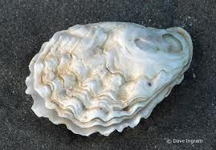
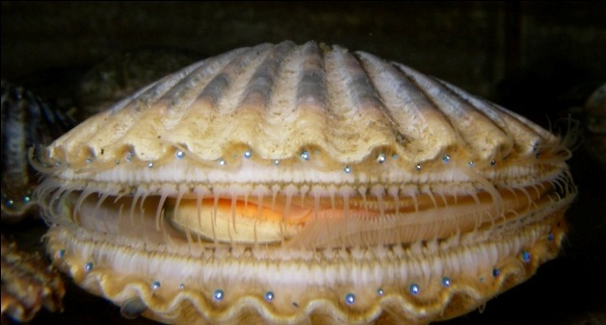
IV. Two-Shelled Mollusks
A. Class Bivalvia; Origin of name: bi = two;
valve = shell
B. Have two shells that are hinged together at the back and held together by one or two powerful muscles
C. Examples of bivalves: clams, oysters, scallops

Slide 16
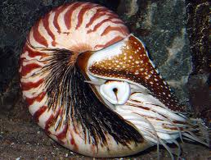
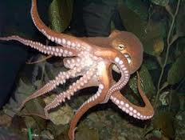
V. Tentacled Mollusks
Class Cephalopoda;
Origin of name : cephalo = head; pod = foot
B. Examples of cephalopods: cuttlefish, squids, octopi, nautiluses
C. Size: < 2 cm to 20 m(!)

Slide 17
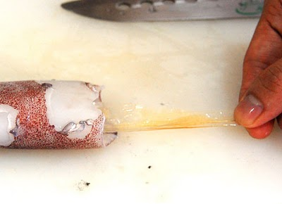
D. Most cephalopods have small internal shell (squid, cuttlefish) or none (octopus)

Slide 18
E. Defences:
1. Move rapidly by using a form of jet propulsion forcing water out of the mantle
cavity through the tubelike siphon
2. Release dark-colored, foul-tasting ink
Change colour to blend into surroundings
A squid video
An Octopus video

Slide 19
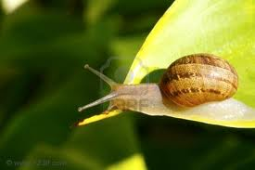
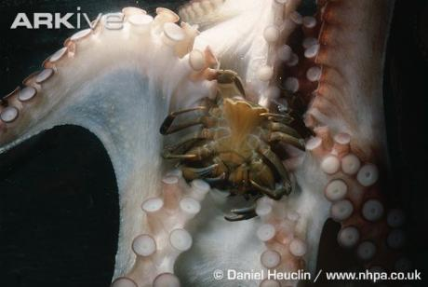
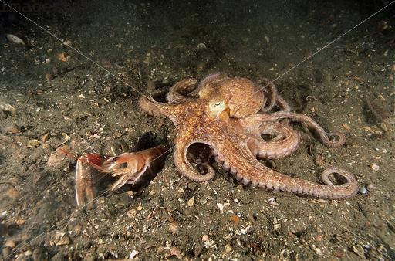
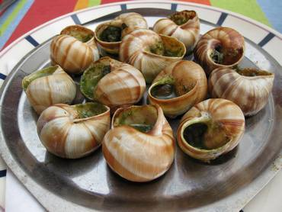
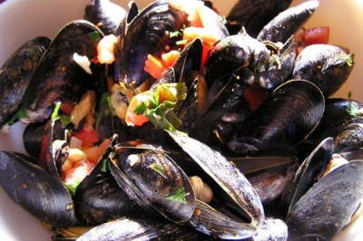
VI. How Mollusks Fit into the World
VI. How Mollusks Fit into the World
A. Many ecological roles:
1. Herbivores
2. Carnivores
3. Scavengers: eat detritus (clean up dead material)
B. Food source for humans and other animals

Slide 20
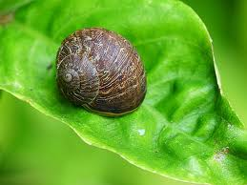
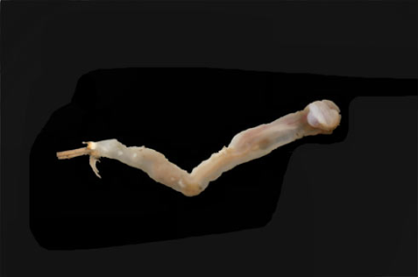
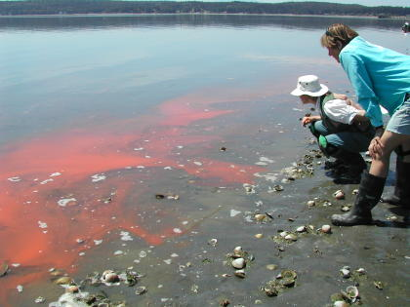
C. 3 examples of mollusks and how they are detrimental:
Damage gardens and crops
Shipworms: destroy wooden
boats and docks
3 Clams and oysters can concentrate toxins in the water (e.g. red tide) that can harm or kill those who unknowingly harvest them

