Slide 1
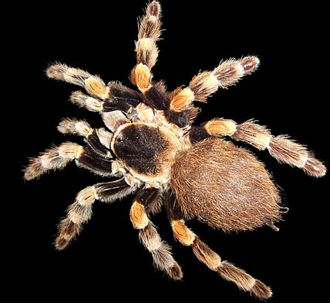
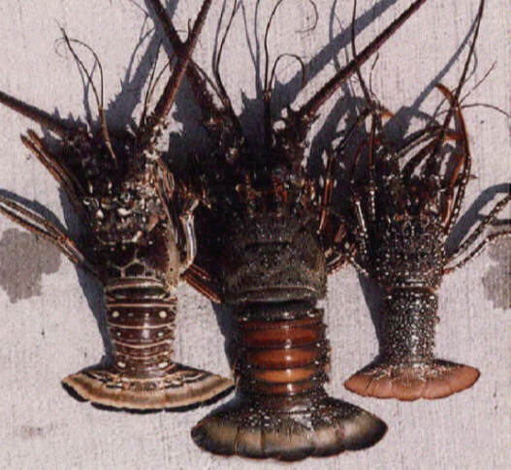
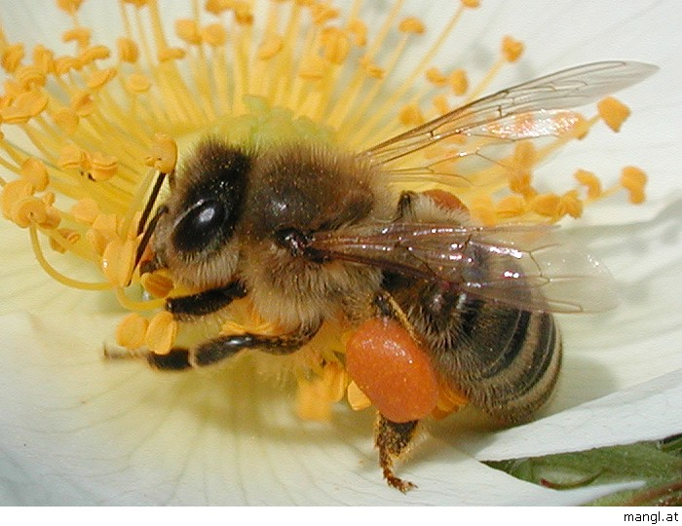
28-1 Introduction to Arthropods

Slide 2
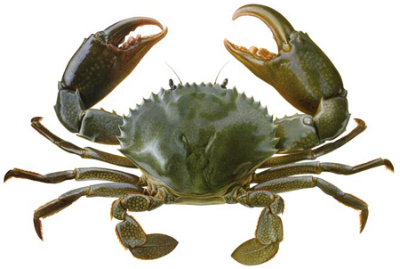
I. Form and Function in Arthropods
A. All arthropods have 3 key features:
1. Tough exoskeleton
2. Jointed appendages
3. Segmented body

Slide 3
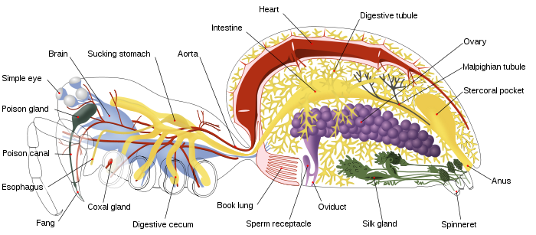
Many arthropods have 3 additional features:
1. Brain in the dorsal part of the head
2. Ventral nerve cord
3. Open circulatory system with a heart

Slide 4
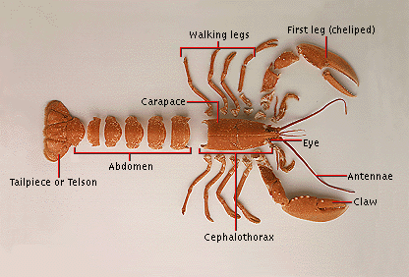
Arthropod body plan
1. Exoskeleton: A system of external supporting structures that are made of carbohydrate chitin
a) Function:
i) Protection
ii) Waterproof (prevents water loss)
iii) Move efficiently
b) Disadvantage: Skeleton cannot grow
as the animal grows

Slide 5
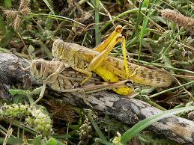
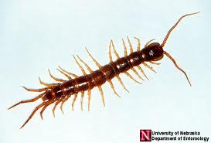
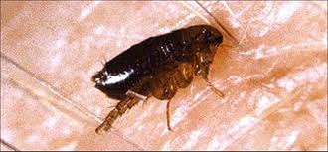
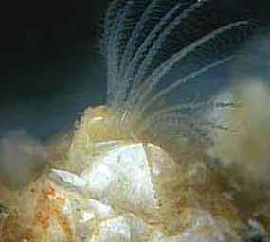
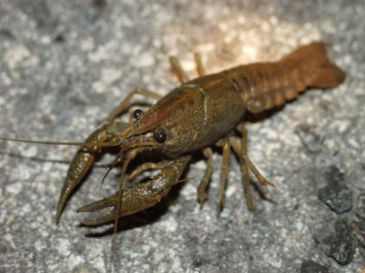
D. Feeding
List and give an example of each type of feeding method
Herbivores – locusts
Carnivores - spiders, centipedes
Parasites - ticks, fleas, lice
d) Filter feeders - marine arthropods
(barnacles)
e) Detritus feeders - crayfish

Slide 6
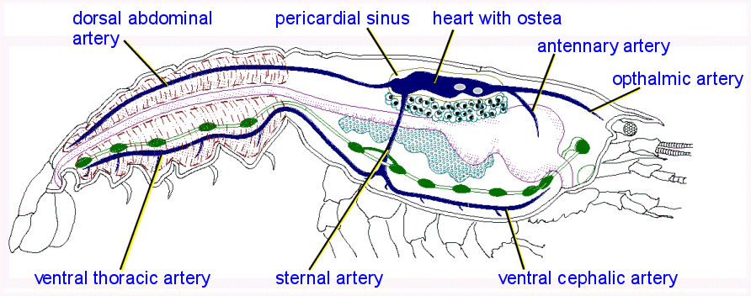
E. Respiration
1. 3 basic types of respiratory structures:
a) Gills
b) Book gills and book lungs
c) Tracheal tubes
F. Internal Transport
Have a well-developed heart pumping blood through an open circulatory system
Blood moves out of vessels through spaces called sinuses

Slide 7
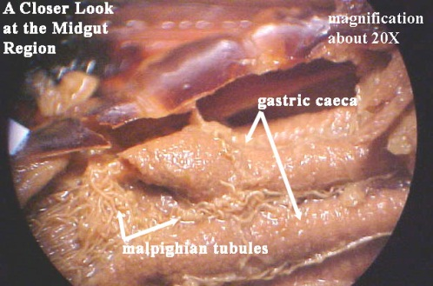
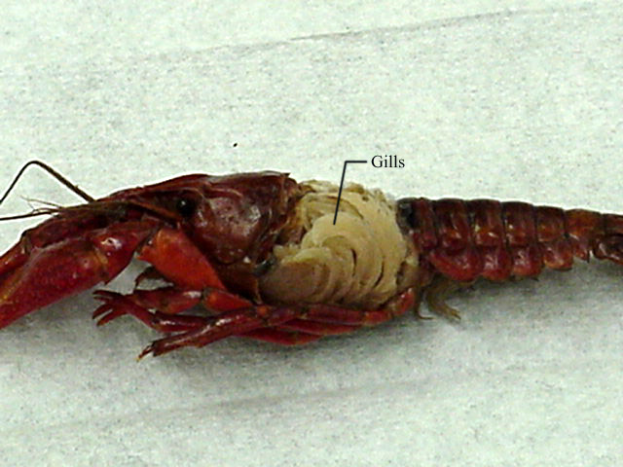
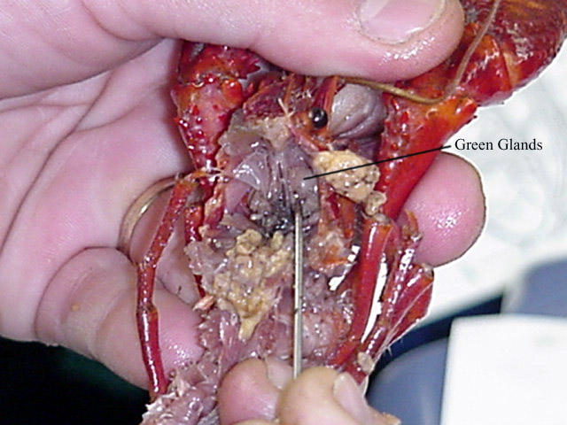
G. Excretion
1. Solid waste: Leaves through the anus
2. Metabolic waste eliminated by:
a)Malphighian tubules
- filter nitrogen based waste from blood
b)Diffusion through the gills
c) Green glands
- filter blood at base of
antennae

Slide 8
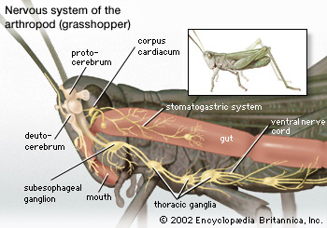
H. Response
1. Nervous system composed of:
a) Brain (with 2 ganglia in the head)
b) A pair of nerves that runs around the
esophagus and connects the brain to a ventral nerve cord

Slide 9
2. Have sense organs such as:
a) Statocysts
b) Chemical receptors
c) Compound eyes
d) Taste receptors
e) Sensory hairs
f) Ears

Slide 10
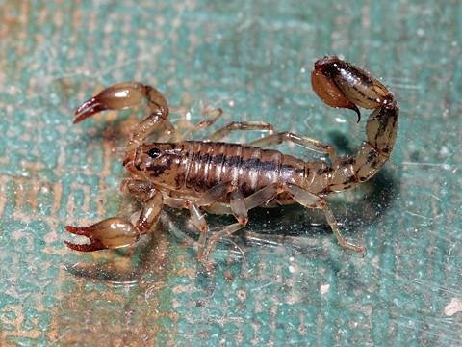
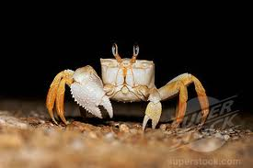
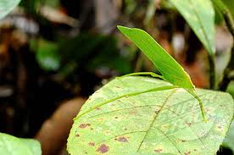
3. Defense against predators:
Venomous stings
and bites
Attack with powerful
claws, chemicals
Create a diversion
(ex. Drop a body part)
d) Visual trickery (ex. camouflage)

Slide 11
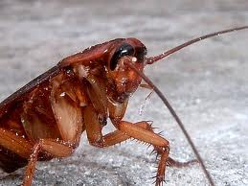
I. Reproduction
1. Fertilization is internal
2. Males transfer sperm directly or drop a
packet of sperm that is picked up by the
female
Cockroaches

Slide 12
II. Growth and Development in Arthropods
A. What is a problem with exoskeletons?
They must be replaced with larger ones in order to allow the body inside to increase in size as it matures
B. Describe the steps that occur during molting:
1. The epidermis digests the inner part of the exoskeleton, absorbing the chitin to recycle it
2. Secretes a new exoskeleton inside the old one
3. Arthropod pulls completely out of its old exoskeleton (may eat what’s left – more recycling)
4. The animal then expands to its new, larger size, and the new exoskeleton stretches to cover it
5. Wait for the new exoskeleton to harden; during these few hours to a few days, the new shell is soft and the animal is quite vulnerable
Giant Spider Crab Molt

Slide 13
C. What is the difference between complete metamorphosis and incomplete metamorphosis?
Complete Metamorphosis involves VERY different physical appearances at the different stages of growth (usually: egg, larva, pupa, adult).
Butterfly LifeCycle
Incomplete Metamorphosis is involves stages with a physical appearance that more closely resembles one another (usually: egg, nymph, adult).
Preying Mantis Lifecycle

Slide 14
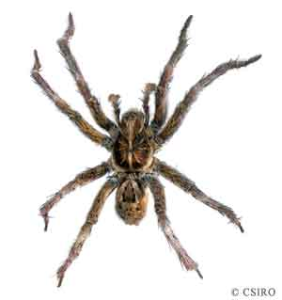
28-2 Spiders and Their Relatives
I. Spiders and Their Relatives
A. Subphylum Chelicerata has 3 main characteristics
1. Two-part body
2. Mouthparts called chelicerae
3. Lack sensory “feelers” (antennae) on the head

Slide 15
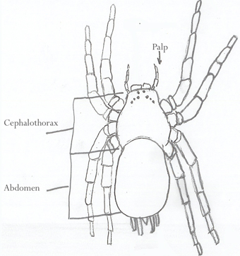
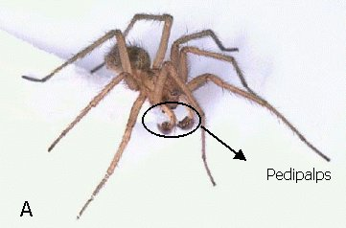
II. Arachnids
A. Characteristics:
1. Four pairs of walking legs on their cephalothorax
2. Carnivores that have pedipalps adapted for capturing and holding prey and chelicerae adapted for biting and sucking out their soft parts

Slide 16
B. Some examples of Arachnids:
1. Spiders
2. Mites and ticks
3. Scorpions

