Slide 1
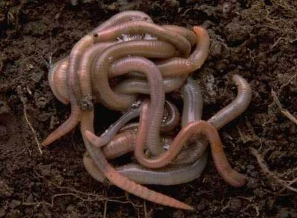
27-2 Phylum Annelida

Slide 2
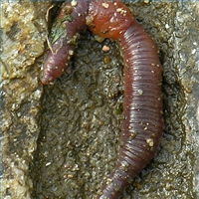
I. What is an Annelid?
A. Phylum: Annelida from Latin annellus = little rings
B. Description: Round, wormlike animal that has a long, segmented body
C. Size: <1/2 mm to >3 m

Slide 3
The Coelom
Let’s start at the beginning….
As animals become more complex the develop different tissue layers.
Sponges are multicellular but don’t really have a tissue layer
But as things get more complex: three tissue types develop:
Ectoderm: outer embryonic layer - skin and nervous tissue
Endoderm : lines digestive tract
Mesoderm: muscles, bones, circulatory system, organs

Slide 4
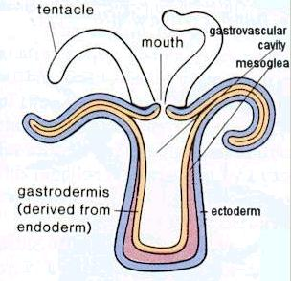
In Cnidarians you see aggregations of tissue into layers.
ectoderm and endoderm
separated by a noncellular mesoglea
( translucent, inert, jelly-like substance
that It acts as the creatures'
structural support)

Slide 5
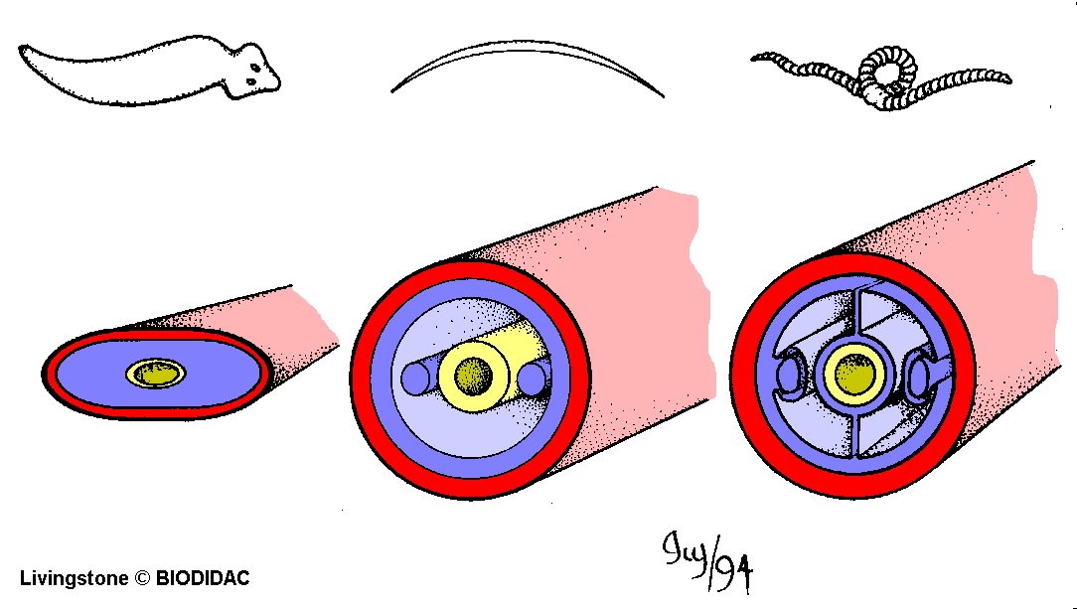
Body Cavities: Coeloms
So flatworms have:
three layers of tissue
no body cavity
body double-walled sac surrounding digestive cavity
single opening to outside

Slide 6
Roundworms:
body cavity between mesoderm and endoderm, but not a real coelom: a pseudocoelom

Slide 7
Annelids:
tube within a tube = body cavity
Advantages
body cavity allows more room for organs in fluid filled cavity with no pressure from muscles
cavity can serve as circulatory system
more efficient and longer digestive system
more room for gonads, gametes, etc.
can function as a hydrostatic skeleton.

Slide 8
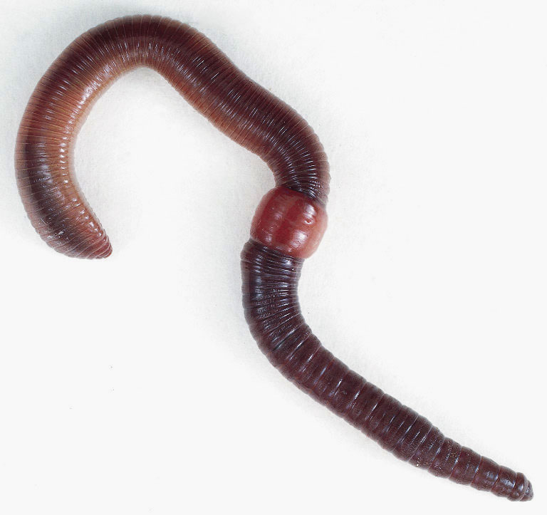
II. Form and Function in Annelids
A. Septum: Internal walls
1. Most of the body segments are identical to one another but some segments are modified to
perform special functions
For example the first few segments may carry one or more pairs of eyes, antennae, or other sense organs

Slide 9
Feeding
1. Describe how Annelids feed:
Food enters through the mouth and travels through the gut and digested
2. Pharynx: Muscular front end of the
digestive tube
a) Why is the pharynx different in different types of annelids?
To suit the different types of food they eat

Slide 10
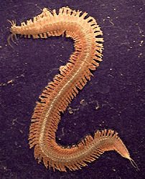
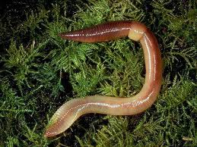
Respiration
1. Describe how different annelids breathe when they live in various habitats
a) Aquatic: Gills
b) Terrestrial: Through their skin
2.Why do worms have to live in moist areas?
Gas exchange occurs through the skin

Slide 11
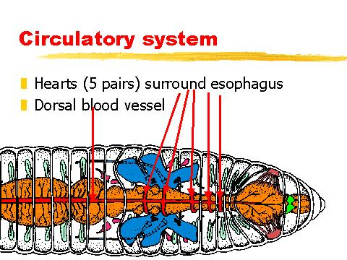
D. Internal Transport In Annelids
Closed circulatory system: System in which blood moves inside blood vessels.
In Earthworms there are longitudinal vessels running the entire length of the worm, one dorsal and several ventral. Connecting the dorsal and ventral vessels, and so completing the circuit are five pairs of hearts,

Slide 12
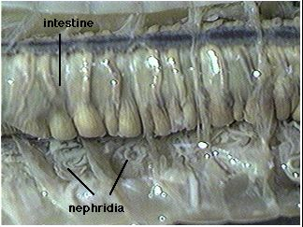
E. Excretion
1. Produces 2 kinds of wastes:
a) Solid wastes: Pass out through the
anus at the end of the gut
b) Cellular metabolic wastes: nephridia
2. Nephridia: Simple tube-shaped excretory organ used to remove ammonia from the blood and release it from the body

Slide 13
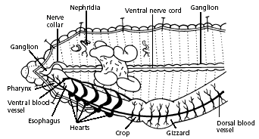
F. Response
Brain is on top of the gut at the front end of the body. Two large nerves pass around the gut and connect the brain with a pair of ganglia below. From these ganglia, a ventral nerve cord runs the entire length of the worm. Nerves from each segment of the worm enter and leave the nerve cord at a pair of small ganglia. These nerves help carry messages from sense organs and coordinate the movement of muscles.

Slide 14
2. Sense organs:
a) Best developed in the free-living
marine species (polychaetes)
palps, antennae, eyes, statocysts, nuchal organs and lateral organs
b) Earthworms have no specialized sense
organs
Defense from predators (earthworm):
a) Grab onto the wall of their burrow

Slide 15
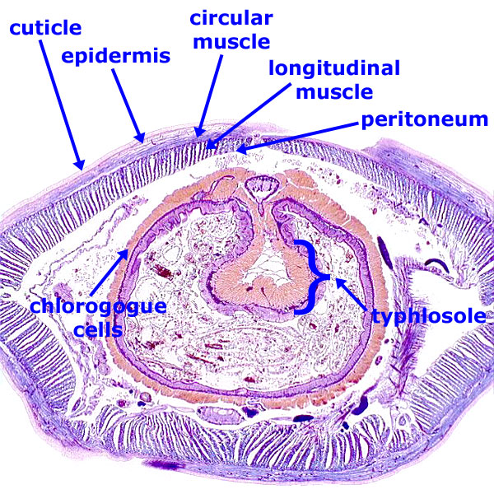
G. Movement
1. Two major groups of muscles in their body walls:
Longitudinal
Circular
Longitudinal muscles contract, they make the worm shorter
3. Circular muscles make the worm skinnier

Slide 16
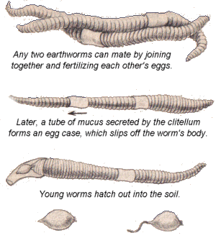
H. Reproduction
Most annelids reproduce sexually
Some species have separate sexes and external fertilization with females and males releasing gametes into the open water where fertilization occurs
Some species are hermaphrodites with internal fertilization
4. Clitellum: Secretes a mucus ring into which eggs and sperm are released

Slide 17
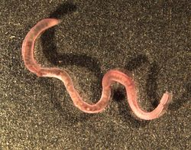
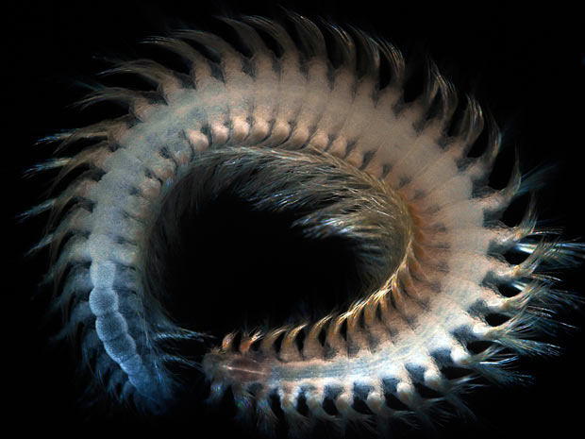
IV. Earthworms and Their Relatives
A. Class: Oligochaeta
B. Earthworm
1. Description: Long pink worms
2. Habitat: Soil
C. How are oligochaetes different than their
relatives, the marine polychaetes?
Have fewer bristles

Slide 18
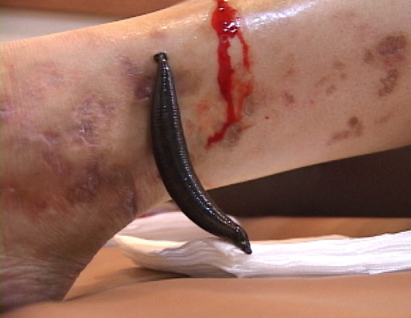
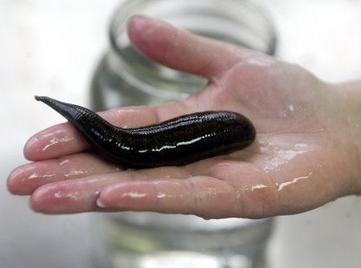
V. Leeches
A. Class: Hirudinea
B. Habitat: Freshwater, ocean, terrestrial
Describe how leeches feed:
Leeches penetrate the skin then use their muscular pharynx to suck blood from the area

Slide 19
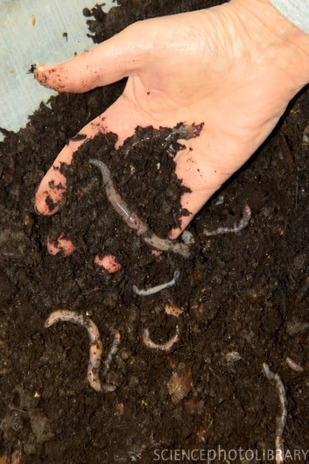
VI. How Annelids Fit into the World
2 examples of annelids and their role in the ecosystem:
1. Are food for other organisms
2. Condition the soil (aerate, speed up the return of nitrogen)

